Slide 1
Gamma-ray Bursts from Prompt to Afterglow What can we learn from the Fermi GRBs
2025 High-Energy 년 한국고에너지물리학회 및 핵-입자-천체분과 연합 워크샵
Donggeun Tak
Seoul National University

Slide 2


Slide 3
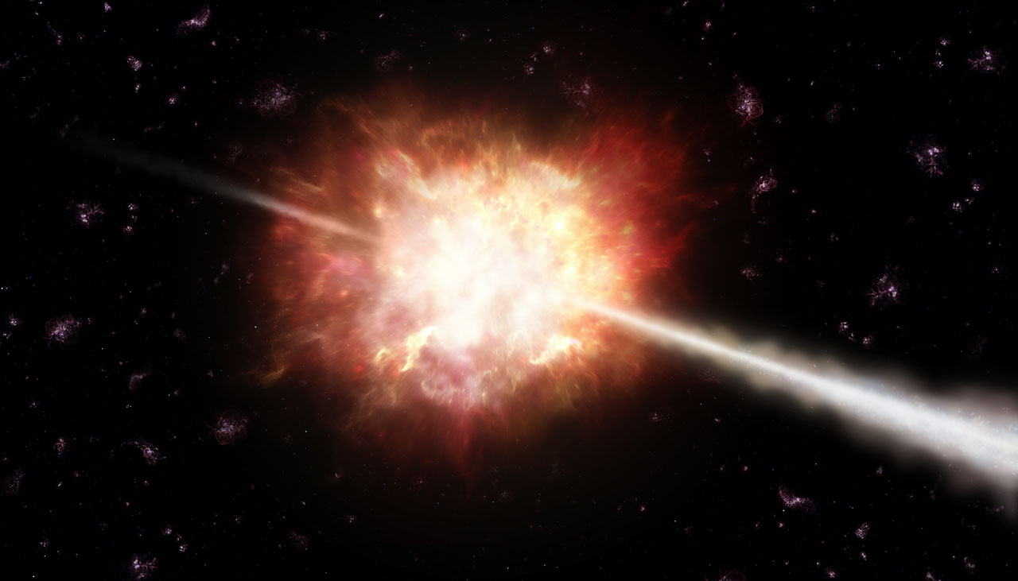


A Unique Laboratory for Modern Astrophysics
GAMMA-RAY BURST
The most energetic and luminous electromagnetic events ($10^{50}−10^{54}erg$)
The fastest motion in the universe ($Γ>100)$
One of the most distant events (z > 8)
GAMMA-RAY BURST
* $Γ=100 →v=0.99995 c$

Slide 4
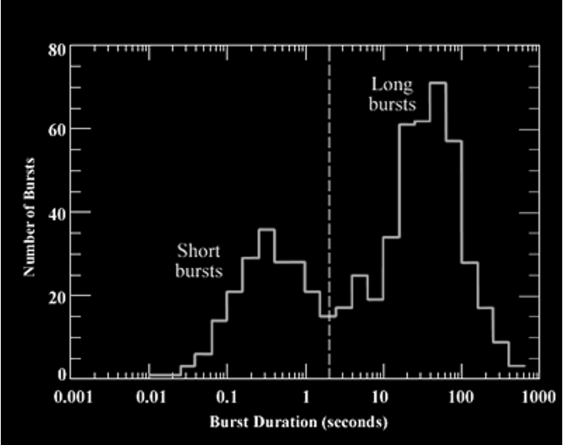
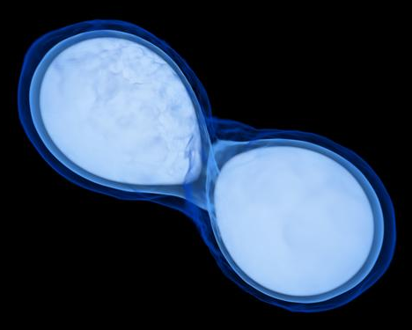
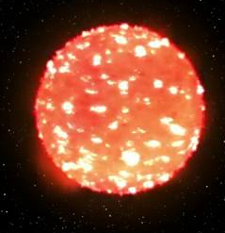
CLASSICAL VIEW
Core-collapse of massive stars
Connection between long-duration GRBs and supernovae (e.g., many…)
Binary neutron star mergers
Connection between short-duration GRBs and kilonovae (e.g., GRB170817A)
GAMMA-RAY BURST

Slide 5
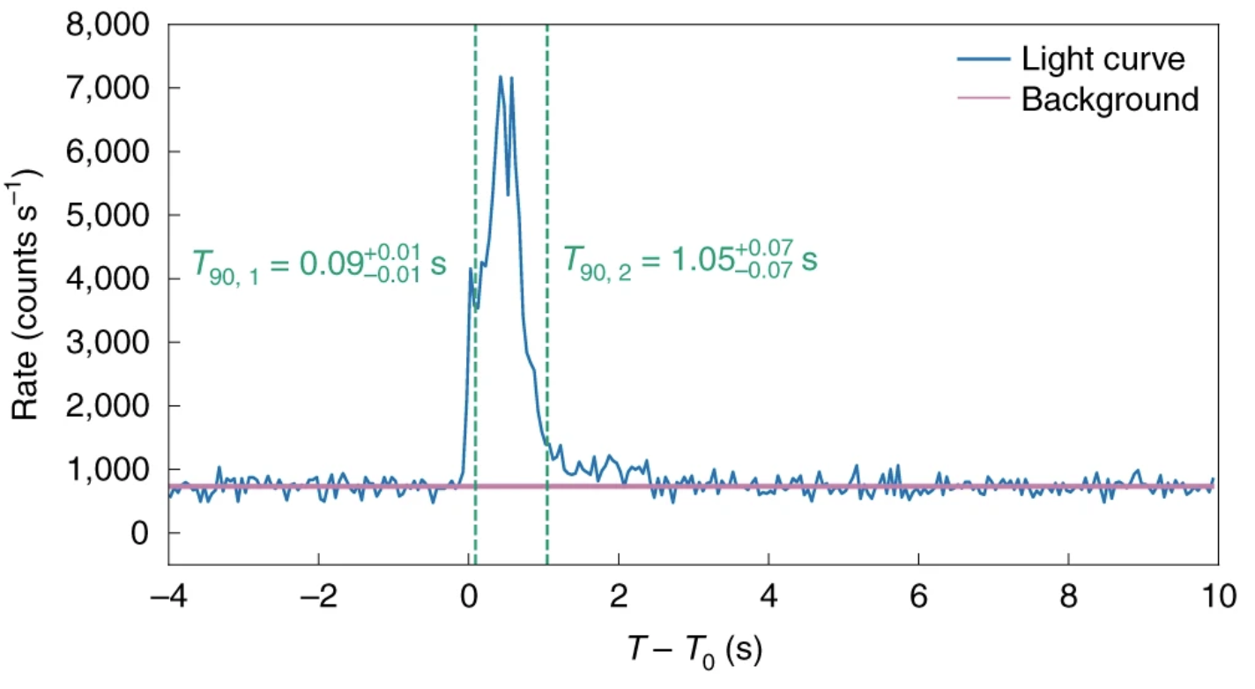


BREAK THE BAR
A. Levan+2023
B.-B. Zhang+2021
GRB200826A ($t_{90}≃1s)$ with its supernova counterpart
GAMMA-RAY BURST
GRB 230307A ($t_{90}≃35s)$ with its kilonova counterpart

Slide 6
NOW, GRB TYPE
Criterion | Type I | Type II
Classical view | Short GRB | Long GRB
Duration | Usually short | Usually Long
GW signal | Yes | Unknown
Counterpart | Kilonova | Supernova
Medium | Uniform | Wind
Host galaxy offset | Outskrit or outside | Well inside
Redshift | Relatively low | Relatively high
Zhang+2009
GAMMA-RAY BURST

Slide 7
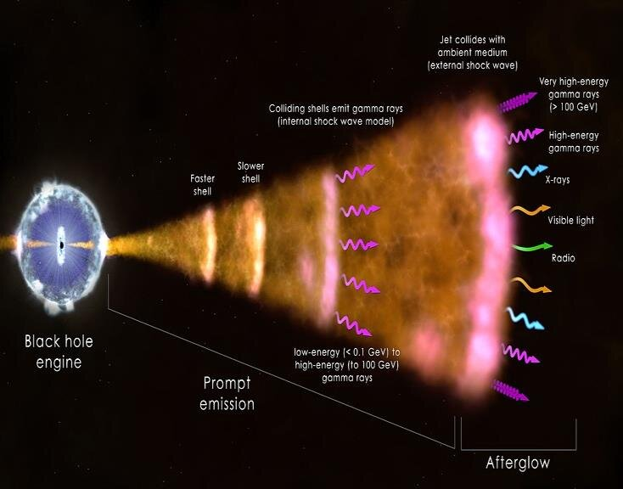
GRB EMISSIONS
PROMPT EMISSION
Both type of GRBs are believed to have a similar physical mechanism (Ghirlanda+2011, Shahmoradi+2015, …)
GAMMA-RAY BURST
AFTERGLOW

Slide 8
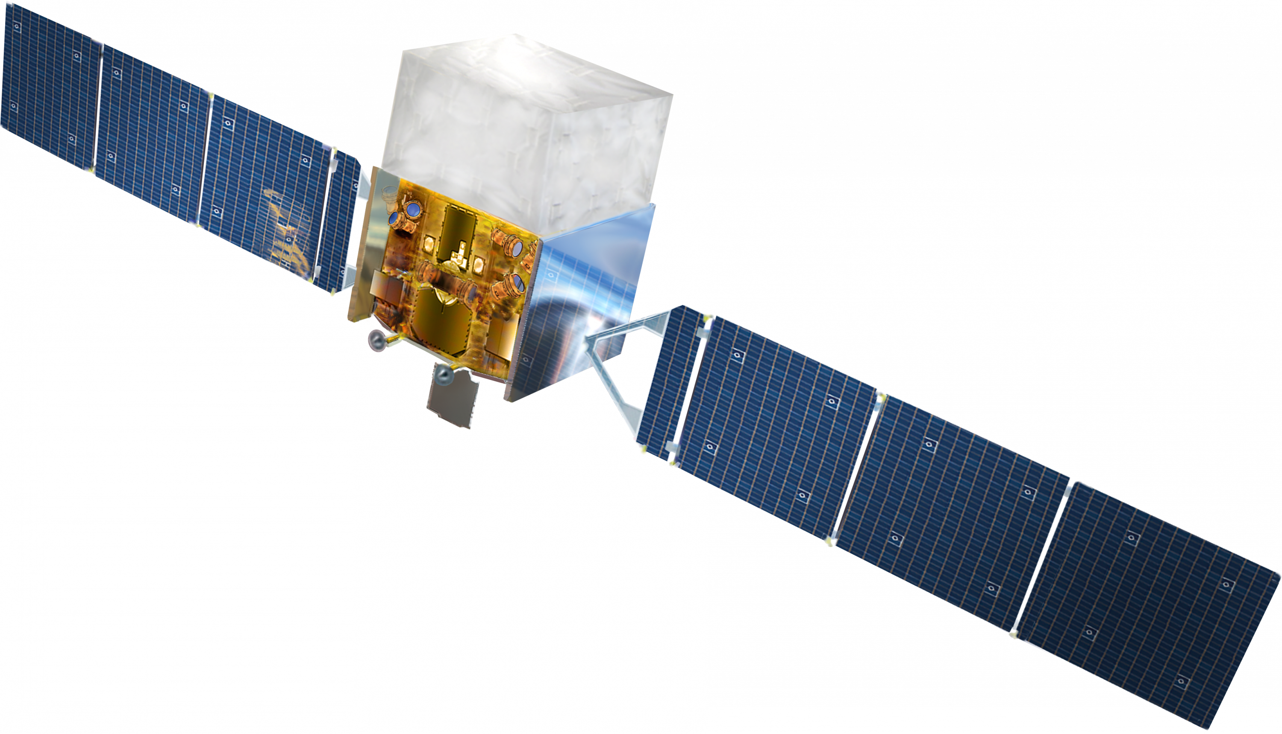
Fermi 𝛄-ray Space Telescope
Fermi Gamma-ray Space Telescope was launched on 2008 with two instruments
GAMMA-RAY BURST

Slide 9
Fermi 𝛄-ray Space Telescope
Fermi Gamma-ray Space Telescope was launched on 2008 with two instruments
Gamma-ray Burst Monitor (GBM)
Large Area Telescope (LAT)
GAMMA-RAY BURST

Slide 10
Fermi 𝛄-ray Space Telescope
Fermi Gamma-ray Space Telescope was launched on 2008 with two instruments
Gamma-ray Burst Monitor (GBM)
- Covering 8 keV to 40 MeV
- Almost full sky coverage
Large Area Telescope (LAT)
GAMMA-RAY BURST

Slide 11
Fermi 𝛄-ray Space Telescope
Fermi Gamma-ray Space Telescope was launched on 2008 with two instruments
Gamma-ray Burst Monitor (GBM)
Large Area Telescope (LAT)
- Covering 100 MeV to 300 GeV
- Full sky coverage every 3 hours
GAMMA-RAY BURST

Slide 12
PROMPT EMISSION

Slide 13
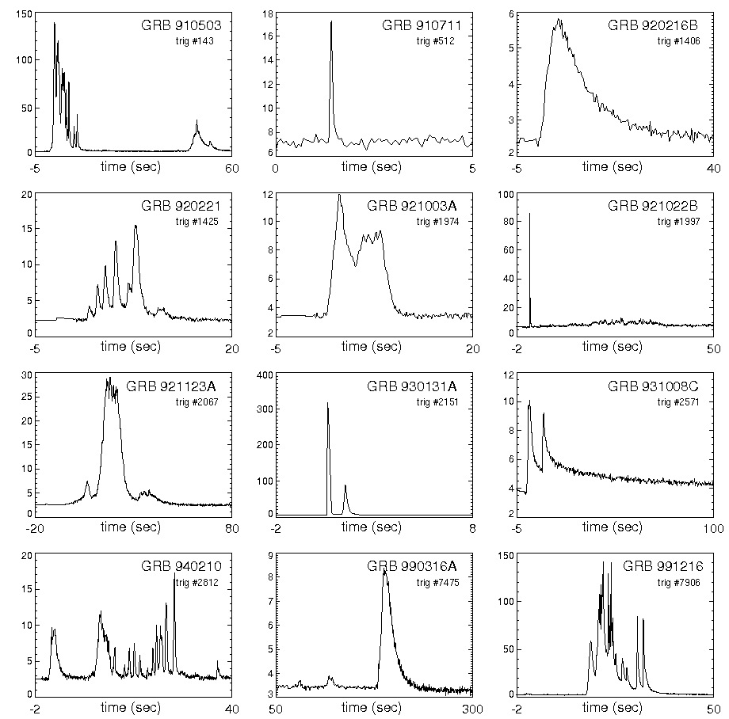
PROMPT EMISSION
Short, spiky, and luminous emission in the keV-MeV energy band, requiring the relativistic motion.
GAMMA-RAY BURST
Diversity of GRB prompt emission

Slide 14
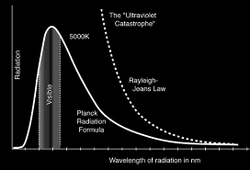
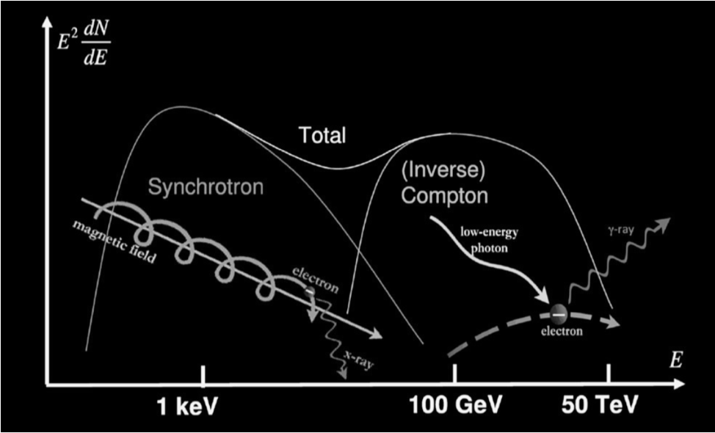

LEADING MODELS
Photosphere model
Internal-shock model
Magnetic-jet model
Naturally expected from the explosive event, where $τ_{γγ}∼1$.
In an unsteady outflow, a shock condition can be easily produced, powering the emission.
GAMMA-RAY BURST
In a highly magnetized outflow, the magnetic reconnection can power the emission

Slide 15
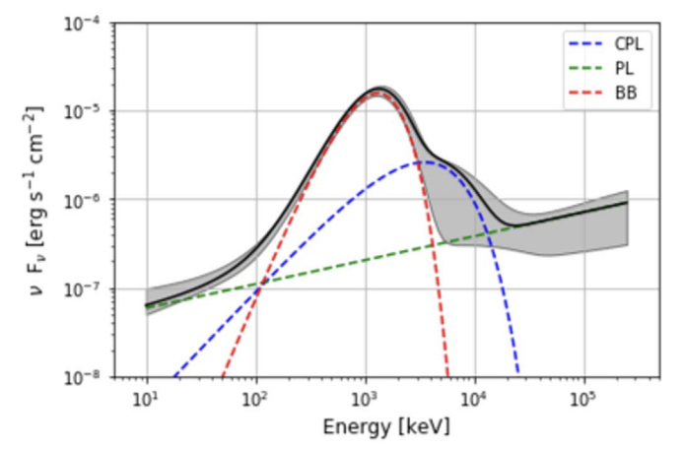
DISCREMENATE MODELS
Spectral Features
Tak+2019a
Photosphere model
Internal-shock model
Magnetic-jet model
Thermal emission (blackbody-like)
Non-thermal emission (synchrotron)
GAMMA-RAY BURST
Non-thermal emission (synchrotron)
Short GRB160709A:
Thermal + Non-thermal emissions

Slide 16
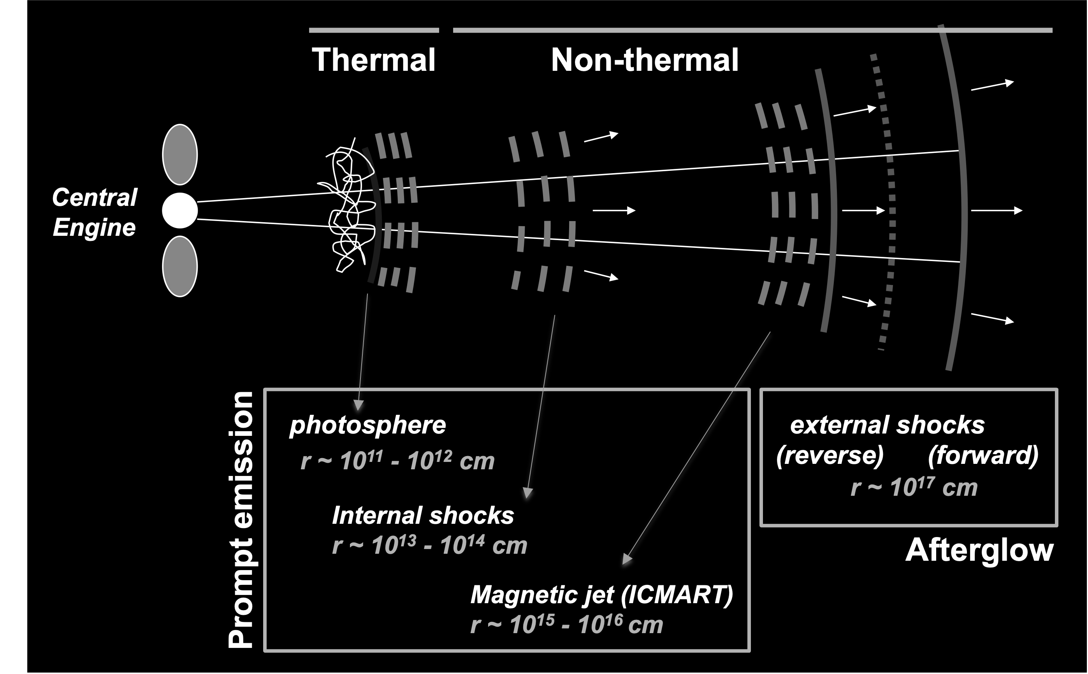



DISCREMENATE MODELS
Emitting Radii
Photosphere model
Internal-shock model
Magnetic-jet model
$$r \sim 10^{11} −10^{12} cm$$
$$r \sim 10^{13} −10^{14} cm$$
GAMMA-RAY BURST
$$r \sim 10^{15} −10^{16} cm$$

Slide 17
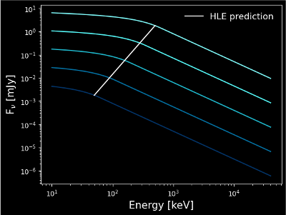

RADIUS ESTIMATION
LoS: Line of Sight
LoSE: Line of Sight Emission
HLE: High Latitude Emission
GAMMA-RAY BURST
If this geometrical feature of the relativistic jet exists in the prompt emission,
$$r≃2cΓΔt_{pulse}$$
Piran 1998

Slide 18
IDENTIFIED
Tak+2023; Uhm, Tak+2024
About 58% (18 out of 32) of our sample shows the clear evidence of the geometrical effect.
GAMMA-RAY BURST

Slide 19
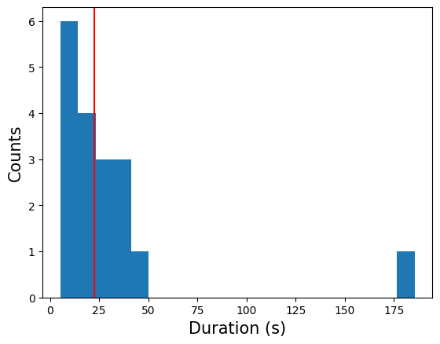




PREFERRED MODEL
Emitting Radii
Photosphere model
Internal-shock model
Magnetic-jet model
$$r \sim 10^{11} −10^{12} cm$$
$$r≃10^{16}cm{\left(\frac{Γ_{bulk}}{100}\right)}^{2}\left(\frac{Δt}{20s}\right)$$
$$r \sim 10^{13} −10^{14} cm$$
GAMMA-RAY BURST
$$r \sim 10^{15} −10^{16} cm$$

Slide 20
AFTERGLOW

Slide 21
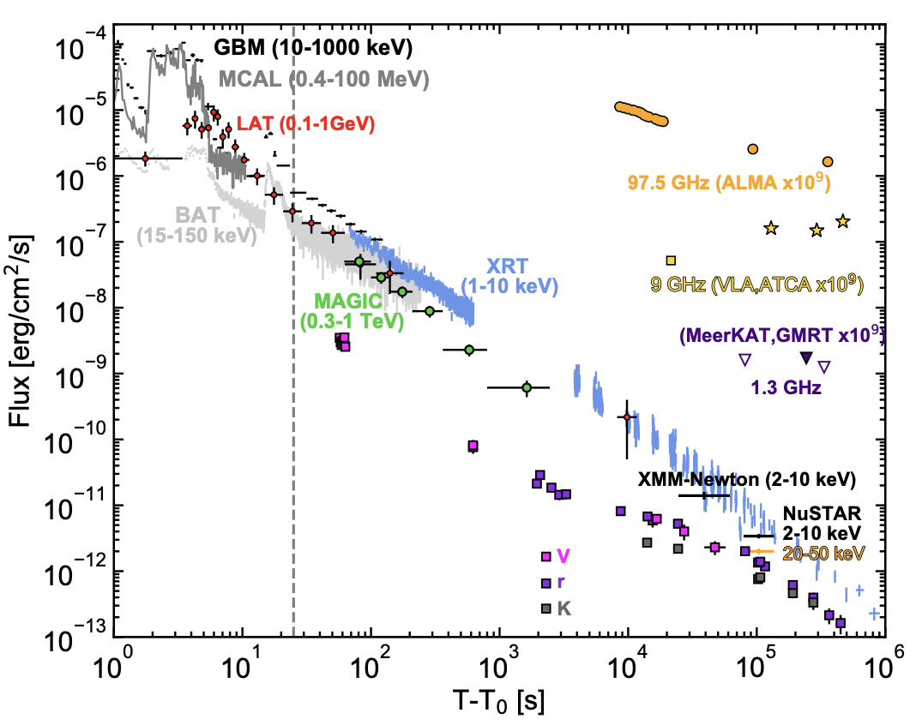
AFTERGLOW
Acciari, Tak+2022
Long-lasting, fading emission observed in the broad band from radio to TeV energies.
GAMMA-RAY BURST
GRB190114C light curve

Slide 22
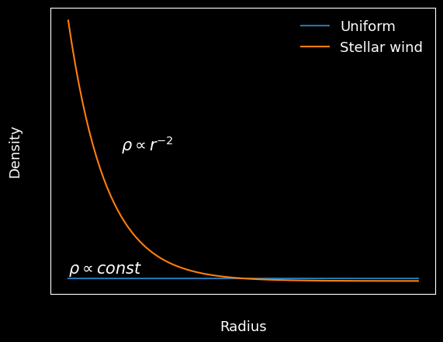
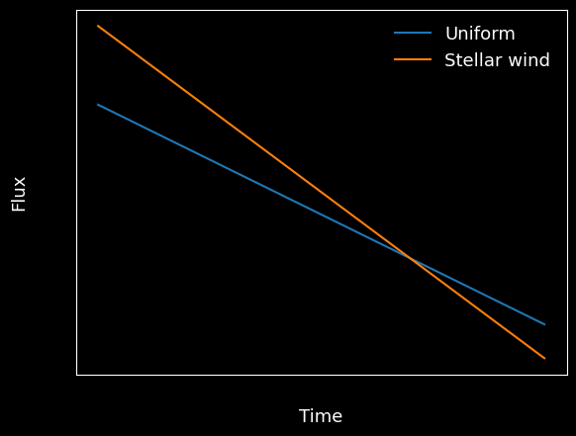
AFTERGLOW MODEL
According to the external forward shock model (afterglow model),
Compact objects
Massive star
Not emitting winds
Emitting stellar winds
Slowly decay
Rapidly decay
GAMMA-RAY BURST

Slide 23
Let’s focus on afterglow in high energies
Thanks to Fermi-LAT, MAGIC, LHAASO, and many (very-) high-energy observatories,
our understanding on the high-energy emission has improved significantly.
GAMMA-RAY BURST

Slide 24
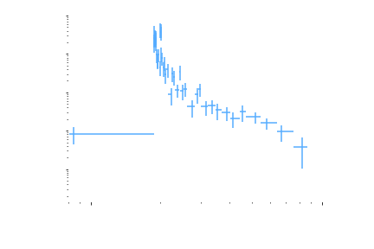






GeV ENERGY BAND
Zhang+2006
0.1– 100 GeV
$$Flares$$
$$F_{ν}∝t^{−\hat{α}}$$
$$\hat{α}∼3$$
Flux
$\hat{α}∼$0.5
$\hat{α}∼$1.2
$\hat{α}∼$2
GAMMA-RAY BURST
Time
GRB160625B light curve
Standard picture of GRB afterglow

Slide 25

GeV ENERGY BAND
Zhang+2006
0.1– 100 GeV
$$\hat{α}∼3$$
$$F_{ν}∝t^{−\hat{α}}$$
Flux
$\hat{α}∼$1.2
GAMMA-RAY BURST
Time
GRB160625B light curve
Standard picture of GRB afterglow

Slide 26



GeV ENERGY BAND
$$F_{ν}∝t^{−\hat{α}}$$
0.1– 100 GeV
$\hat{α}∼$1.2
$$\hat{α}=1 .0±0.8$$
GAMMA-RAY BURST
Ajello, Tak+2019
GRB160625B light curve

Slide 27
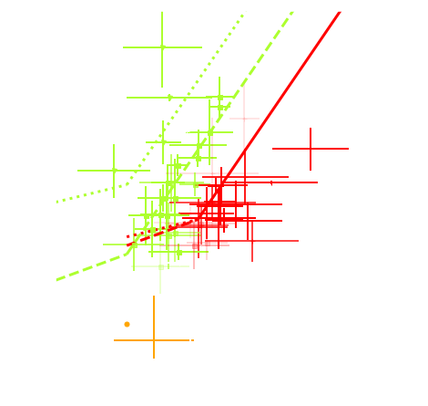

AGREE WITH MODEL
Tak+2019b
GRB090510
(Short)
ISM: Interstella medium (= uniform)
$$F_{ν}∝t^{−\hat{α}}v^{−\hat{β}}$$
GAMMA-RAY BURST
The afterglow model aligns with GRB090510 (short), with about 80% of samples in agreement.

Slide 28

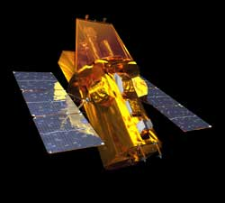
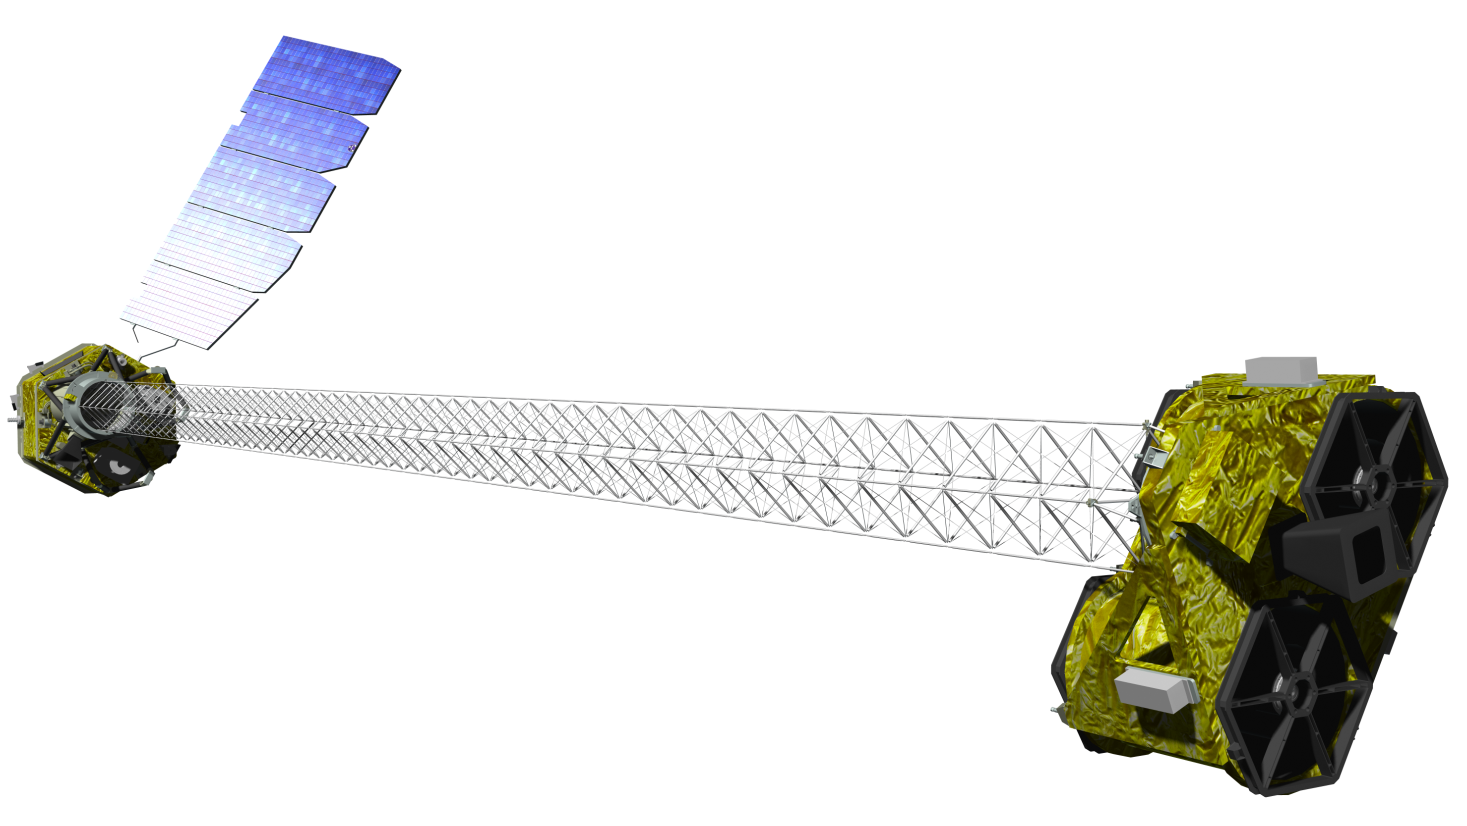
BRIGHTEST OF ALL TIME (BOAT)
GRB221009A is the most energetic burst ever detected with a redshift of 0.151.
The Large High Altitude Air Shower Observatory (LHAASO) in China reported the observation of 5,000 very-high-energy (>100 GeV) photons.
We perform a multiwavelength analysis from the optical to the GeV energy band to broaden our understanding on the afterglow.
SomangNet
(optical)
Fermi
(GeV)
NuSTAR
(X-ray)
GAMMA-RAY BURST
Swift
(X-ray)

Slide 29
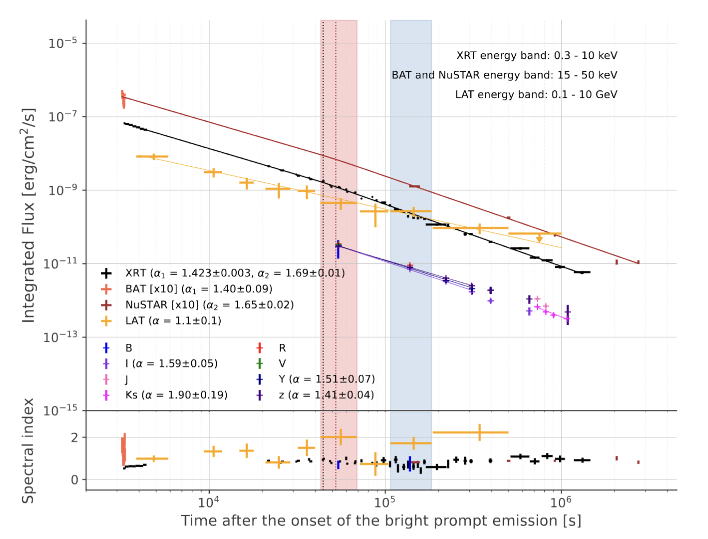
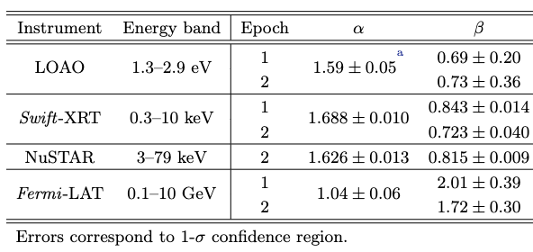

MW LIGHTCURVE
Tak+2025
1. Normal decay phase: afterglow
Temporal indices from optical and X-ray energy bands are consistent.
$$\hat{α}∼1.5−1.7$$
The spectral shapes in the optical and X-ray energy band look consistent.
$$\hat{β}=Γ−1∼0.7 −0.8$$
The GeV emission looks very different
GAMMA-RAY BURST
GRB221009A Lightcurve

Slide 30
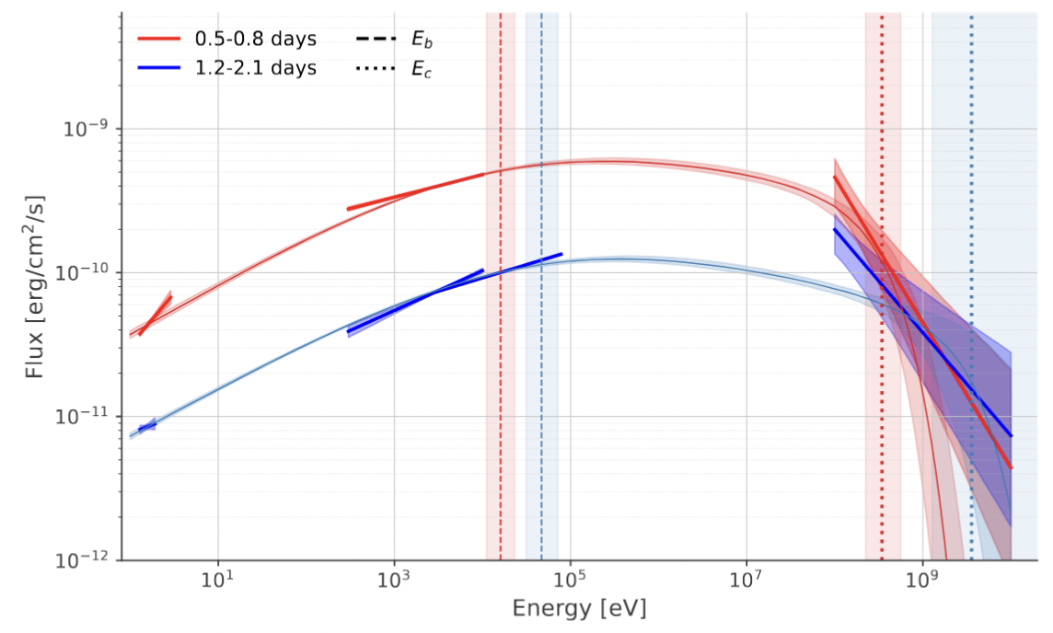

MW SPECTRUM
Tak+2025
From the afterglow model, we infer
- Particle acceleration properties
(electron distribution, slow cooling, …)
- The surrounding medium: a wind medium is preferred.
The low efficiency of particle acceleration at high energies can cause a cutoff in the GeV range.
1
2
$$Γ_{bulk}≃\frac{E_{cutoff} (1+z)}{100 MeV}$$
GAMMA-RAY BURST
GRB221009A Multiwavelength Spectrum

Slide 31
Conclusion
GRBs provide an ideal testing ground for our understanding of physics in extreme environments and so far, this approach has been largely successful.
The prompt emission, however, appears too complex to be explained by a single unified model.
While afterglows in individual energy bands have been extensively studied, it is now necessary to integrate these results into a more comprehensive picture.
To gain a deeper understanding of GRBs, multi-messenger studies are strongly encouraged.
CONCLUSION

Slide 32

Thank you
Contact
Donggeun Tak
Seoul national university
donggeun.tak@gmail.com
Link to my orcid

