Slide 1
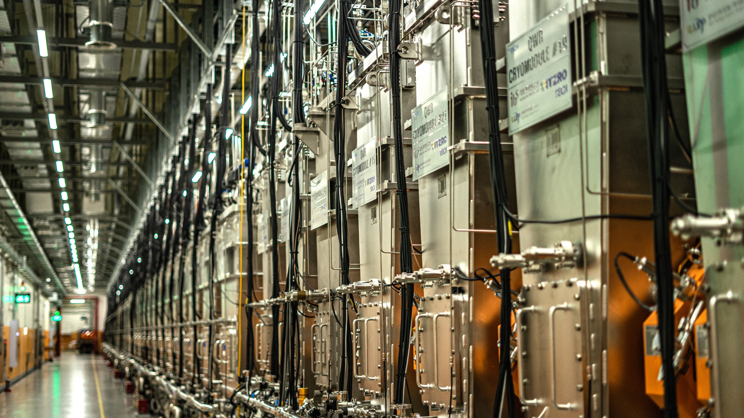



Heavy-Ion Collisions at Intermediate Energies
2025.11.20 KSHEP
Kyungil Kim (IRIS, IBS)

Slide 2

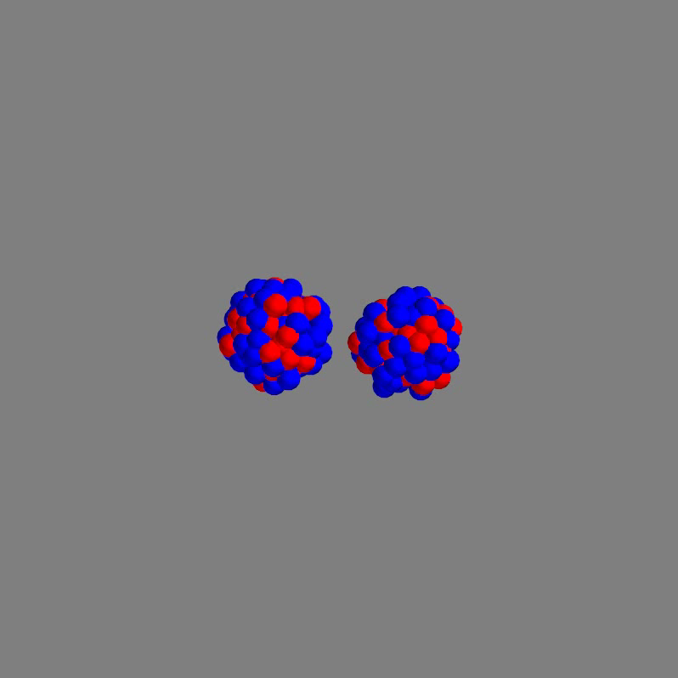

01
Motivations – Heavy Ion Collisions
¹²⁹Xe+¹²⁰Sn, E_{beam} = 65 MeV/n, b=1 fm
Initial condition
Detection in experiments
How can we understand the process of heavy-ion collisions?
Ex.) How can we know the impact parameter of an event?
Transport models (BUU, QMD, …)
Hydrodynamics
Time-dependent Hatree-Fock models
Multifragmentation models
Statistical models

Slide 3
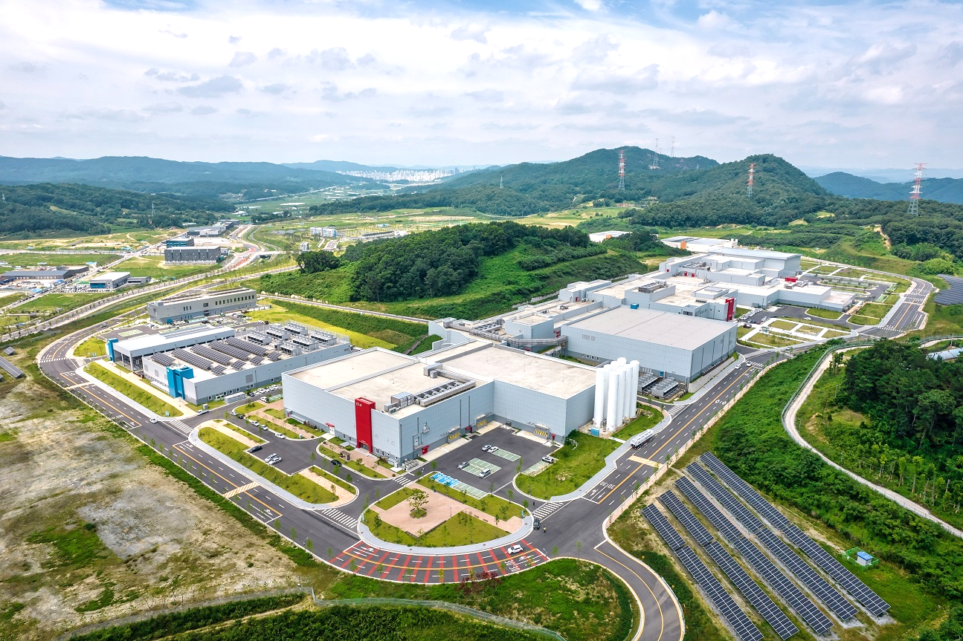
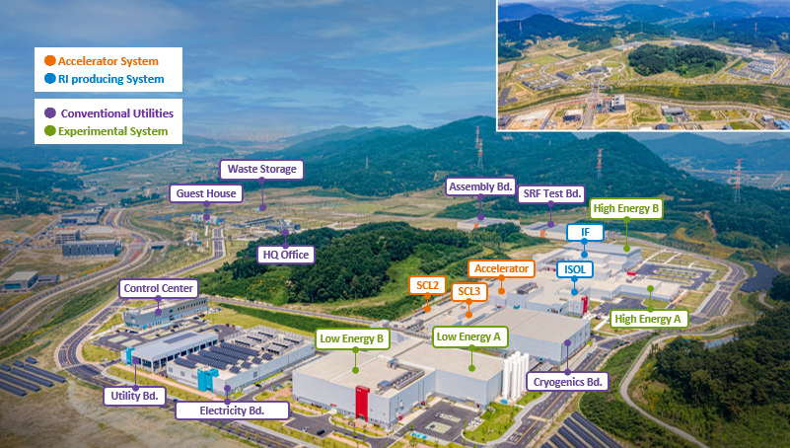
01
Motivations – RAON
● Accelerator System
● RI production System
● Conventional Utilities
● Experimental System
Low energy
~20 MeV/n
High energy
~200 MeV/n
Waste Storage
Assembly Bd.
Guest House
SRF Test Bd.
IF
High Energy B
HQ Office
Accelerator
Control Center
ISOL
SCL2
High Energy
Intermediate energies!!
SCL3
Low Energy A
Utility Bd.
Low Energy B
Cryogenics Bd.
Electricity Bd.

Slide 4
02
Transport Model
Boltzmann-Uehling-Uhlenbeck (BUU)
Quantum Molecular Dynamics (QMD)
One nucleon
One nucleon
One nucleon
N test particles
moving in the mean field
n-body Hamiltonian based
statistically good!
event by event analysis!

Slide 5
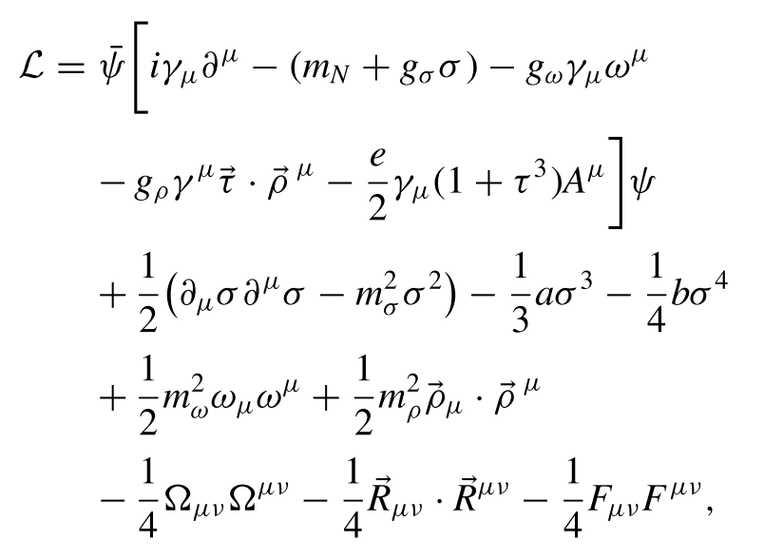
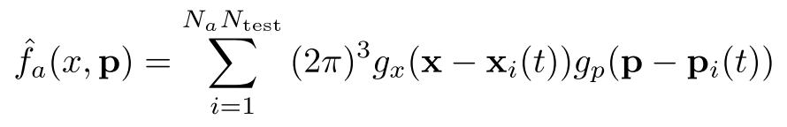

02
DJBUU
DaeJeon Boltzmann-Uehling-Uhlenbeck (DJBUU)
Ref.) M.Kim et al. PRC 101 (2020) 064614
Lagrangian (QHD)
Phase-space density
Equation of motion

Slide 6
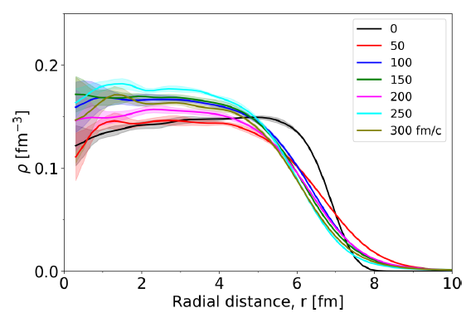
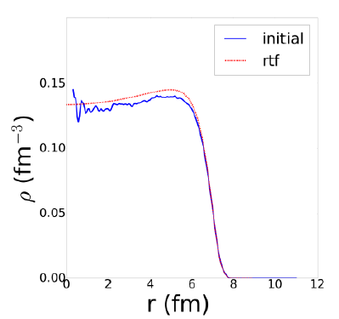
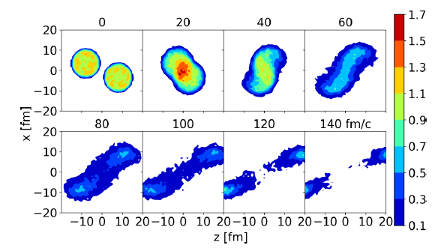
02
DJBUU - Initialization
Check the stability of an initialized nuclei
¹⁹⁷Au
for 300 fm/c
Relativistic Thomas-Fermi model calculation with same Lagrangian
Comparison of the density evolution in a heavy-ion collision
¹⁹⁷Au + ¹⁹⁷Au
Beam energy 100 MeV/n
for 140 fm/c

Slide 7
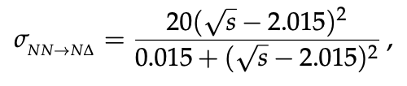
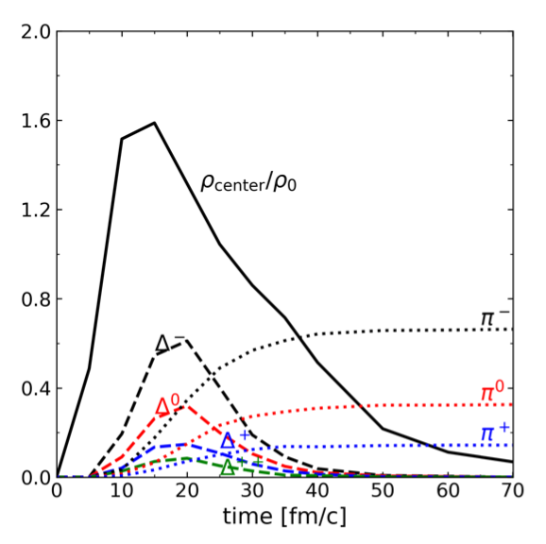
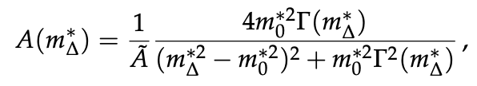
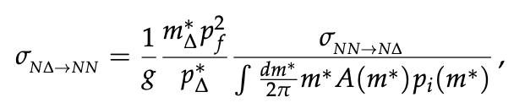
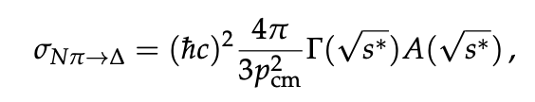
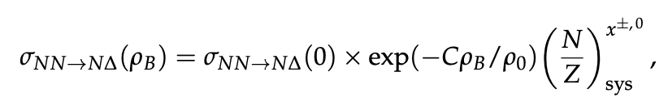
02
DJBUU – Pion Production
Ref.) M.Kim et al. Universe 8 (2022) 564
Production of pion in DJBUU
NN->N𝚫 𝚫 -> N𝛑
Isospin-dependent in-medium cross-sections

Slide 8
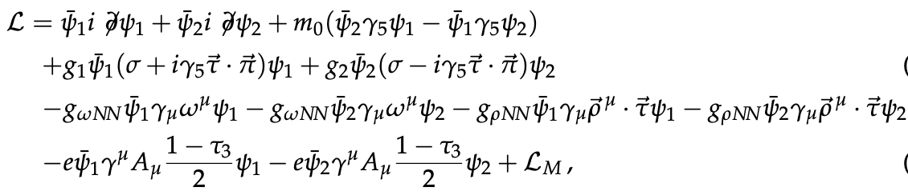

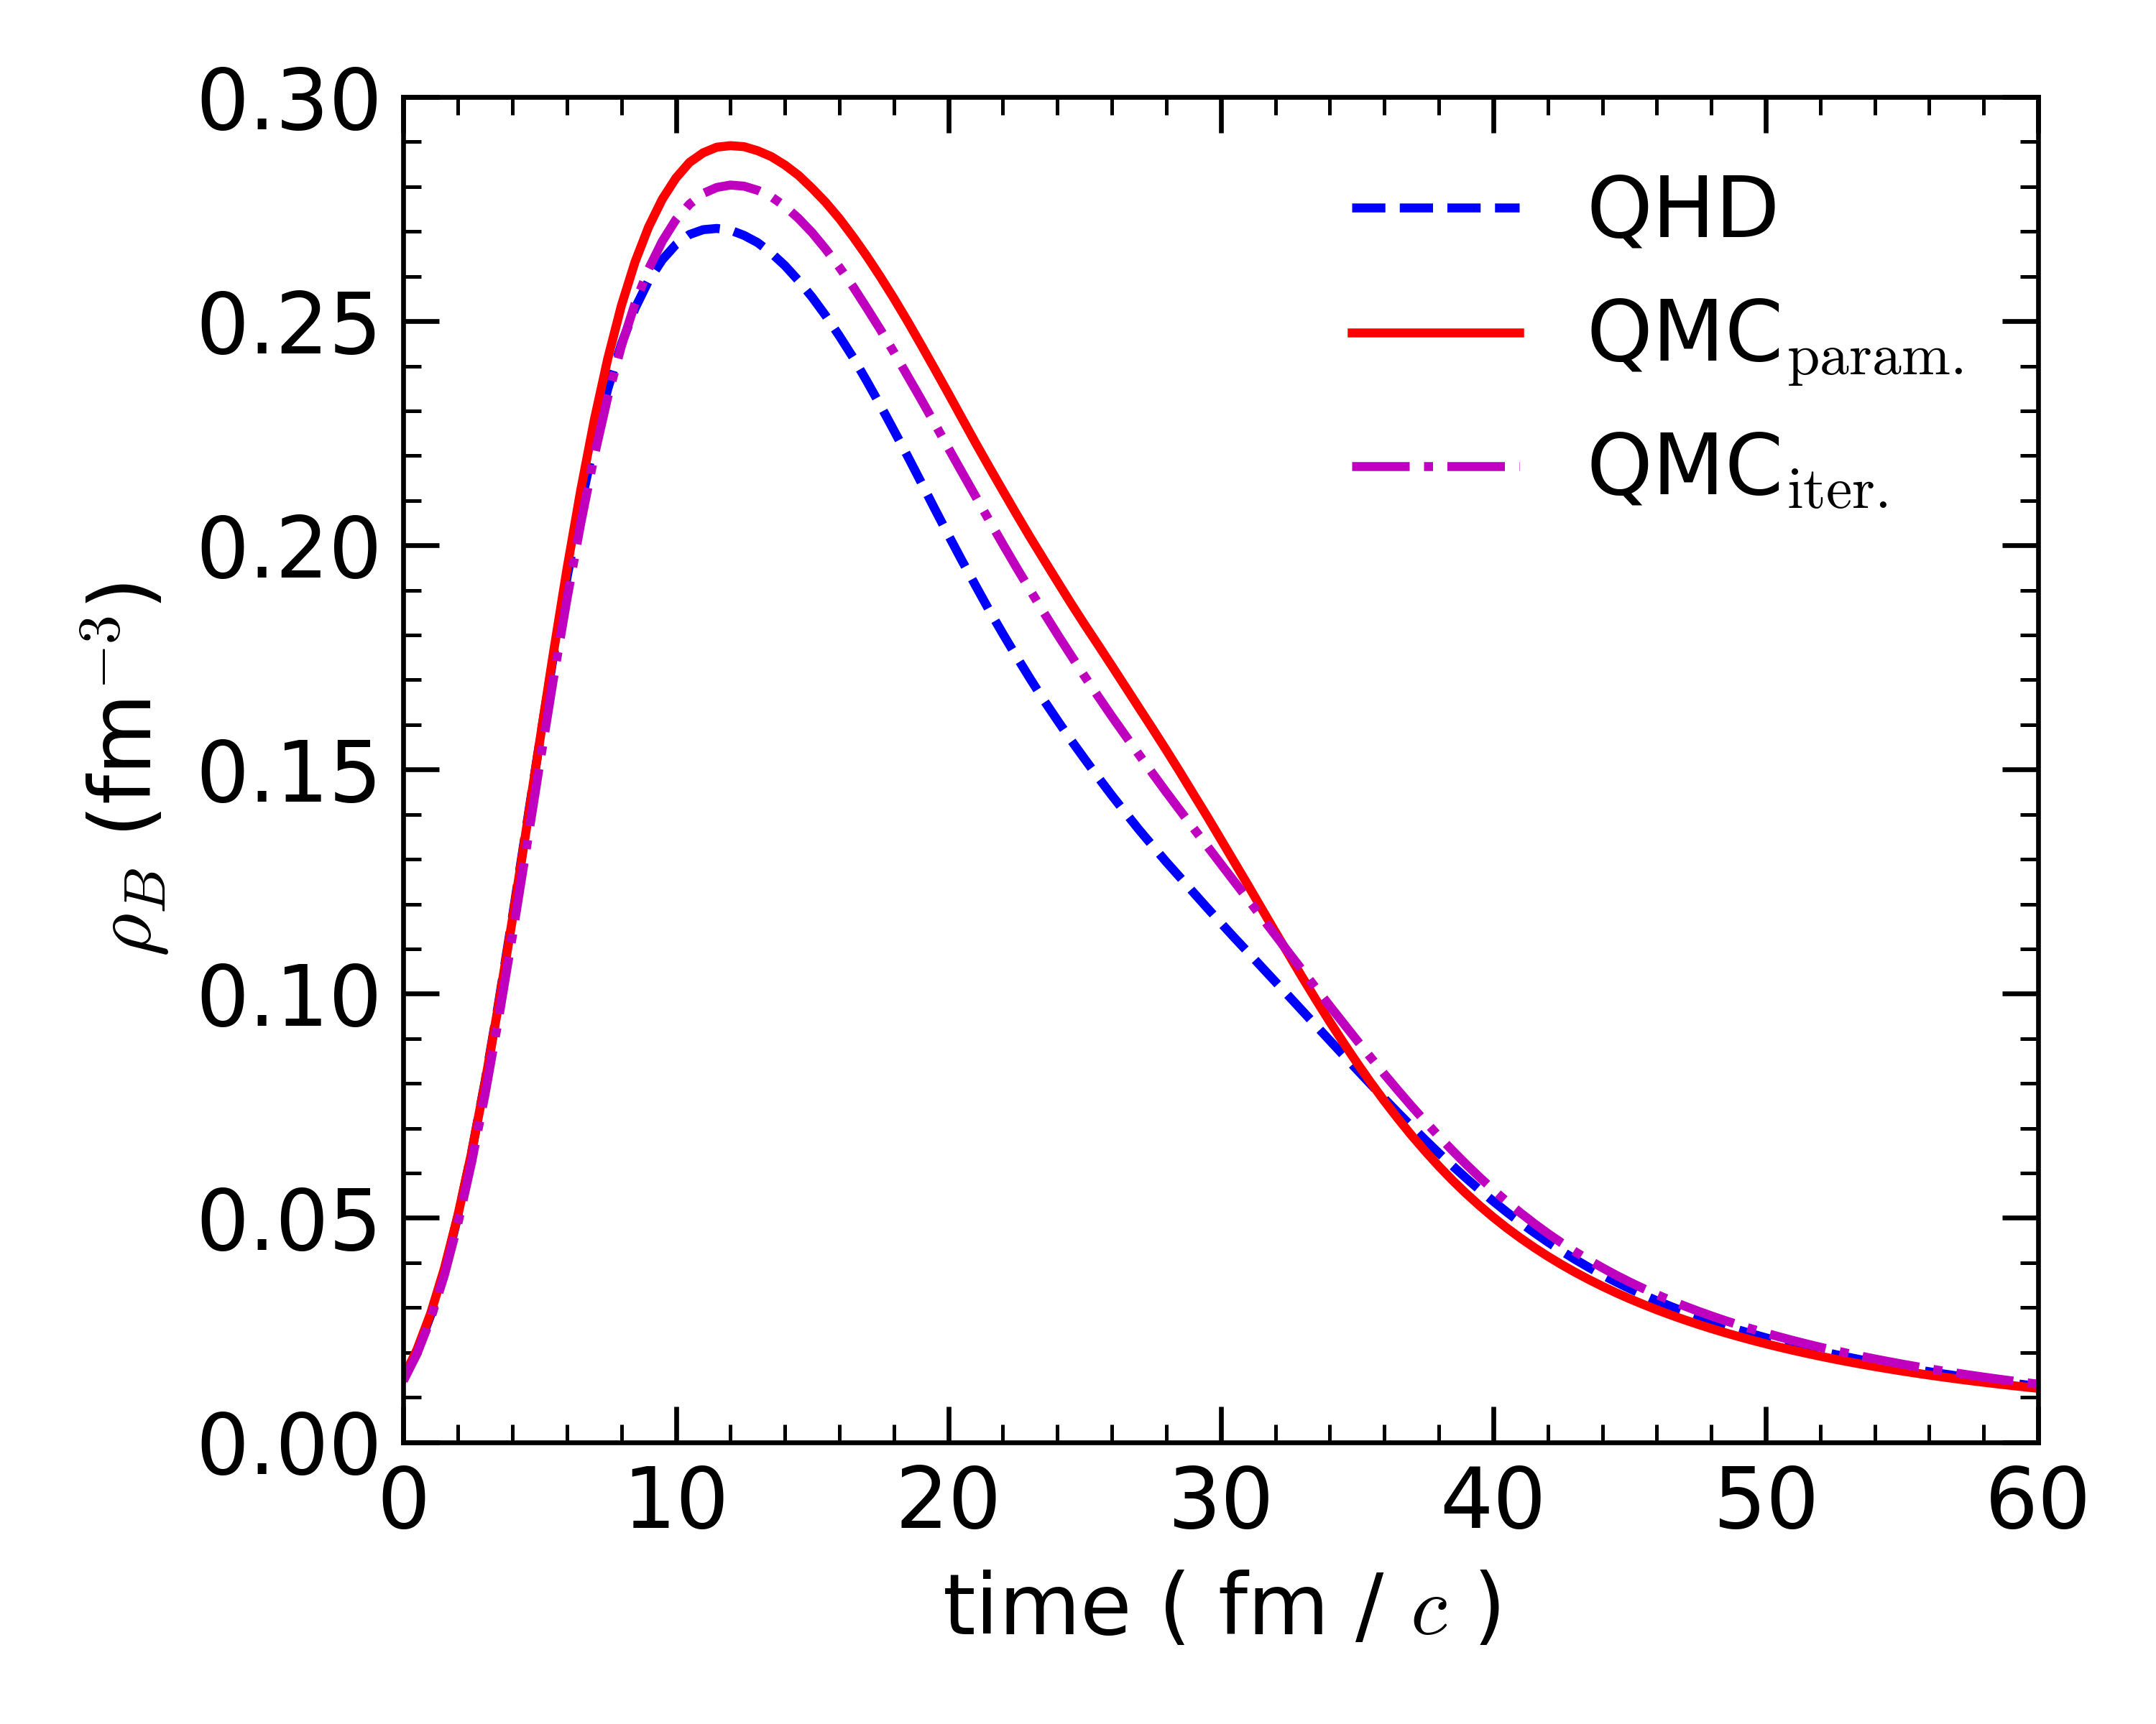
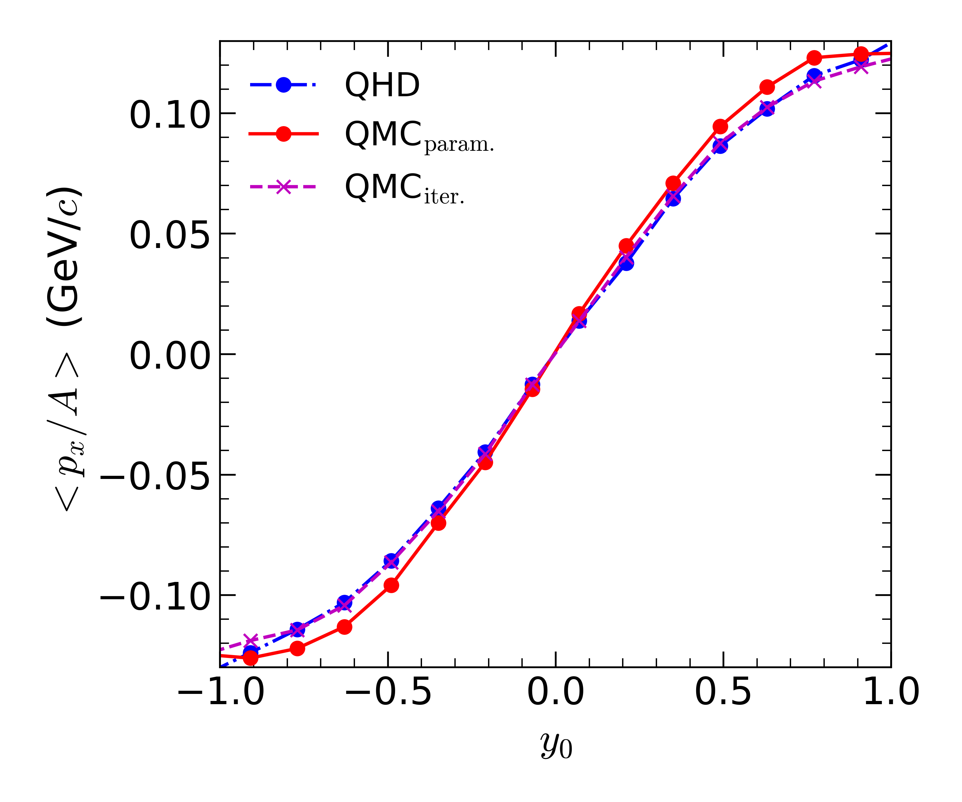
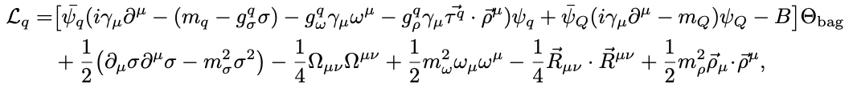

03
DJBUU with various models
DJBUU with the extended Parity Doublet Model (J. Zhou et al. in preparation)
DJBUU with the Quark-Meson Coupling Model (D. I. Kim et al. in preparation)

Slide 9
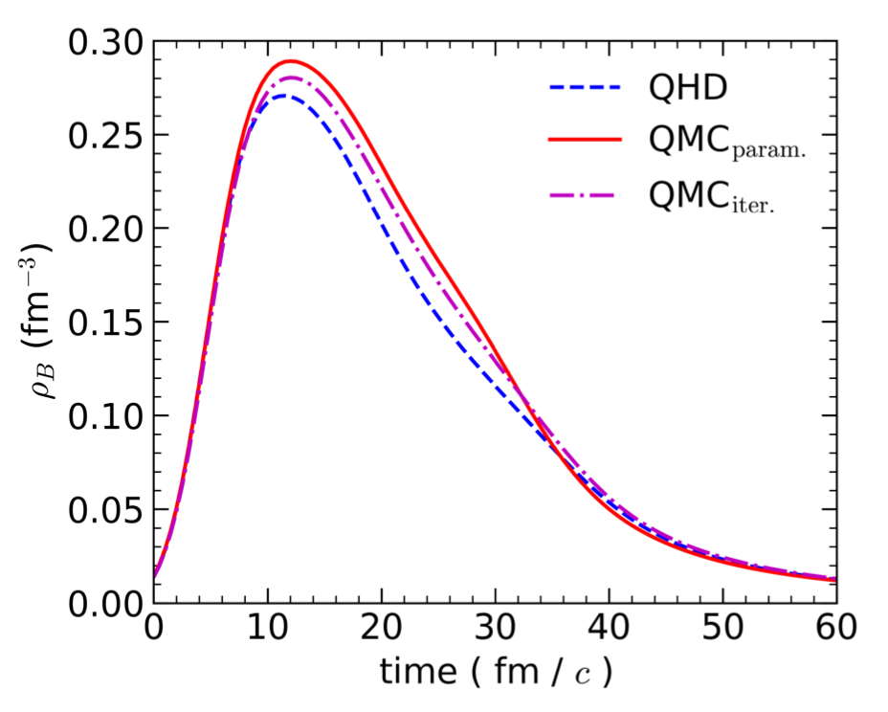
03
DJBUU with QMC model
Density evolution in the collision center
<QMC Lagrangian>
<Effective mass>

Slide 10
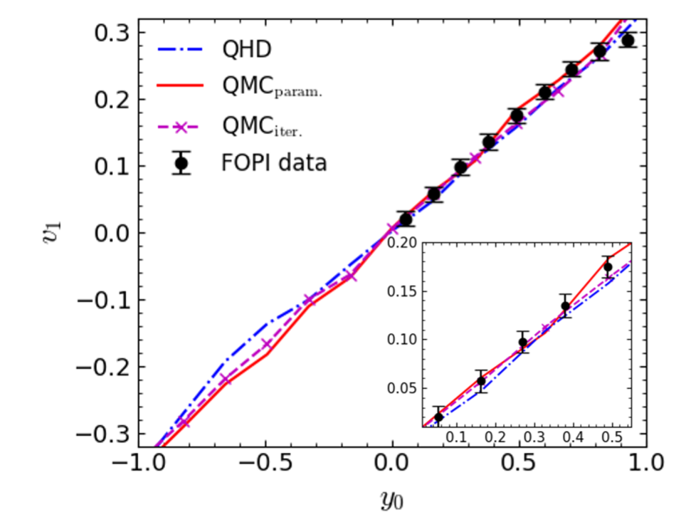
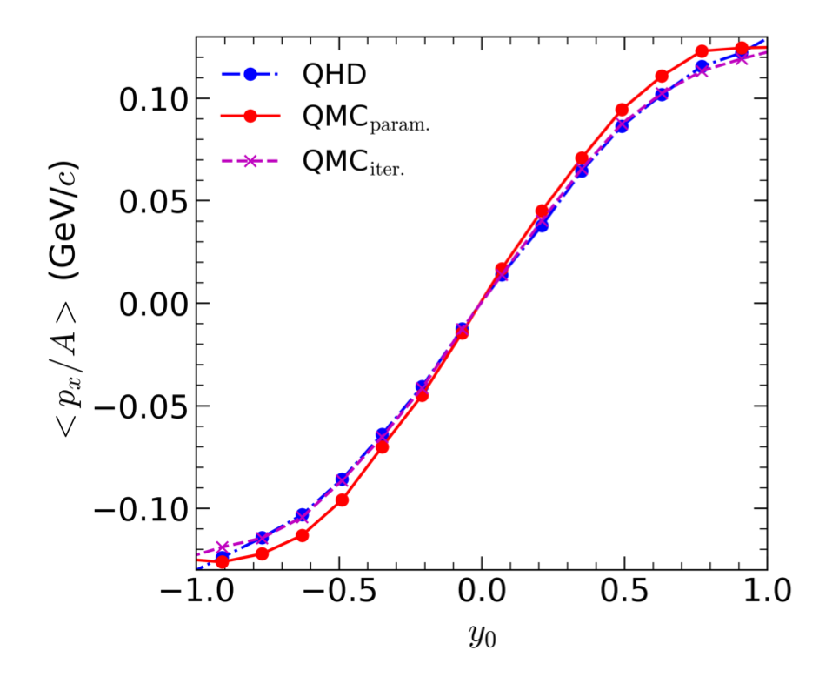
03
DJBUU with QMC model
Directed flow (v1) comparison with experiment
<Directed flow>
<Transverse flow>

Slide 11
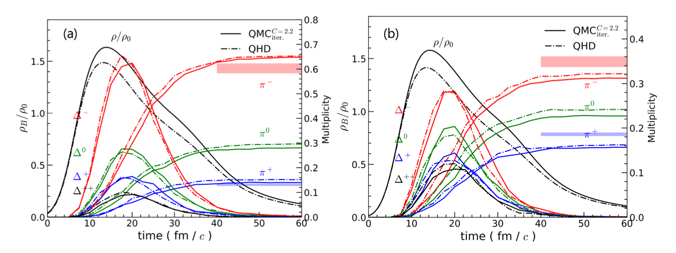
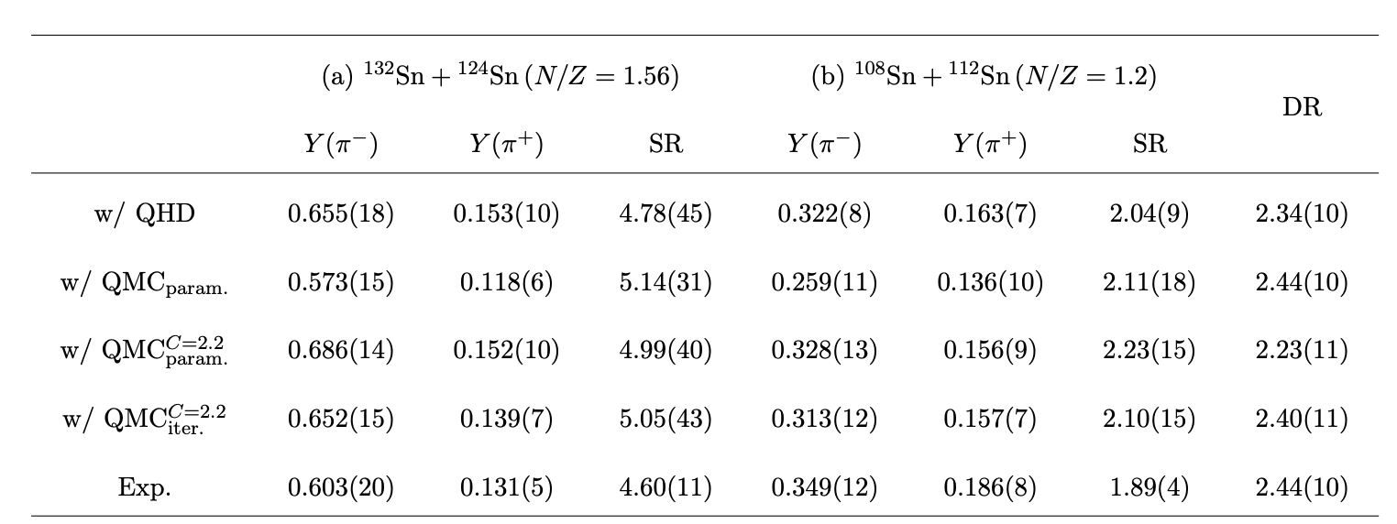
03
DJBUU with QMC model
Delta baryon and pion production
Pion production ratios

Slide 12
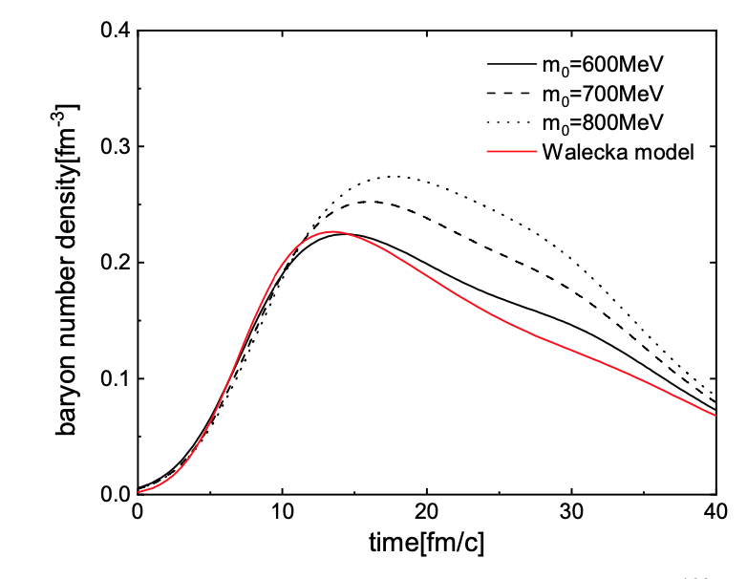
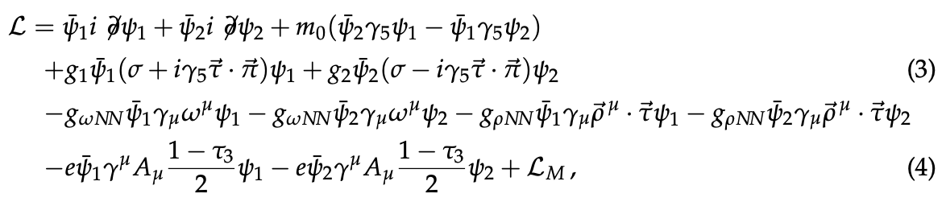
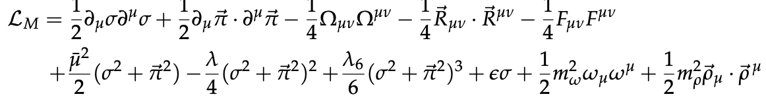
03
DJBUU with PDM model
Density evolution in the collision center
<Effective mass>

Slide 13
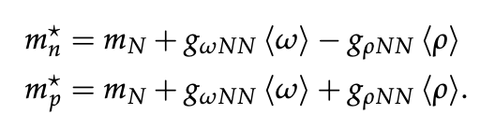
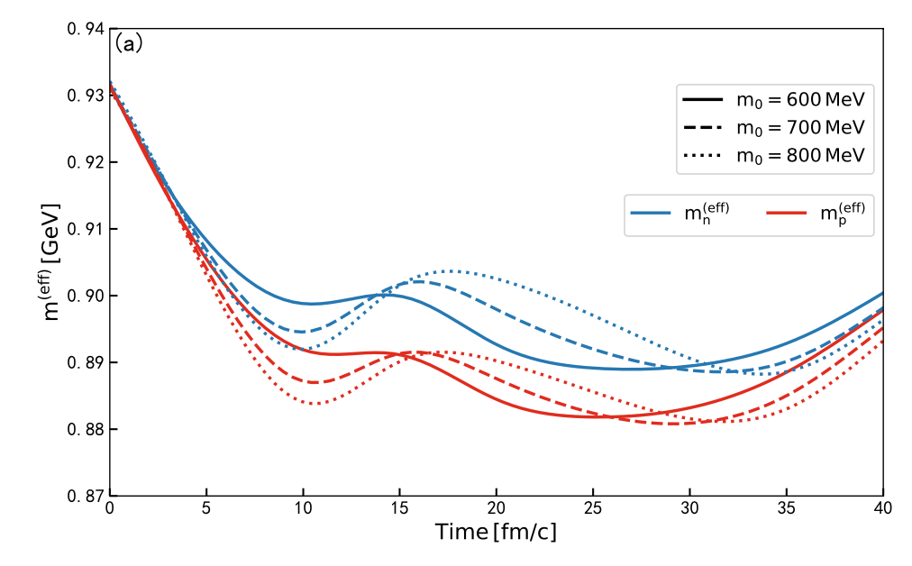
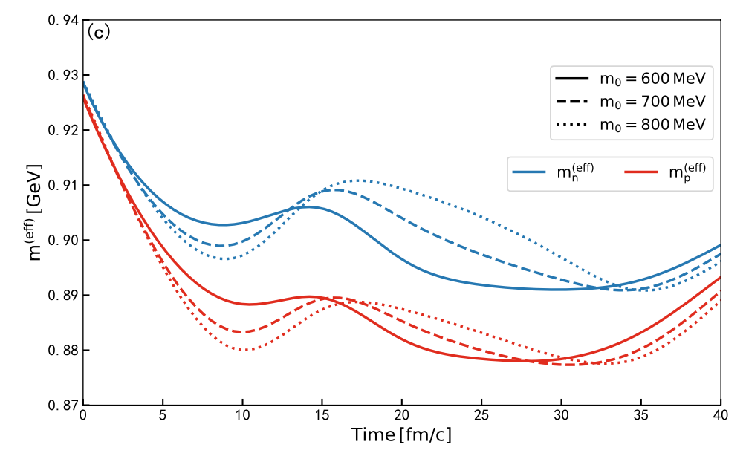
03
DJBUU with PDM model
Effective masses with PDM model
Sn108+Sn112
Sn132+Sn124

Slide 14
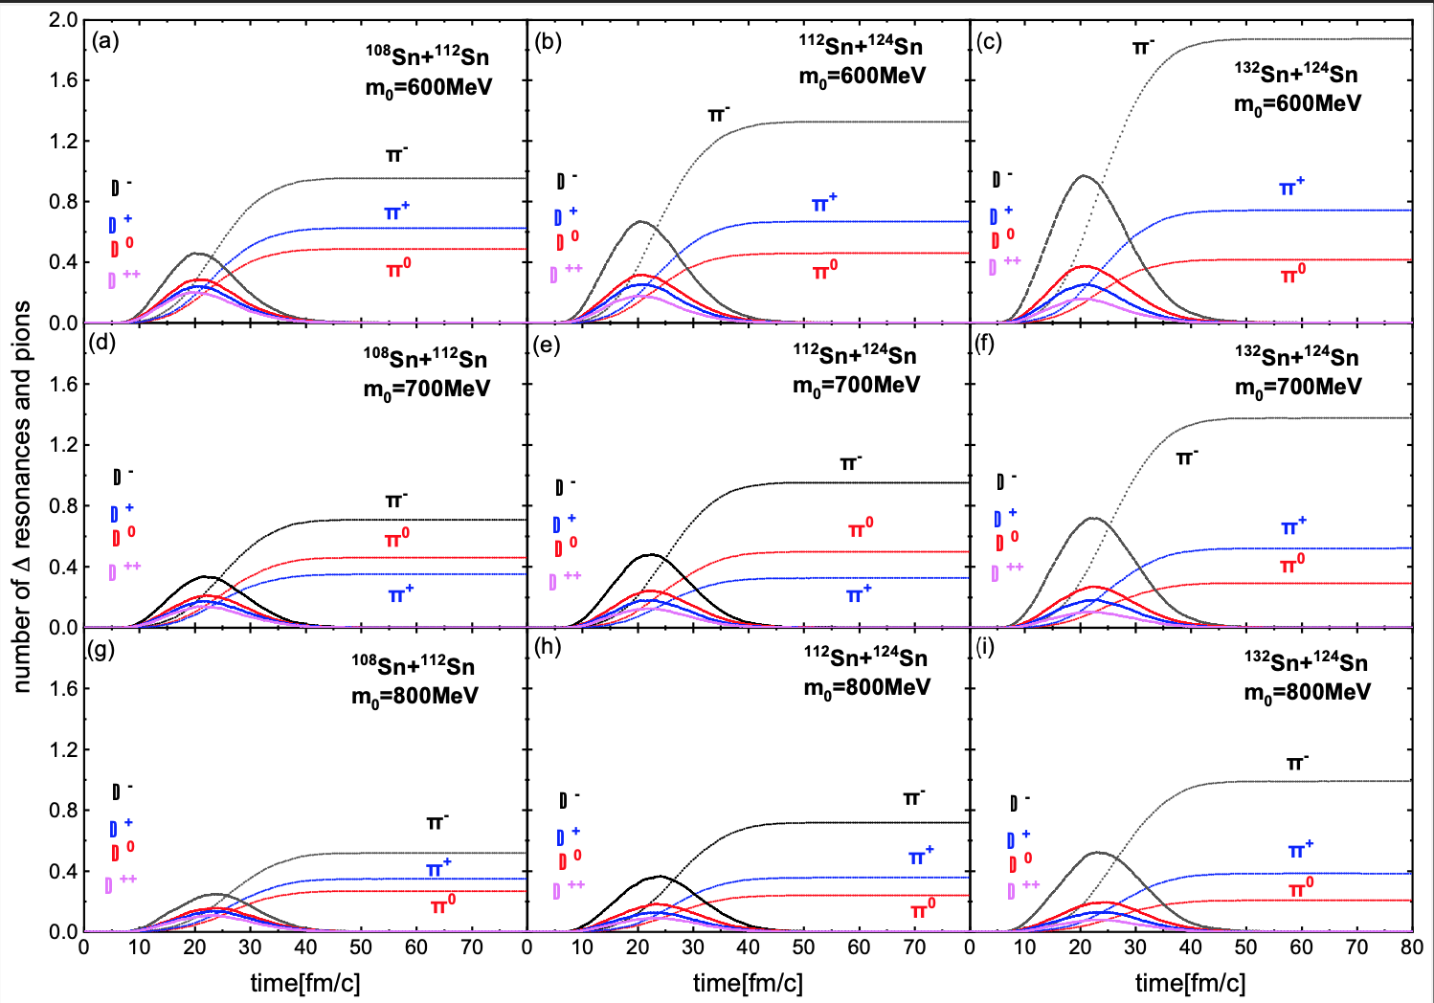
03
DJBUU with PDM model
DJBUU with the extended Parity Doublet Model (J. Zhou et al. in preparation)

Slide 15
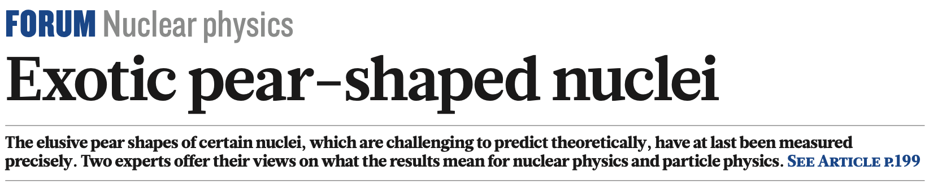
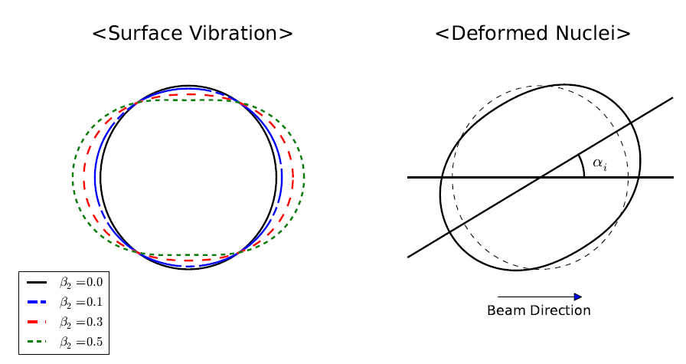
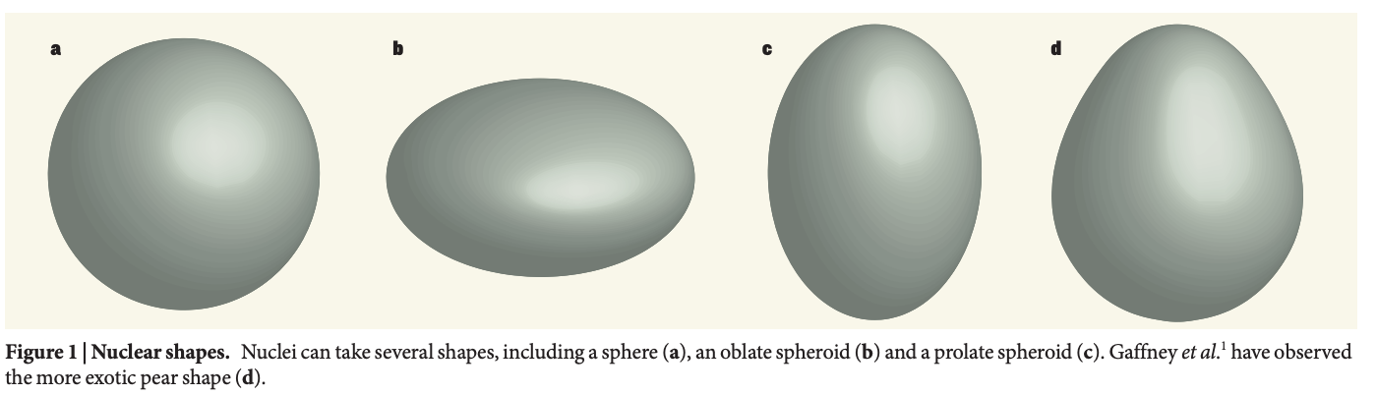
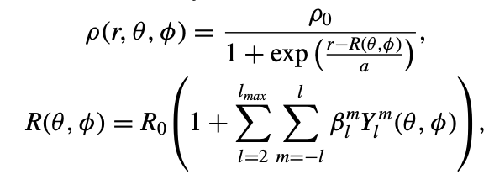
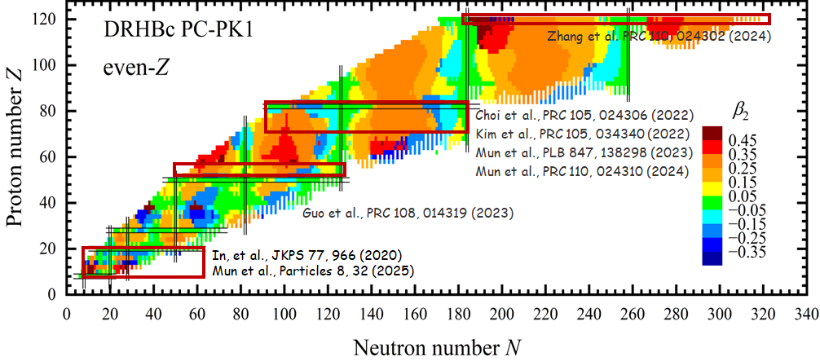
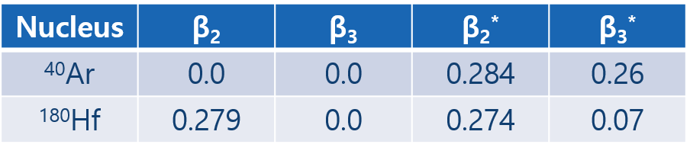
04
Deformation of Nuclei
Ex)

Slide 16
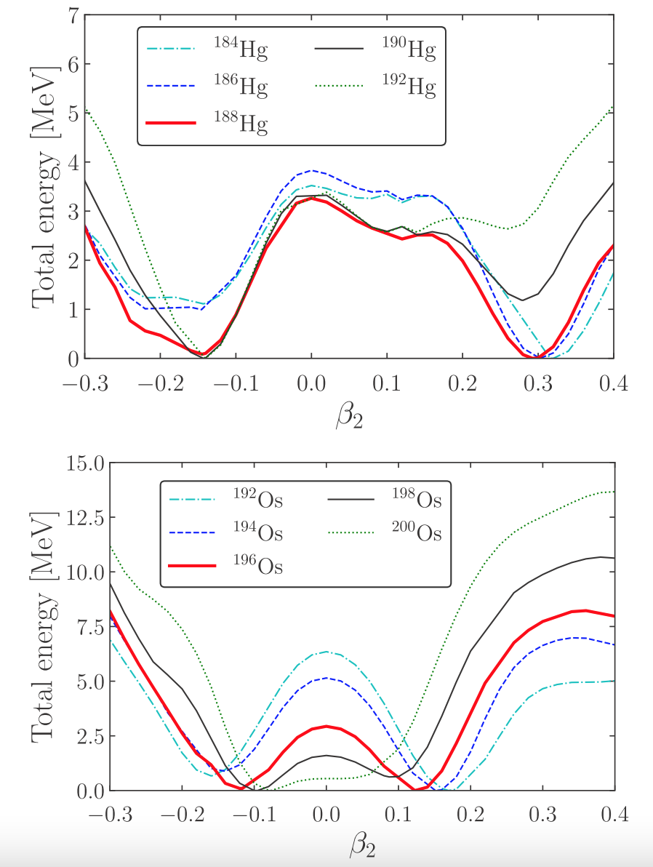
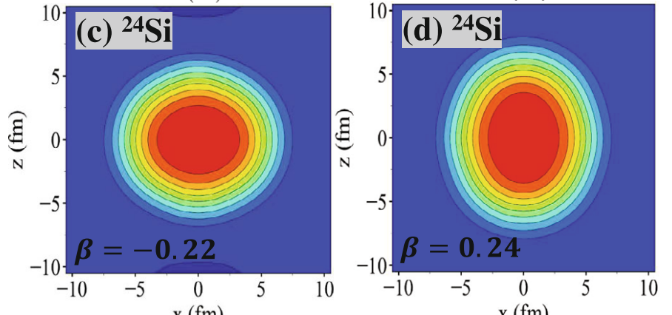
04
Shape Co-existence
Shape co-existence : The ground state of a nucleus can be a mixed state of two states with different shapes.
ref.) E.J.In et al. JKPS 77, 966
ref.) Y.Choi et al. PRC 105, 024306

Slide 17
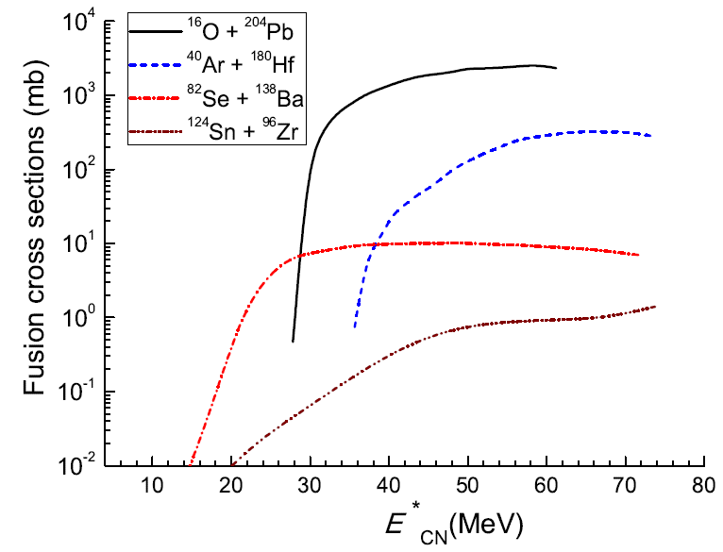
04
Motivations – Low Energy
Inelastic b>b_{c}
scattering
Projectile
Quasi-fission
A few MeV/n
Target
Capture b<b_{c}
Compound Nucleus
Fast-fission
L_{B}<L<L_{cap}
Fission (Fusion-fission)
Competition!
p
Ref.) KK et al. PRC 91 (2015) 064608
Compound Nucleus
n
Evaporation
Fusion 0<L<L_{B}
α

Slide 18
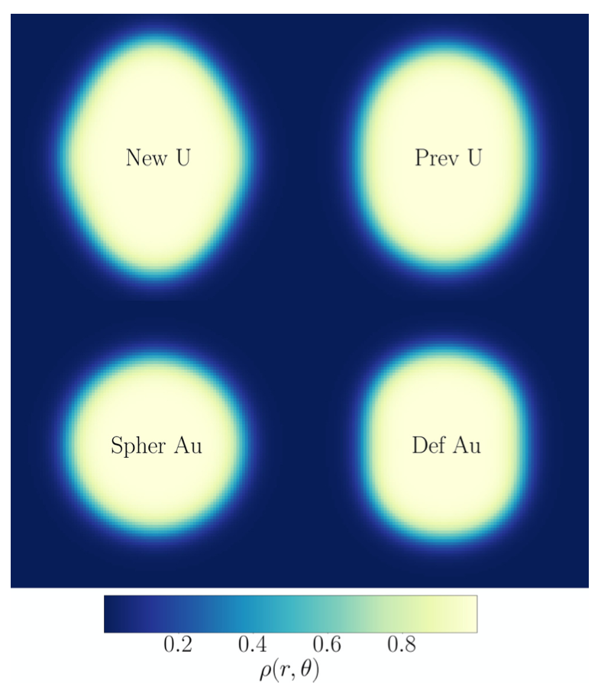
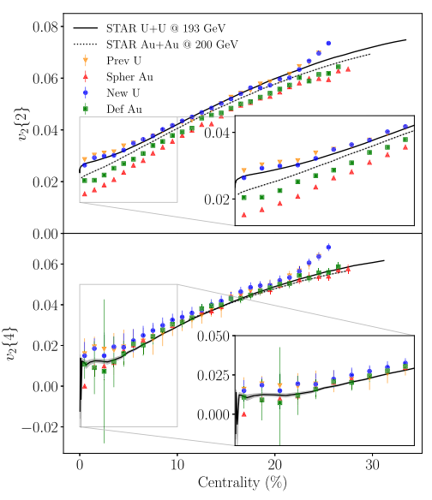
04
Motivations – Relativistic Energy
N.M.Fortier et al. PRC111 (2025) L011901
The deformation of nuclei causes elliptic flows at ultra-central collisions.

Slide 19
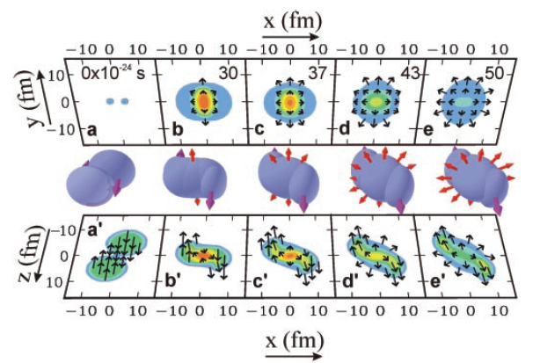
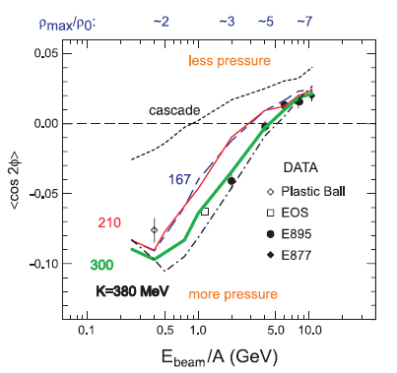
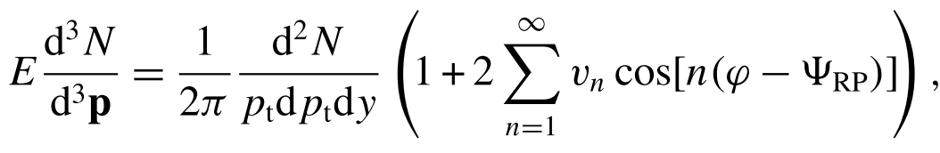

05
Flow Observables
P. Danielewics et al. Science 298, 1592

Slide 20
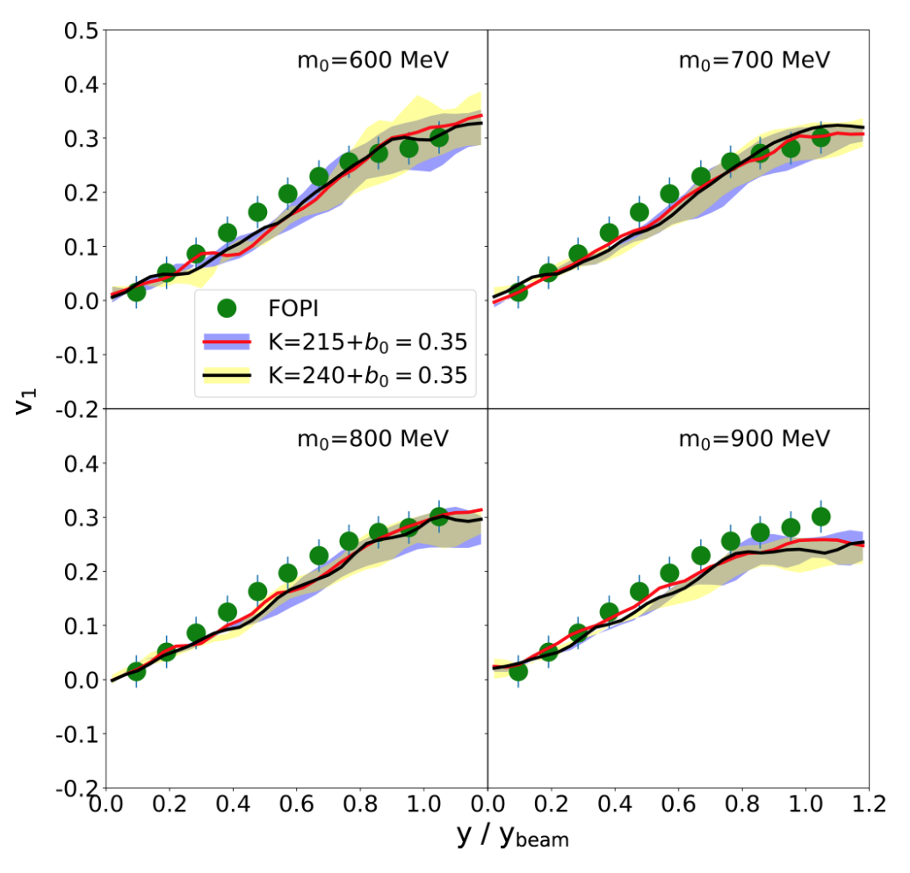
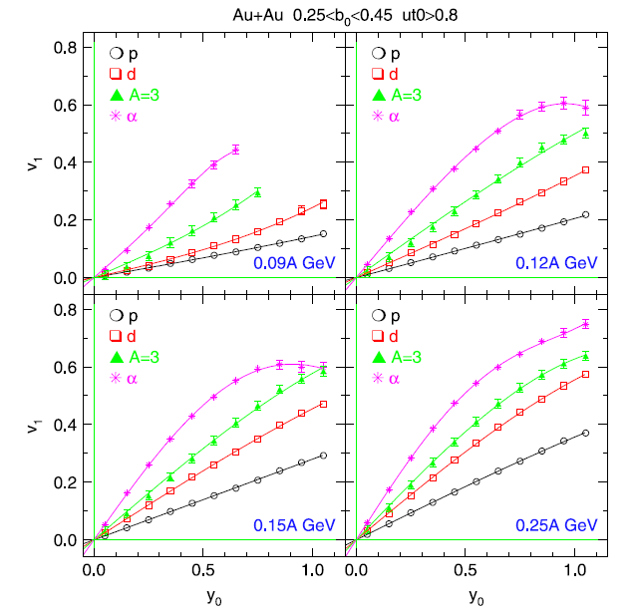
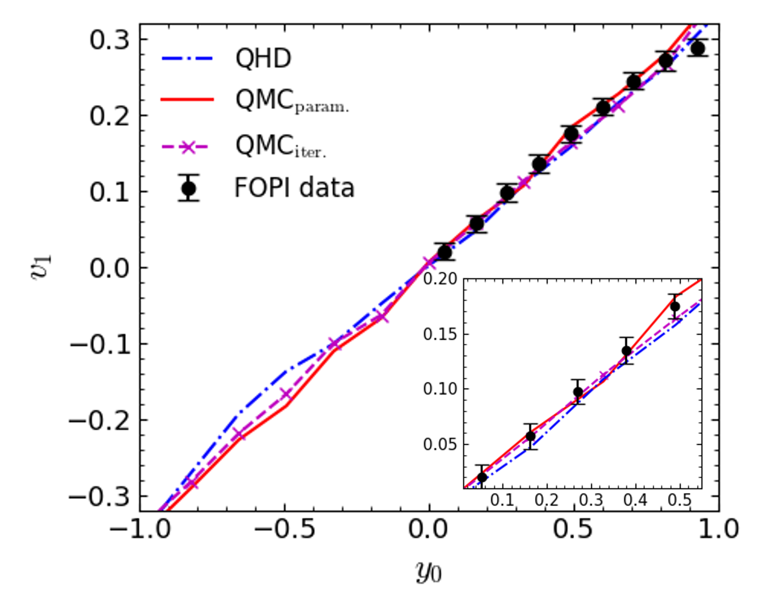
05
Directed Flow
Ref.) M.Kim et al. PRC 101 (2020) 064614
Directed flow
DJBUU+PDM
DJBUU+QMC
FOPI experimental data
Ref.) D.I.Kim in preparation

Slide 21
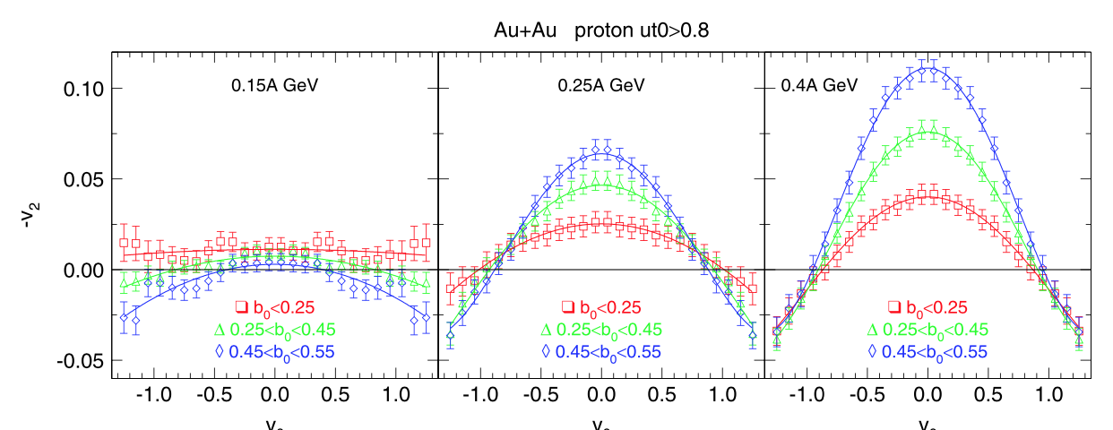
05
Elliptic Flow
FOPI NPA 876 (2012)

Slide 22
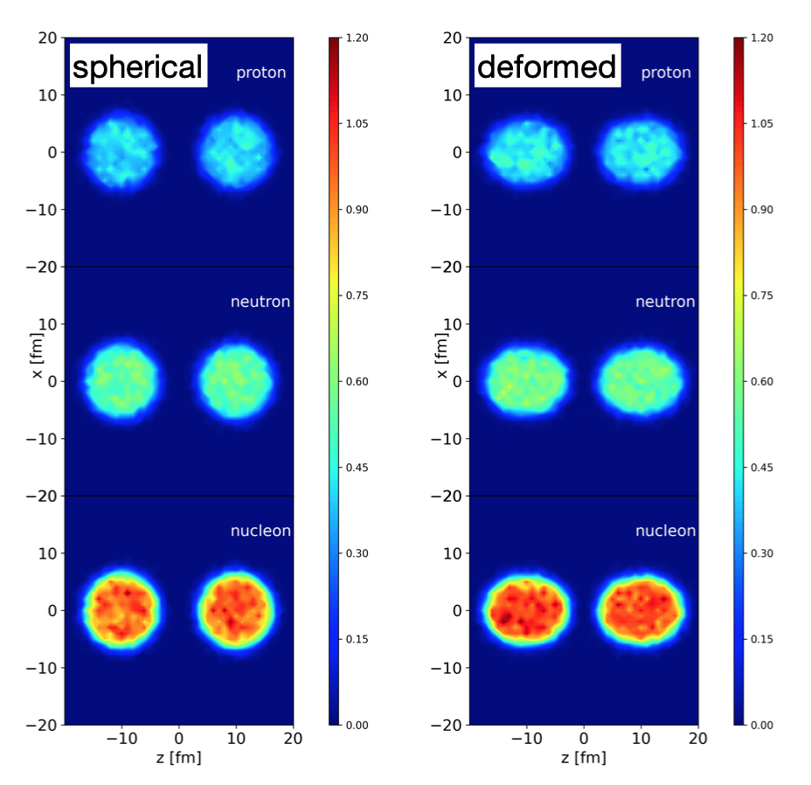

06
Results - Deformed Nuclei

Slide 23

06
Results – Au+Au

Slide 24

06
Results - Au+Au
¹⁹⁷Au+ ¹⁹⁷Au at E_{beam} = 250MeV/n
The beam energy is 250MeV/n for comparison with FOPI experimental data.
# of test particles = 100
The impact parameter is chosen as 2fm for comparison with b₀<0.25 (~3fm)
The slope is stiffer than the experimental data.
Preliminary

Slide 25

06
Results – Au+Au
¹⁹⁷Au+ ¹⁹⁷Au at E_{beam} = 250MeV/n
The beam energy is 250MeV/n for comparison with FOPI experimental data.
# of test particles = 100
The impact parameter is chosen as 2fm for comparison with b₀<0.25 (~3fm)
The slope is stiffer than the experimental data.
Preliminary

Slide 26

06
Results – Er+Er

Slide 27

06
Results – Er+Er
¹⁶⁸Er is a very deformed nuclei in stable nuclei.
(𝛃₂ ~ 0.3)
The beam energy is 250MeV/n for comparison with Au+Au collisions.
# of test particles = 100
Since the impact parameter is 0fm (Ultra-central collision), v₁=0 is expected.
Preliminary

Slide 28

06
Results – Er+Er
Elliptic flow from ¹⁶⁸Er+ ¹⁶⁸Er at 250MeV/n
# of test particle = 100
Non-zero v₂ is expected.
Preliminary

Slide 29
06
Summary
DJBUU uses various relativistic mean field models, and it gives chances to glance at fundamental physical observables.
We investigate the effect of nuclei shapes in heavy-ion collisions at intermediate energies.
Flow observables show us the density distribution formed nuclear matter by heavy-ion collisions.
Since the effect of nuclei shape is relatively small, we need more precise analysis.

Slide 30
Thank you for your attention!

