Slide 1
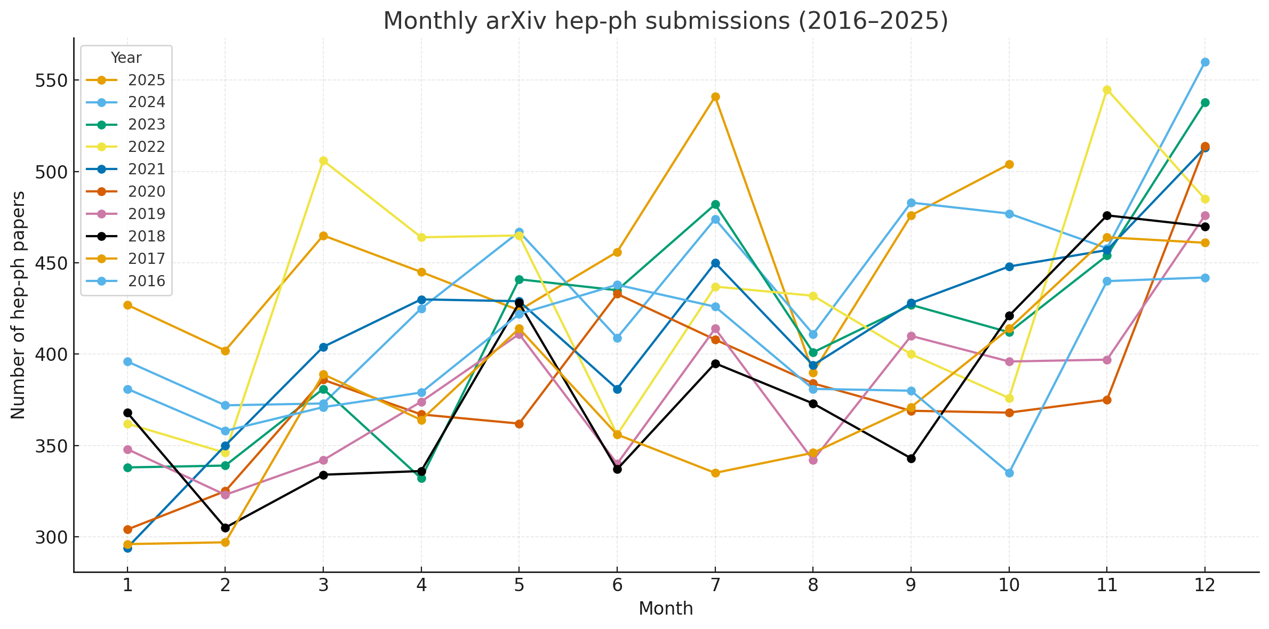

HEP-Phenomenology 2025
Jong-Chul Park
Dept. of Physics &
Inst. for Sciences of the Universe
2025 한국고에너지물리학회 & 핵-입자-천체분과 연합 워크샵
2025.11.22

Slide 2
Monthly HEP-Ph Submissions (2016-2025)

Slide 3
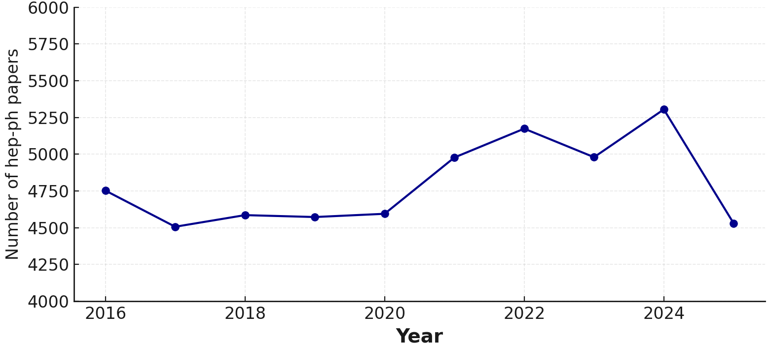
Yearly HEP-Ph Submissions (2016-2025)
?

Slide 4
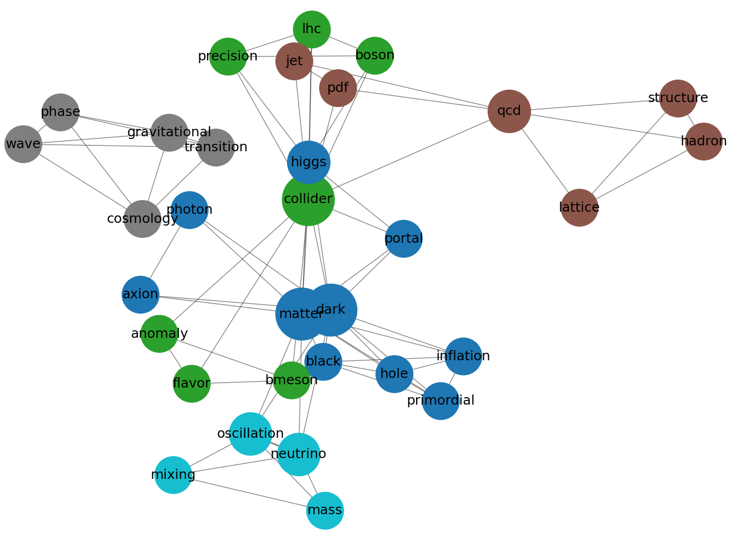

Key Words in HEP-Ph 2025
Not Real!

Slide 5
Dark Matter/Sector

Slide 6
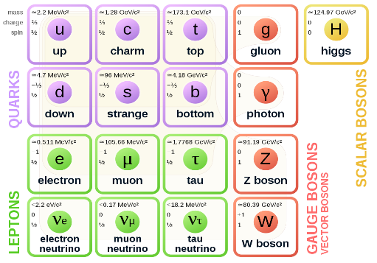
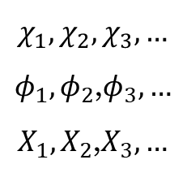
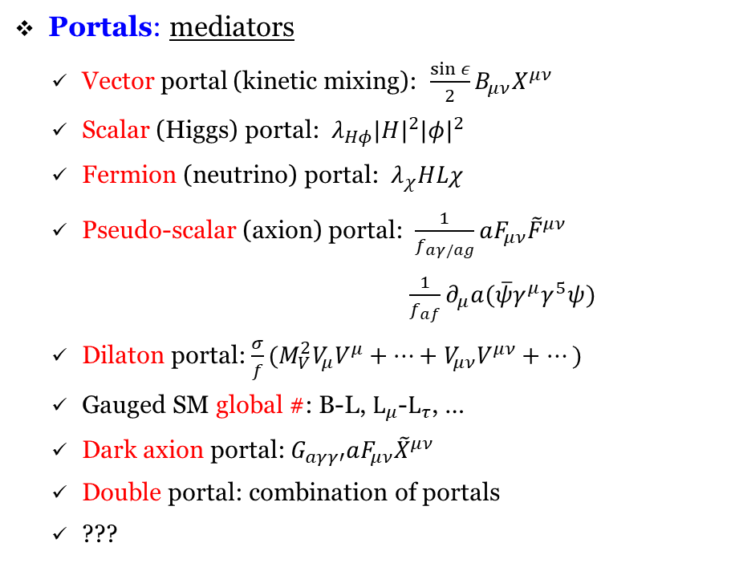
Dark Sector: Dark Particles & Portals
Dark sector
$$χ_{1},χ_{2},χ_{3}, …$$
$φ_{1},φ_{2}$,$φ_{3}, …$
$X_{1},X_{2}$,$X_{3}, …$
Portal
Multiple stable & unstable particles, Various interactions
Multiple stable & unstable particles, Various interactions?
Portals: mediators
  Vector portal (kinetic mixing): $\frac{\sin{ε}}{2}B_{μν}X^{μν}$
  Scalar (Higgs) portal: ${λ_{Hφ}|H|}^{2}{|φ|}^{2}$
  Fermion (neutrino) portal: $λ_{χ}HLχ$
  Pseudo-scalar (axion) portal: $\frac{1}{f_{aγ/ag}}aF_{μν}{\tilde{F}}^{μν}$
  $\frac{1}{f_{af}}∂_{μ}a(\overline{ψ}γ^{μ}γ^{5}ψ)$
  Dilaton portal: $\frac{σ}{f}(M_{V}^{2}V_{μ}V^{μ}+…+V_{μν}V^{μν}+…)$
  Gauged SM global #: B-L, $L_{μ}$-$L_{τ}$, …
  Dark axion portal: $G_{aγγ′}aF_{μν}{\tilde{X}}^{μν}$
  Double portal: combination of portals
  ???
Dark sector particles
  DM spin: fermion, scalar, vector
  DM species: single-/two-/multi-component
  DM mass: light, heavy, light & heavy
  DM interaction: flavor-conserving (elastic),
  flavor-changing (inelastic)
  ???
SM
sector
[Kaneta, Lee, Yun (2016)]
[Belanger, Goudelis, JCP (2013)]

Slide 7
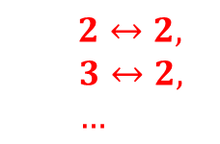
Various Ideas for DM
Various mechanisms for DM relic determination:
Self-interaction can be strong
Maybe unstable
  Assisted freeze-out [Belanger & JCP, 1112.4491]
  Asymmetric dark matter [0901.4117]
  Cannibal dark matter [1602.04219; 1607.03108]
  Co-annihilation [PRD43 (1991) 3191]
  Co-decaying dark matter [Bandyopadhyay, Chun, JCP, 1105.1652; 1607.03110]
  Continuum dark matter [2105.07035]
  Co-scattering mechanism [1705.08450]
  Dynamical dark matter [1106.4546]
  ELastically DEcoupling Relic (ELDER) [1512.04545]
  Freeze-in [0911.1120]
  Forbidden channels [PRD43 (1991) 3191; 1505.07107]
  Inverse decay dark matter [2111.14857]
  Pandemic dark matter [2103.16572]
  Semi-annihilation [0811.0172; 1003.5912]
  Strongly Interacting Massive Particle (SIMP) [1402.5143; 1702.07860]
  …
Self-interaction can be strong
DM1
can be strong
DM2
…
can be very weak
SM
χ
χ/ψ/X/φ
χ/ψ
χ/ψ/X/φ
$2↔2,$
$$3↔2,$$
$$…$$
…
…

Slide 8
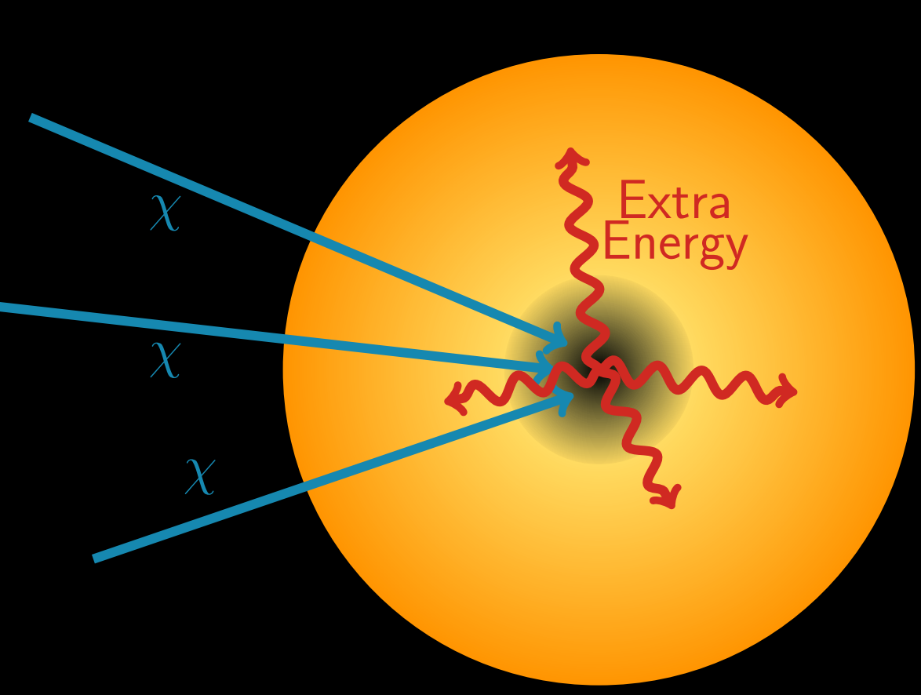
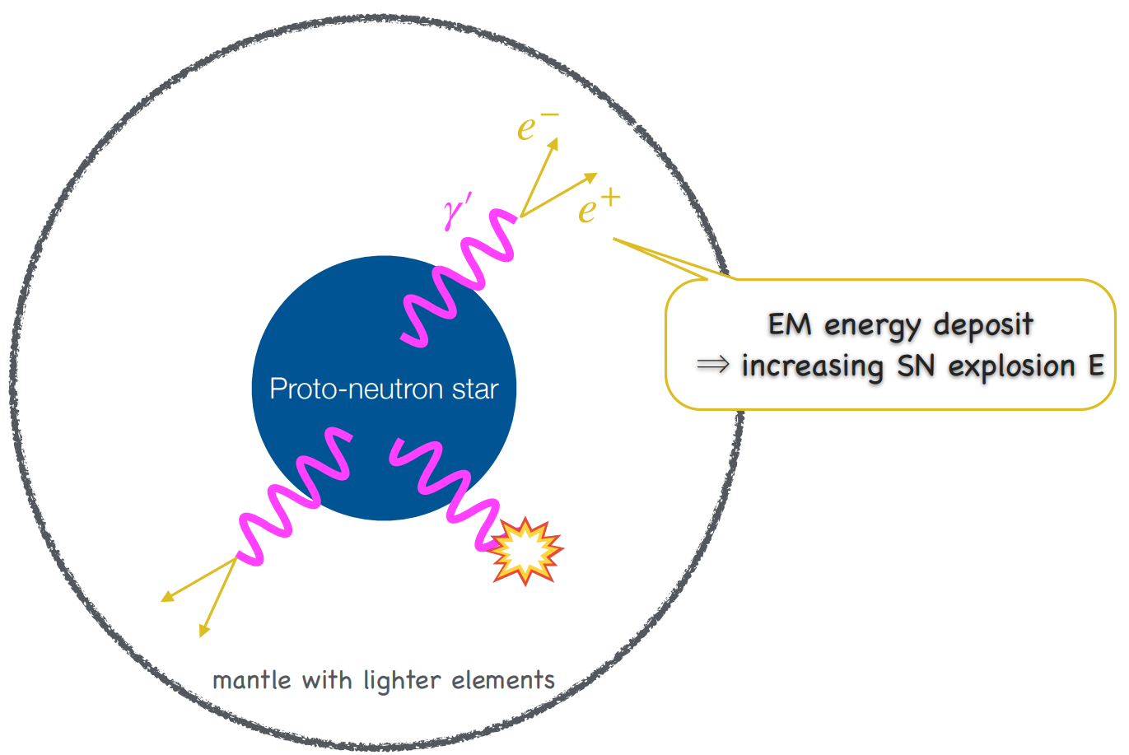
Dark Sector Particles & Astrophysical Objects
Tim Linden (2025)
Seokhoon Yun @ SI 2025
Notes:
DM capture by RG ➔ additional E ➔ T increase

Slide 9
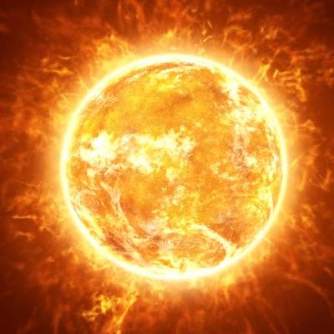
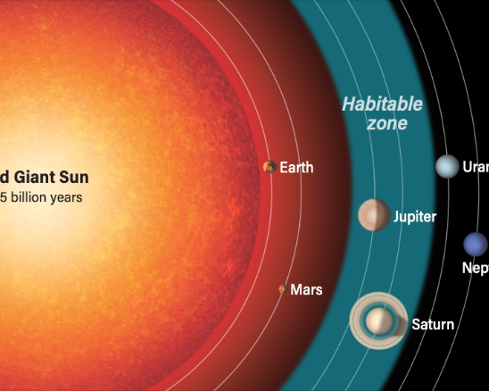
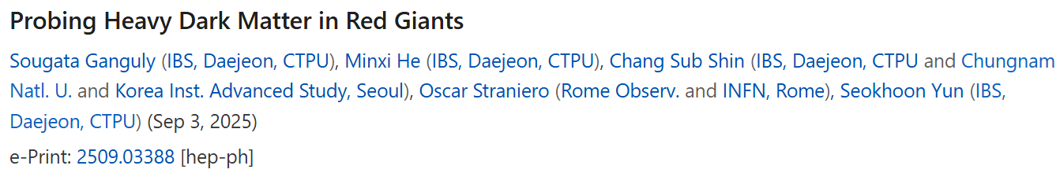
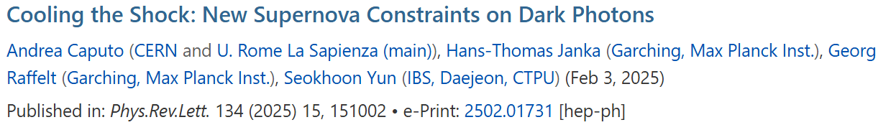
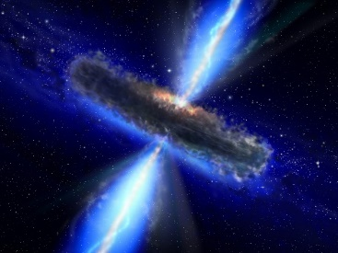
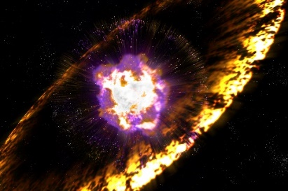
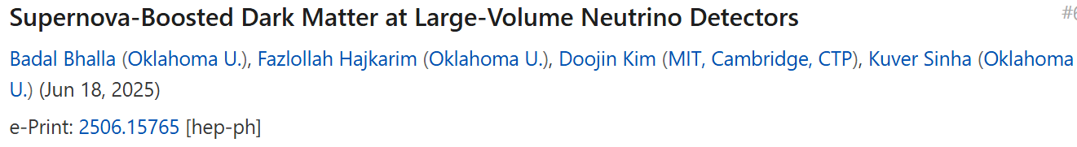
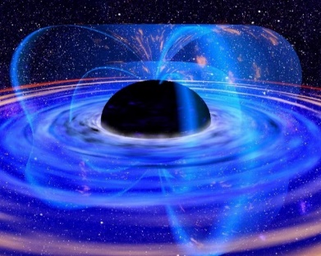
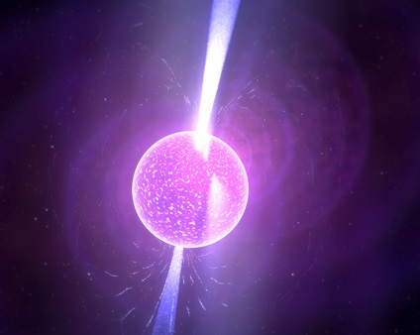
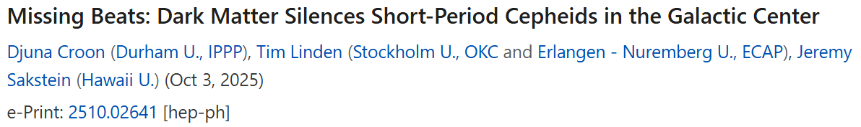
Dark Sector Particles & Astrophysical Objects
* Seokhoon (Thu.) & Ki-Young (Today)
Notes:
DM capture by RG ➔ additional E ➔ T increase

Slide 10
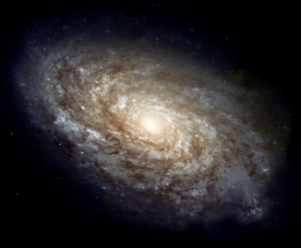

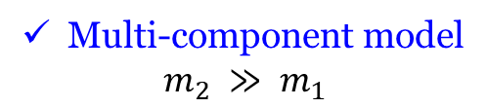
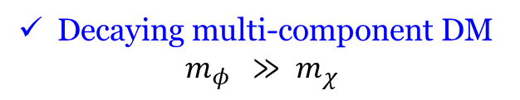


BDM Mechanisms: Dark Sector
Boosted DM (BDM) coming from the Universe
$$χ_{0}$$
$$χ$$
[Belanger & JCP, JCAP (2012); Agashe et al., JCAP ($2014$);
Kong, Mohlabeng, JCP, PLB (2015); Berger et al., JCAP (2015);
Kim, JCP, Shin, PRL (2017);
more]
$$χ_{1}$$
$$χ$$
[D’Eramo & Thaler, JHEP (2010);
Berger et al., JCAP (2015); more]
$$χ_{0}$$
$$χ_{1}$$
$$χ$$
$$X$$
Multi-component model
$$m_{2} ≫ m_{1}$$
Semi-annihilation model
$$m_{χ} ≫ m_{X}$$
Large $E_{k}^{DM}$ (monochromatic) due to mass gap
$$χ$$
$$φ$$
[Bhattacharya et al., JCAP (2015); Kopp et al., JHEP (2015);
Cline et al., PRD (2019);
Heurtier, Kim, JCP, Shin, PRD (2019); more]
$$χ$$
Decaying multi-component DM
$$m_{φ } ≫ m_{χ}$$
Relic component DM: Non-relativistic!
Only Tiny fraction of DM: Relativistic!

Slide 11

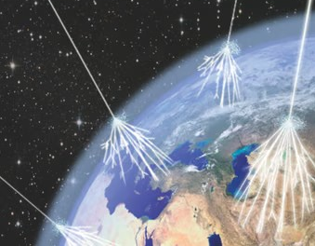

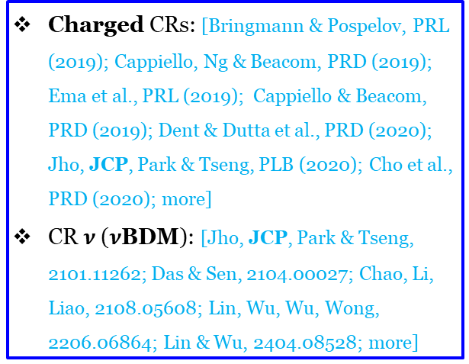


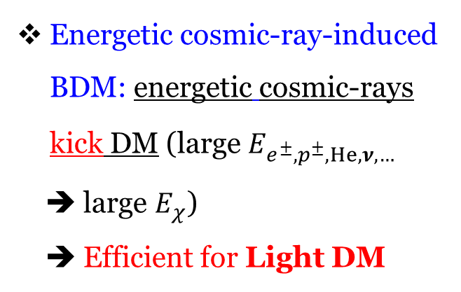
BDM Mechanisms: Cosmic-Rays (CRs)
Charged CRs: [Bringmann & Pospelov, PRL (2019); Cappiello, Ng & Beacom, PRD (2019); Ema et al., PRL (2019); Cappiello & Beacom, PRD (2019); Dent & Dutta et al., PRD (2020); Jho, JCP, Park & Tseng, PLB (2020); Cho et al., PRD (2020); more]
  CR $ν$ ($ν$BDM): [Jho, JCP, Park & Tseng, 2101.11262; Das & Sen, 2104.00027; Chao, Li, Liao, 2108.05608; Lin, Wu, Wu, Wong, 2206.06864; Lin & Wu, 2404.08528; more]
Cosmic-Ray-Induced BDM
$e^{±}, p^{±},He,ν$,
$$…$$
$$e^{±}, p^{±},He,ν,…$$
•
•
$$χ$$
$$χ$$
From astrophysical processes:
Solar evaporation - Kouvaris, PRD (2015)
Dark cosmic rays - Hu +, PLB (2017)
Solar reflection - An +, PRL (2018)
Solar acceleration - Emken +, PRD (2018)
Supernova - DeRocco +, PRD (2019)
Atmospheric collider - Alvey+, PRL (2019)
Earth attraction – Davoudiasl + PRD (2020); Acevedo + JHEP (2024)
PBH evaporation - Calabrese +, PRD (2022)
Blazar jets - Wang +, PRL (2022); more
Energetic cosmic-ray-induced BDM: energetic cosmic-rays kick DM (large $E_{e^{±}, p^{±},He,ν,… }$
➔ large $E_{χ}$)
➔ Efficient for Light DM
$$e^{±}, p^{±},He,ν…$$
$$χ$$

Slide 12
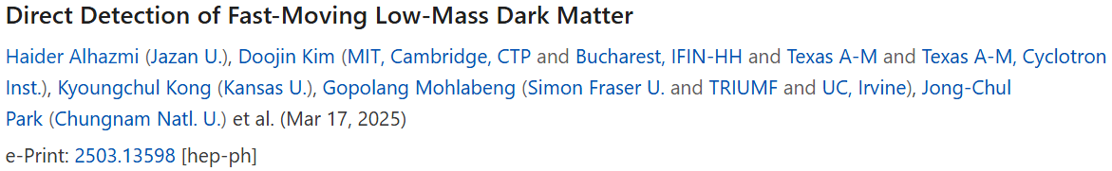
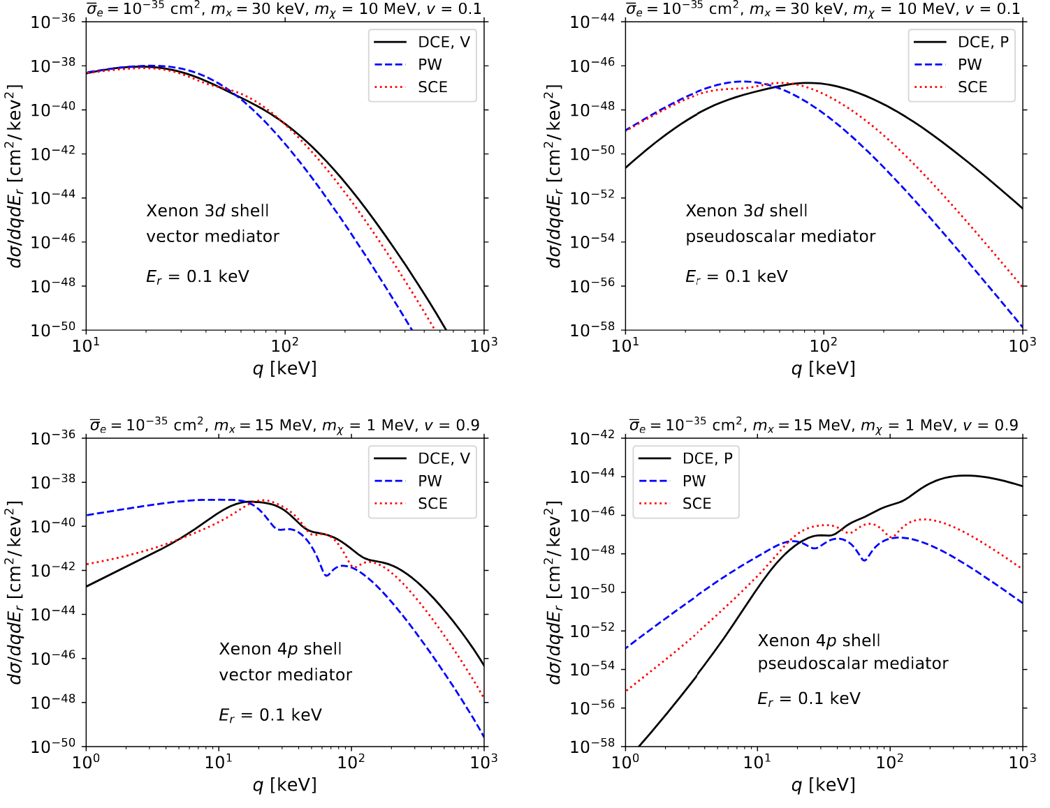

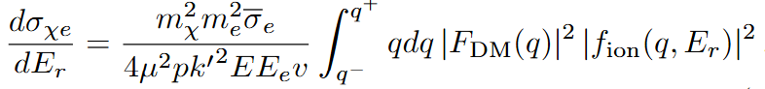
BDM
Revisit & extend the atomic ionization formalism, systematically comparing different approaches used to formulate the ionization form factor
Notes:
Relativistic (DCE: Dirac Continuous E) & non-relativistic (PW & SCE: Schrodinger Continuous E) treatments result in similar-shaped distributions. Both treatments peak at the same location and exhibit a similar declining trend, w/ the relativistic treatment dominating at high q transfer.
Peudoscalar mediator: distinct differences between the two treatments. The relativistic treatment peaks at higher momentum transfer, due to the q dependence of the matrix element, and displays a rising behavior in regions where the non-relativistic (PW and SCE) treatment shows a declining trend.

Slide 13
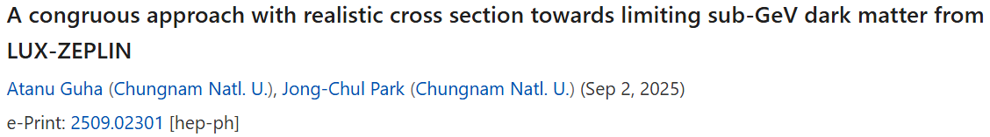
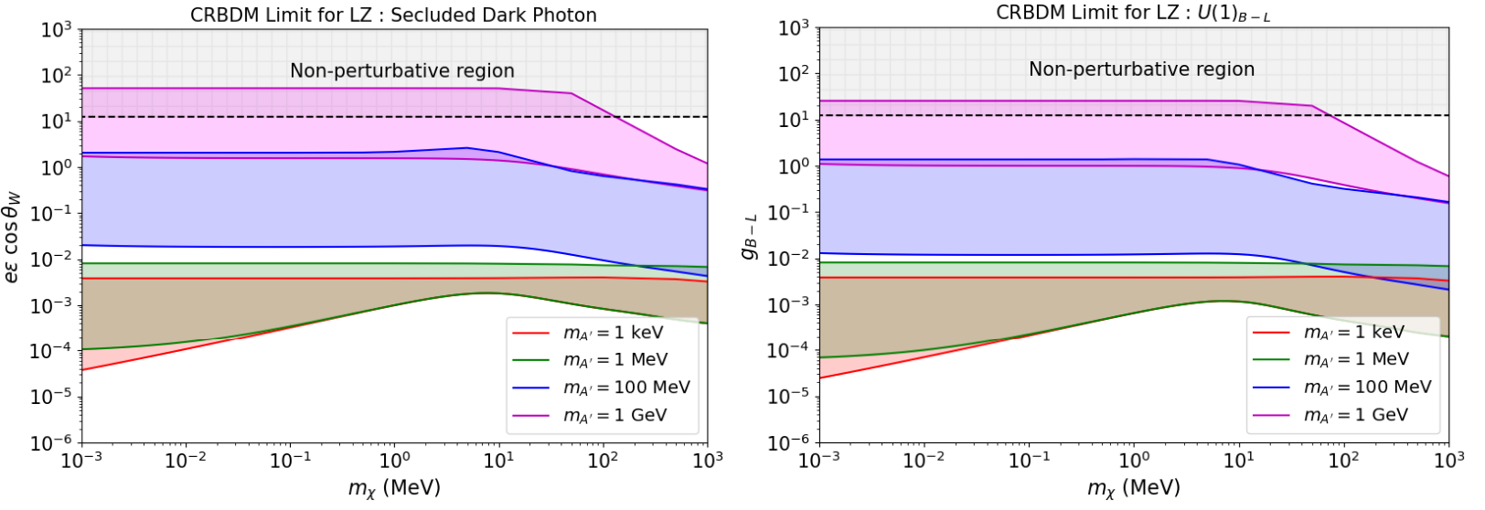
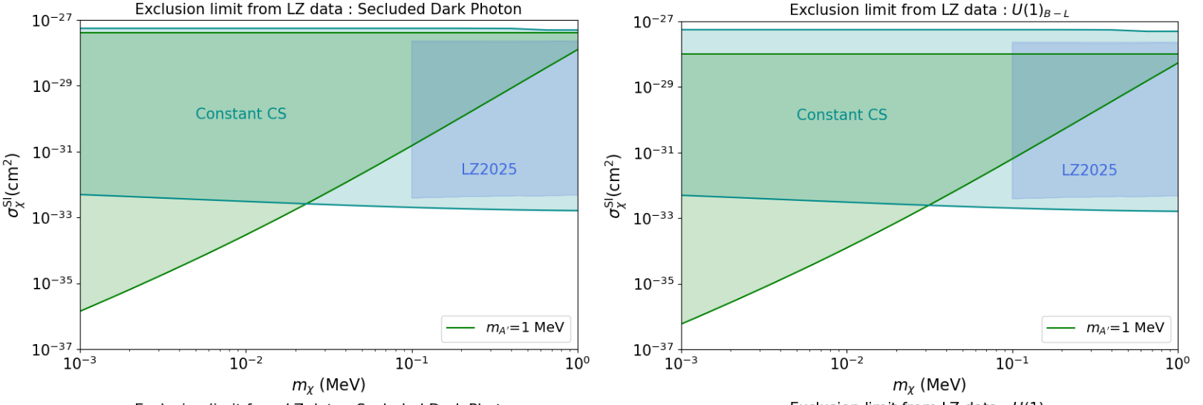
BDM
Limits on CR-BDM w/ realistic cross section using the nuclear recoil data from the LZ experiment
Notes:
nuclear recoil data from the LUX-ZEPLIN (LZ) experiment

Slide 14
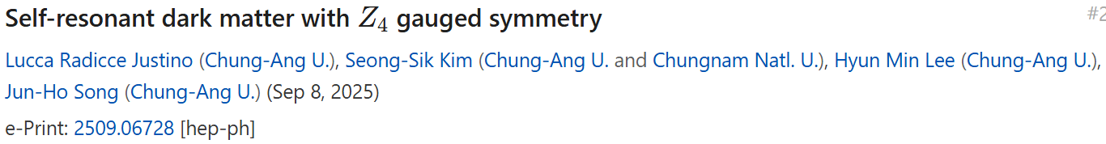
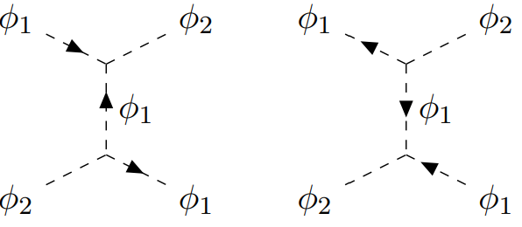
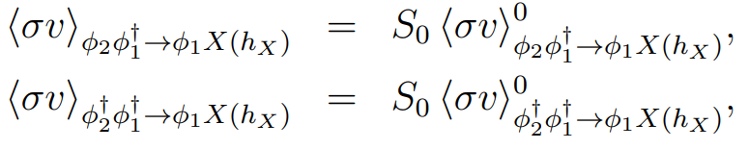
BDM
Two-component scalar DM: the elastic co-scattering processes are enhanced for the lighter DM mediator ➔ to explain the small-scale problems at galaxies.
BDM from semi-annihilation processes
Notes:
Two-component scalar DM. When the resonance condition for DM masses is fulfilled, the elastic co-scattering processes between two components of DM (u-channel processes) are enhanced due to the Yukawa potential with a small effective mass for the lighter DM mediator, so we can use such co-scattering processes for DM to explain the small-scale problems at galaxies.

Slide 15
Neutrino

Slide 16
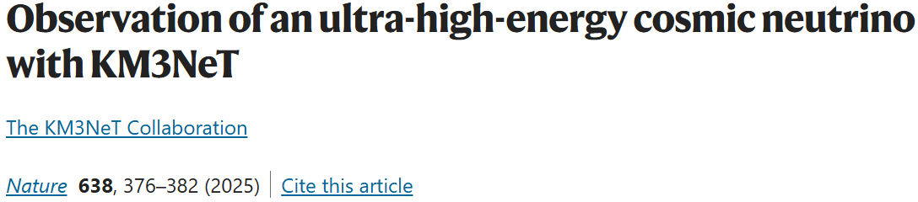
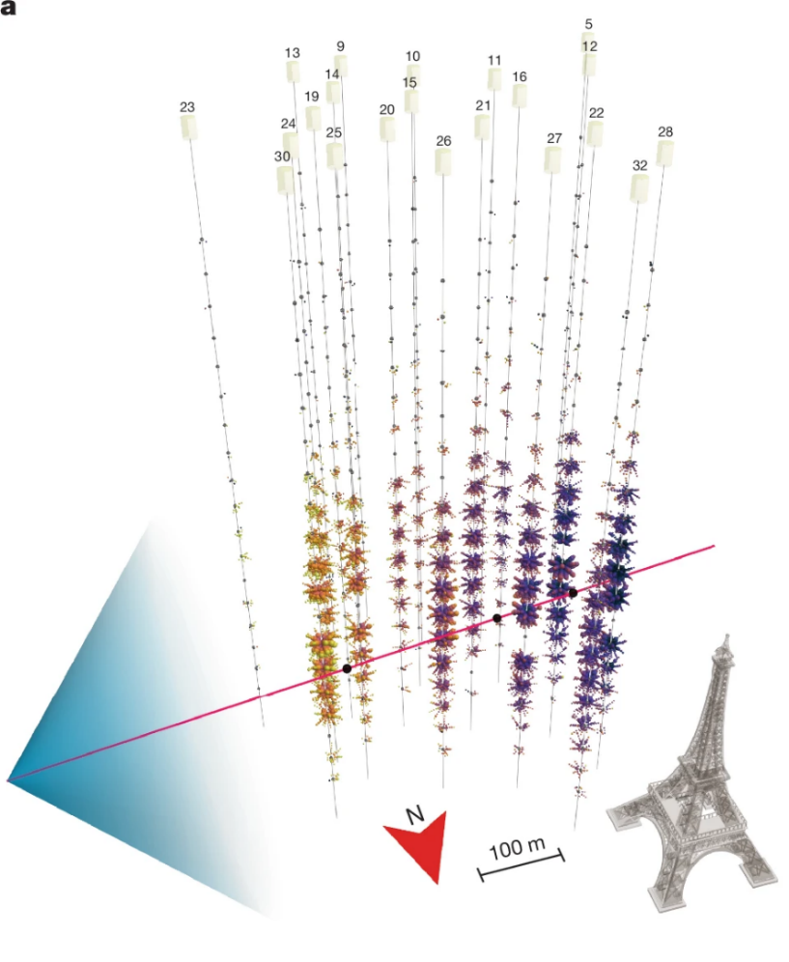
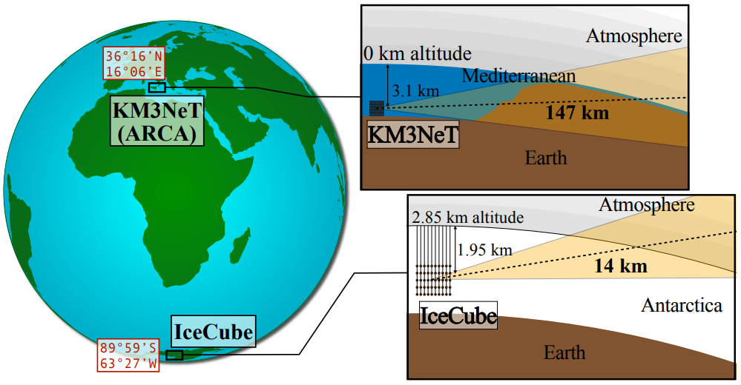
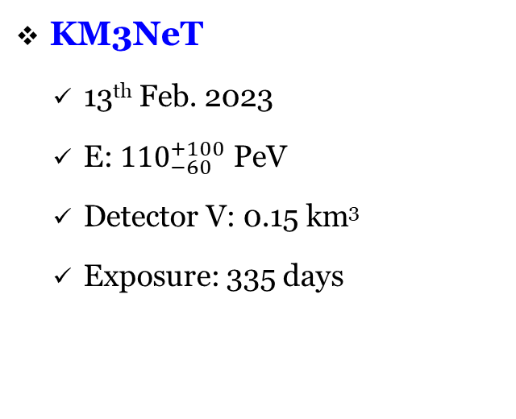
KM3NeT vs IceCube
IceCube
  No evnet
  Detector V: 1 km³
  Exposure: 10 years
KM3NeT
  13th Feb. 2023
  E: ${110}_{−60}^{+100}$ PeV
  Detector V: 0.15 km³
  Exposure: 335 days
Brdar, Chattopadhyay [2502.21299]
Notes:
2 − 3.5𝜎 Tension with IceCube, depending on the neutrino source
Exponentially suppressed by Earth's shielding = overburden: ∼ 10 times more at KM3NeT.
Muon neutrino?

Slide 17
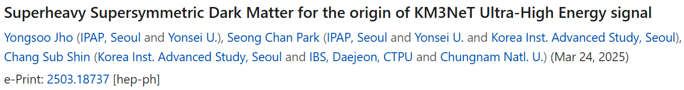
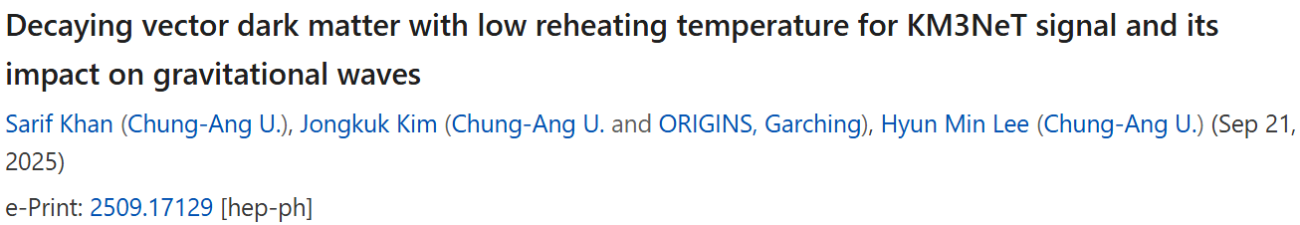
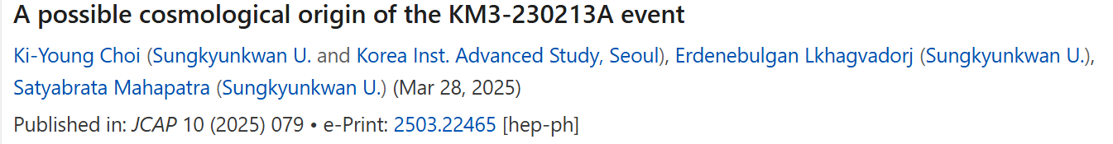
KM3NeT: SM Neutrino or BSM?
SM Neutrino?
  2 − 3.5𝜎 Tension with IceCube, depending on the neutrino source
  Exponentially suppressed by Earth's shielding = overburden: ∼ 10 times more at KM3NeT
Very Unlikely!
BSM?
  Superheavy DM
  Energetic DM
  Superheavy neutrino
Notes:
Muon neutrino?
In producing the SHDM, the normal FO mechanism fails due to overproduction, and the FI mechanism demands a very tiny gauge coupling value. To overcome these, we need to reduce the DM abundance and one of the mechanisms is through the entropy injection when the inflaton decays to the SM bath in a low reheating scenario.
Ultra-high E neutrinos originate from the decay of a super-heavy sterile neutrino produced via the Hawking evaporation of PBHs in the early Universe

Slide 18
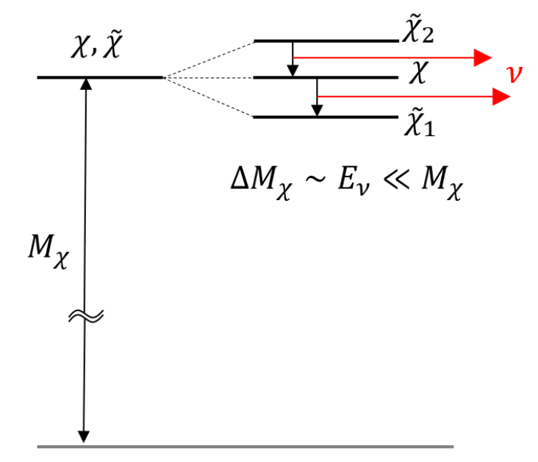
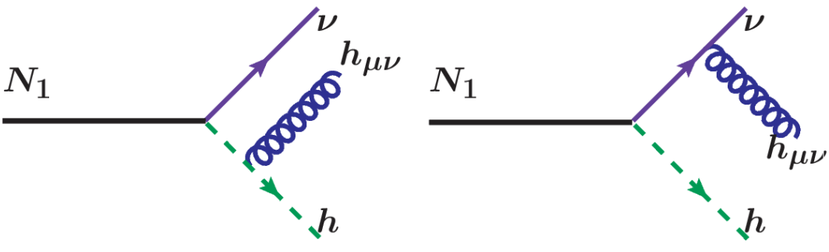
KM3NeT: $ν$ from SuperHeavy State Decay

Slide 19
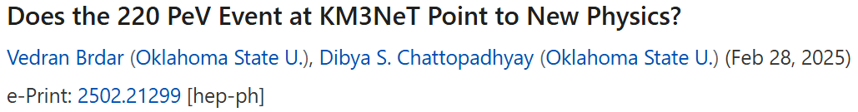
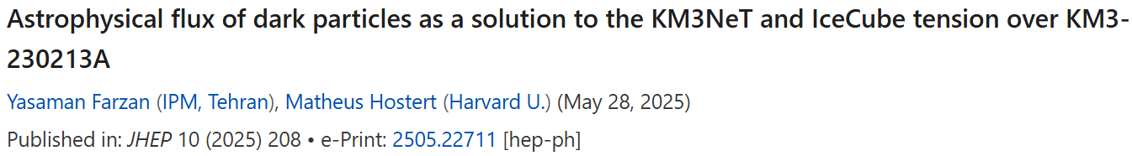
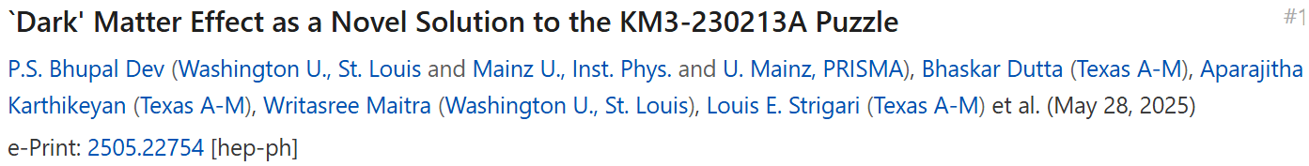

KM3NeT: Earth Matter Effect
Use Earth matter effect to address the tension
  Sterile neutrino oscillations to $ν_{μ}$ inside the Earth
  Dark matter scattering to a muonphilic intermediate state inside Earth
Notes:
Dark matter scattering to a muonphilic intermediate state inside Earth

Slide 20
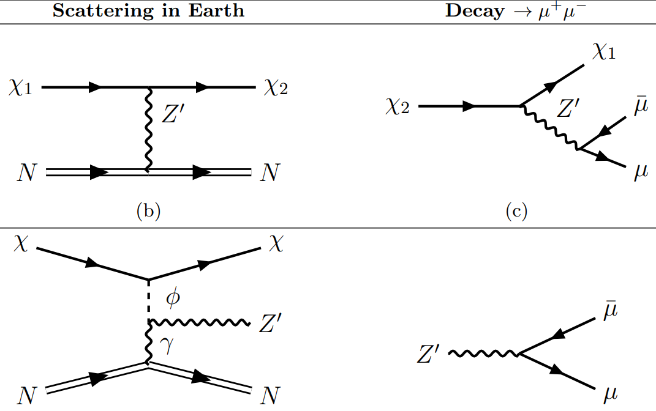
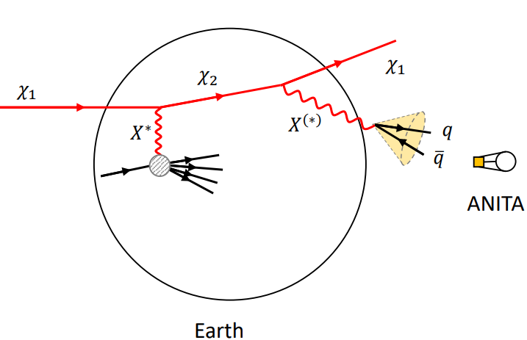
KM3NeT: Earth Matter Effect
iBDM [Kim, JCP, Shin, PRL (2017)]
ANITA EeV Anomaly [Heurtier, Kim, JCP, Shin, PRD (2019)]

Slide 21
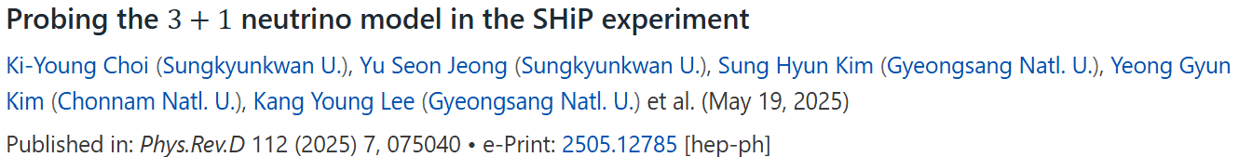

Sterile $ν$ @ SHiP
Short-baseline oscillation from a dual baseline approach: two SND @ 27 m & 120 m
Notes:
estimate the sensitivity of the Search for Hidden Particles (SHiP) experiment to the 3+1 model using the CC DIS event spectrum.
short-baseline oscillation: A dual baseline approach by suggesting Far SND (FSND) at 120 m with Near SND (NSND) at 27 m.

Slide 22



Neutrino NSI
Combination of low- and high-E experiments
Neutrino emission from SN
Notes:
The impact of new physics on the interactions of neutrinos with other particles can be parametrized by a set of effective 4-fermion operators called neutrino NSIs. This NSI framework is useful for studying the complementarity between different types of neutrino experiments.
The combination of low- and high-E experiments results in a viable approach to break NSI degeneracies within the context of simplified models.
Since high-energy colliders often probe the mass scale associated with the four-fermion operators, the effective field theory approach becomes invalid and explicit models must be utilized.
The impact of NSI on SN neutrino emission

Slide 23
Astrophysics & Cosmology

Slide 24





Primordial Black Holes
Jho, Kim, JCP, S. C. Park, Y. Park (2022)
Significant isocurvature perturbations due to their biased clustering amplitude and the branching ratio of the Hawking radiation differing from the abundance ratio.
Effective chiral Lagrangian with a dilaton & pions. Curvature perturbations grow exponentially, producing copious PBHs and a stochastic GW background.
Ki-Young (Today)
Notes:
PBHs < 10^9 g, evaporated before BBN, can induce significant isocurvature perturbations due to their biased clustering amplitude and the branching ratio of the Hawking radiation differing from the abundance ratio.
investigate the production of primordial black holes and gravitational waves in composite hybrid inflation. Starting from an effective chiral Lagrangian with a dilaton and pions, we identify inflation occurring due to the walking dynamics of the theory. Curvature perturbations grow exponentially, producing copious PBHs and a stochastic GW background.

Slide 25

(ElectroWeak) Phase Transitions & GWs
Kai Schmitz (2021)

Slide 26




(ElectroWeak) Phase Transitions & GWs
Ki-Young (Today)

Slide 27
Collider, Higgs & ML

Slide 28




Higgs & Collider
Notes:
A first matching of the real SU(2)_L Higgs triplet extension of the SM to the Higgs effective field theory, hh→hh, WW→hh, ZZ→hh 산란에서 HEFT와 SMEFT 예측을 비교. 강한 전이(phase transition) 영역에서 SMEFT보다 HEFT가 더 적합함을 보임.

Slide 29




ML & Quantum
Sung Hak (Thu.)
“Quantum circuits provide a promising alternative: compared to conventional neural networks, they can achieve rich expressivity with fewer parameters, and the parameter-shift rule provides an exact analytic form for circuit gradients, ensuring precise optimization.”
Myeonghun (Thu.)
Notes:
A modular architecture called Analysis Model (AM) was developed as a deep learning framework tailored for jet classification. AM can be used to adjust the simulated event distribution with experimental measurements through event reweighting.
Detecting the radiative decay of very weakly interacting particles by leveraging the extreme sensitivity of quantum devices, such as superconducting transmon qubits and trapped ion systems, to faint electromagnetic signals.

Slide 30

Key Words in KHEP-Ph 2025?
Not Real!

