Slide 1
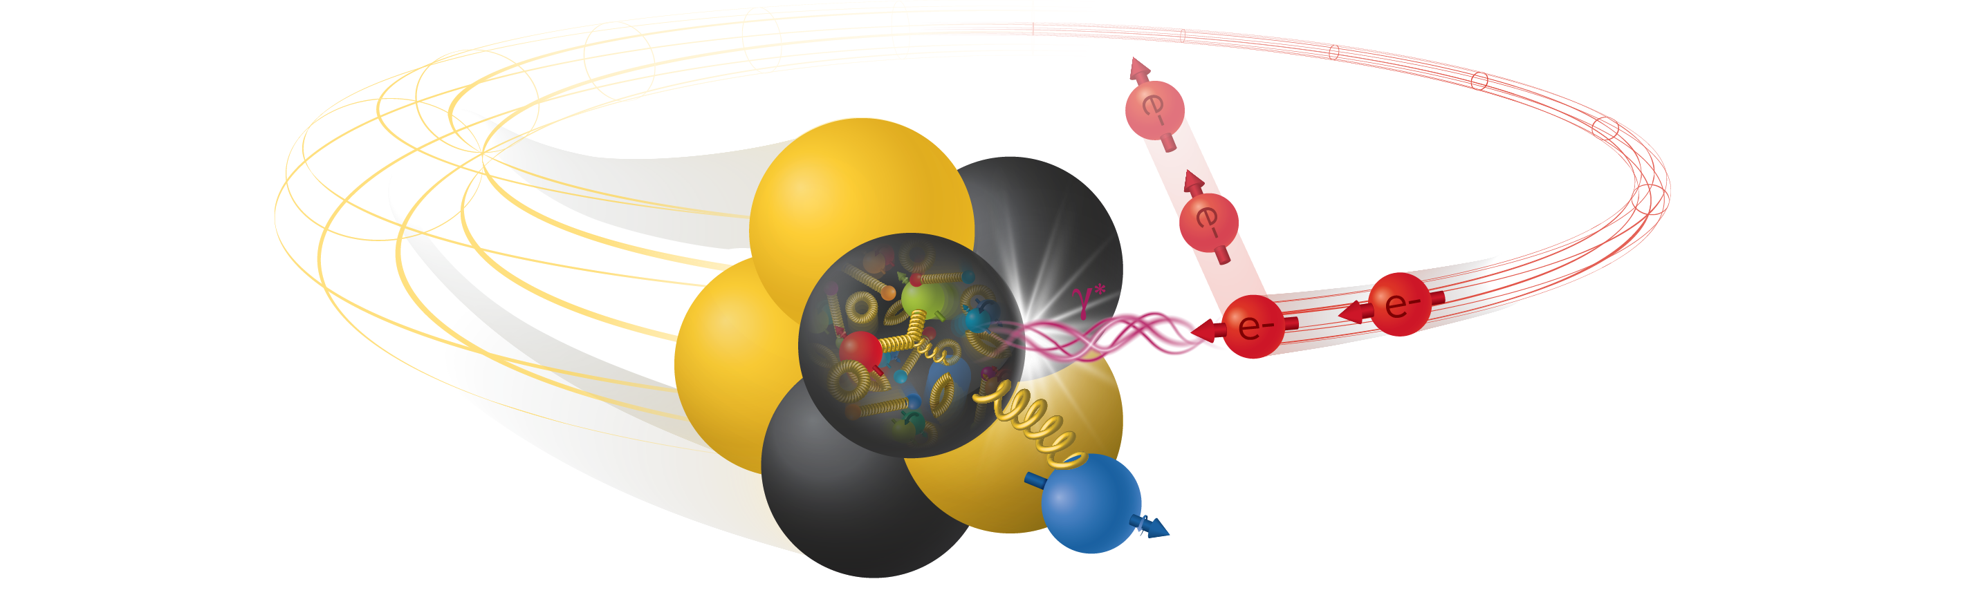


Electron-Ion Collider Phenomenology
Daekyoung Kang (Fudan U)
On behalf of EIC$φ$ collaboration
2025 KSHEP meeting, Chonman National University, Gwangju Korea, Nov 22 2025

Slide 2
Advertisement

Slide 3
Pre-Workshop School
First time ever in the history of the workshop!
let the incoming graduate students and young researchers learn and taste SCET and related subjects so that they can smoothly participate in the research
Lecturers:Mike Luke (U of Toronto): EFT’s from four-fermi theory to SCET
Thomas Becher (U of Bern): introduction to SCET
Xiangdong Ji (U of Maryland): lattice QCD
Chris Lee (LANL)
Adam Leibovich (U of Pittsburgh): TBA
Special request: a colloquium style (20-30 minutes) that attracts experimentalists
No registration fee + dormintory/hotel support
Zoom broadcast
Thanks for our sponsors: IBS-CTPU, KIAS, ko-ALICE, k-CMS, APCTP (tentative)
Google scet 2026 and register NOW!

Slide 4
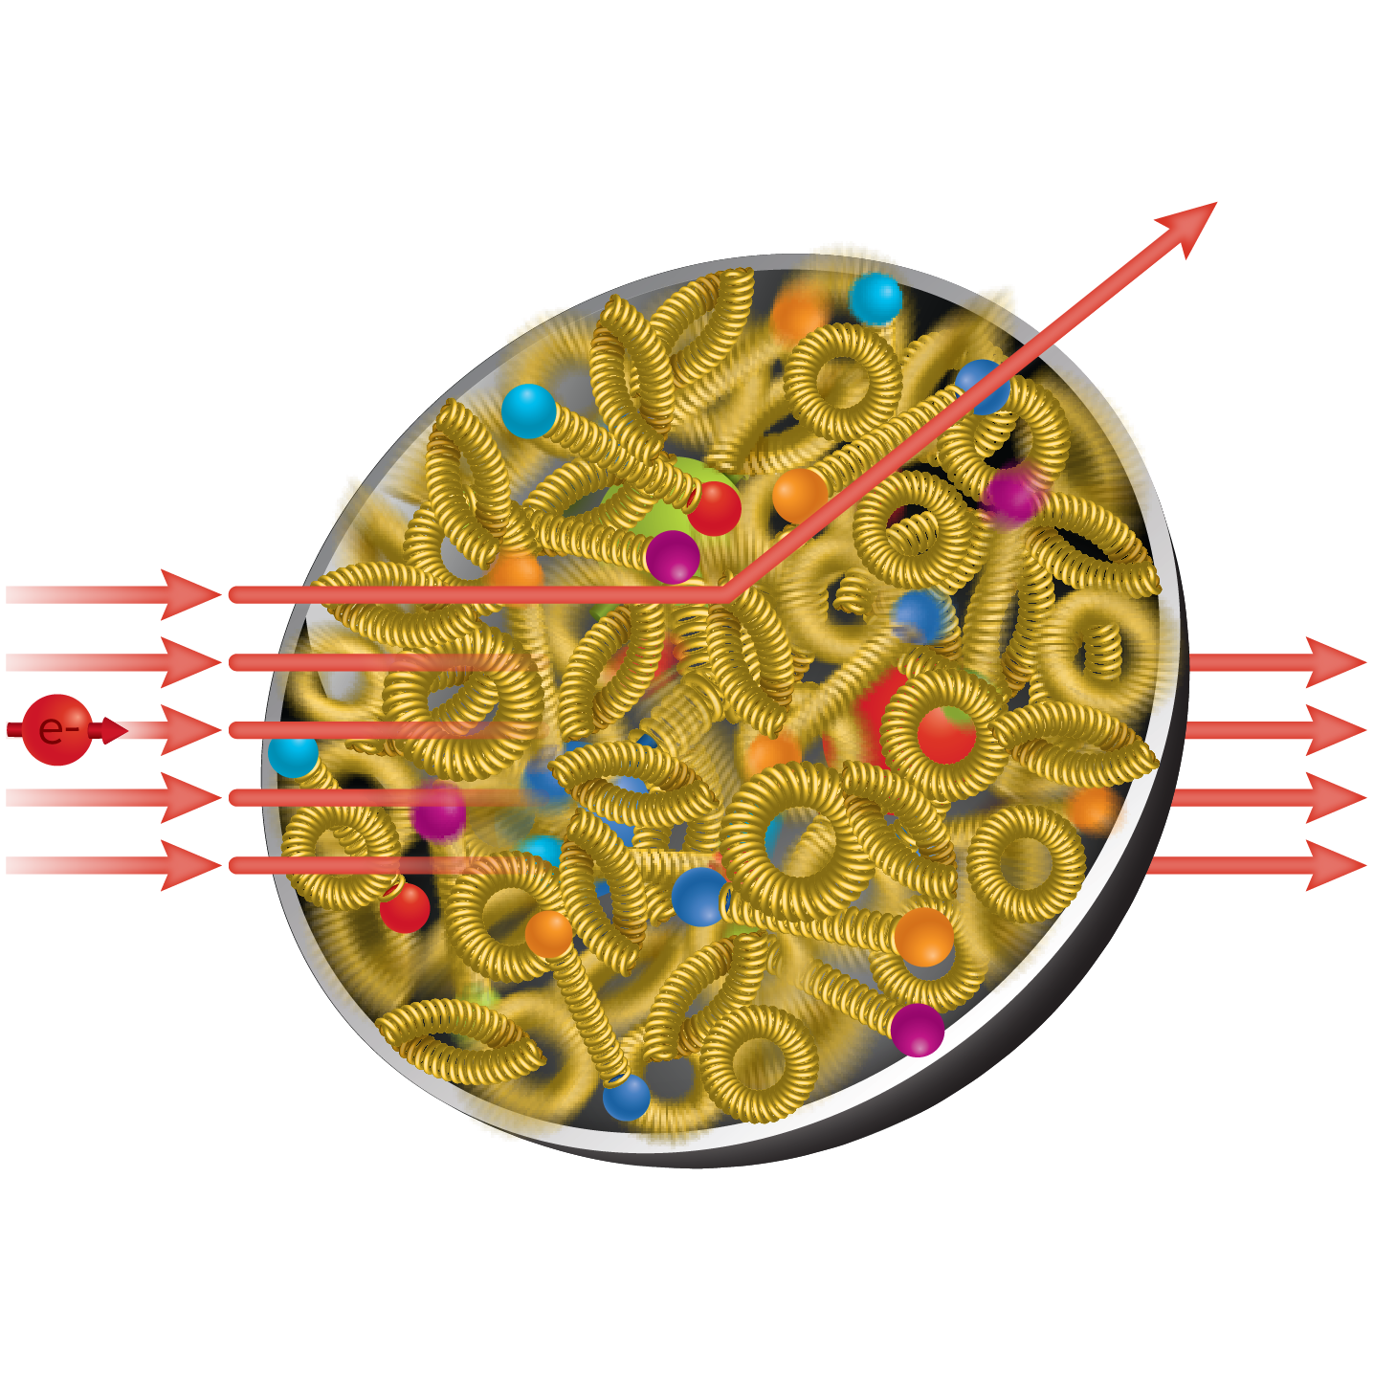
Electron-Ion Collider
probing nuclear structure

Slide 5
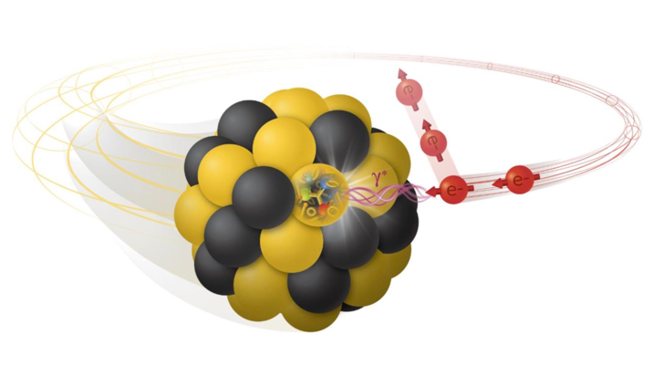
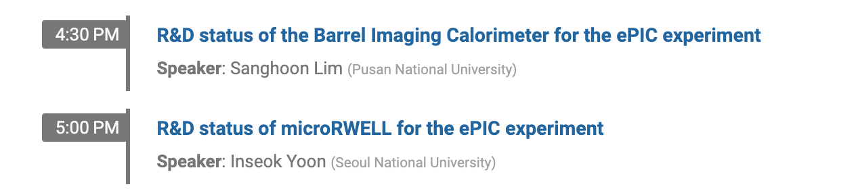
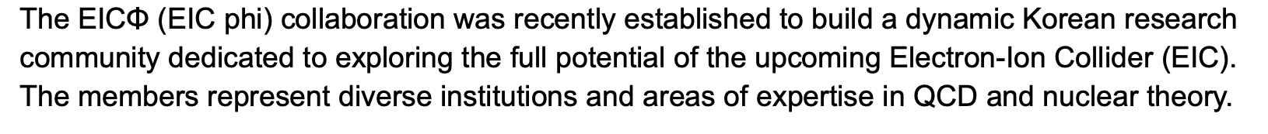
K-ePIC experiment
EIC𝜙 collaboration (theory)
newly formed in 2025 by Sejong, Korea, PKNU, GWNU, Seoul Tech, IBS-CTPU + overseas (Fudan, LLNL, MIT)

Slide 6
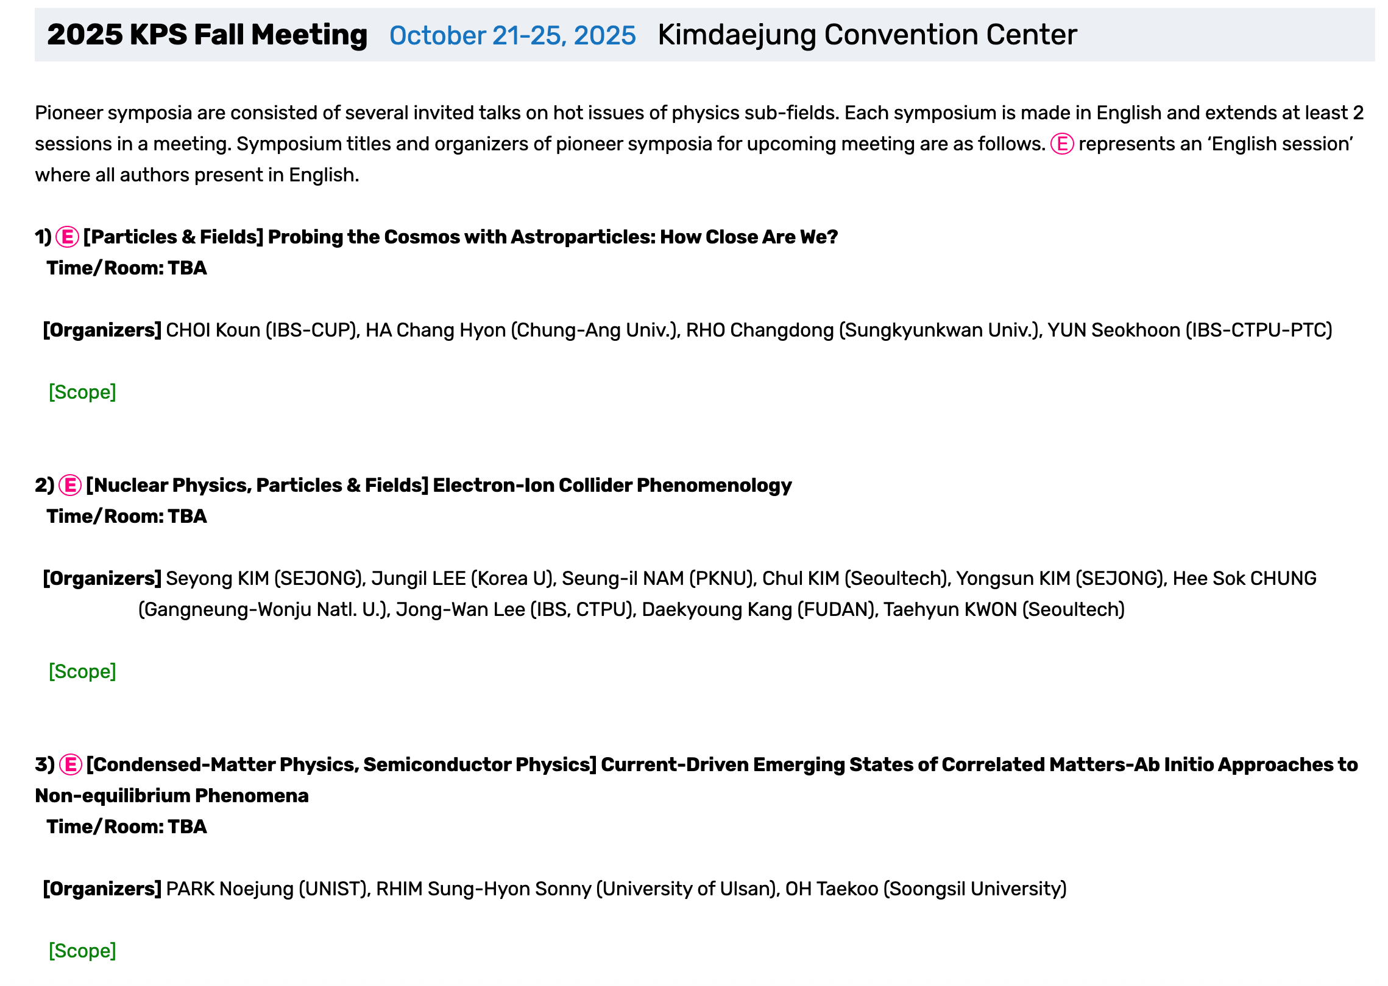
EIC𝜙 activity: Pioneer Symposium in KPS 2025

Slide 7
EIC𝜙 activity: Pioneer Symposium in KPS 2025

Slide 8
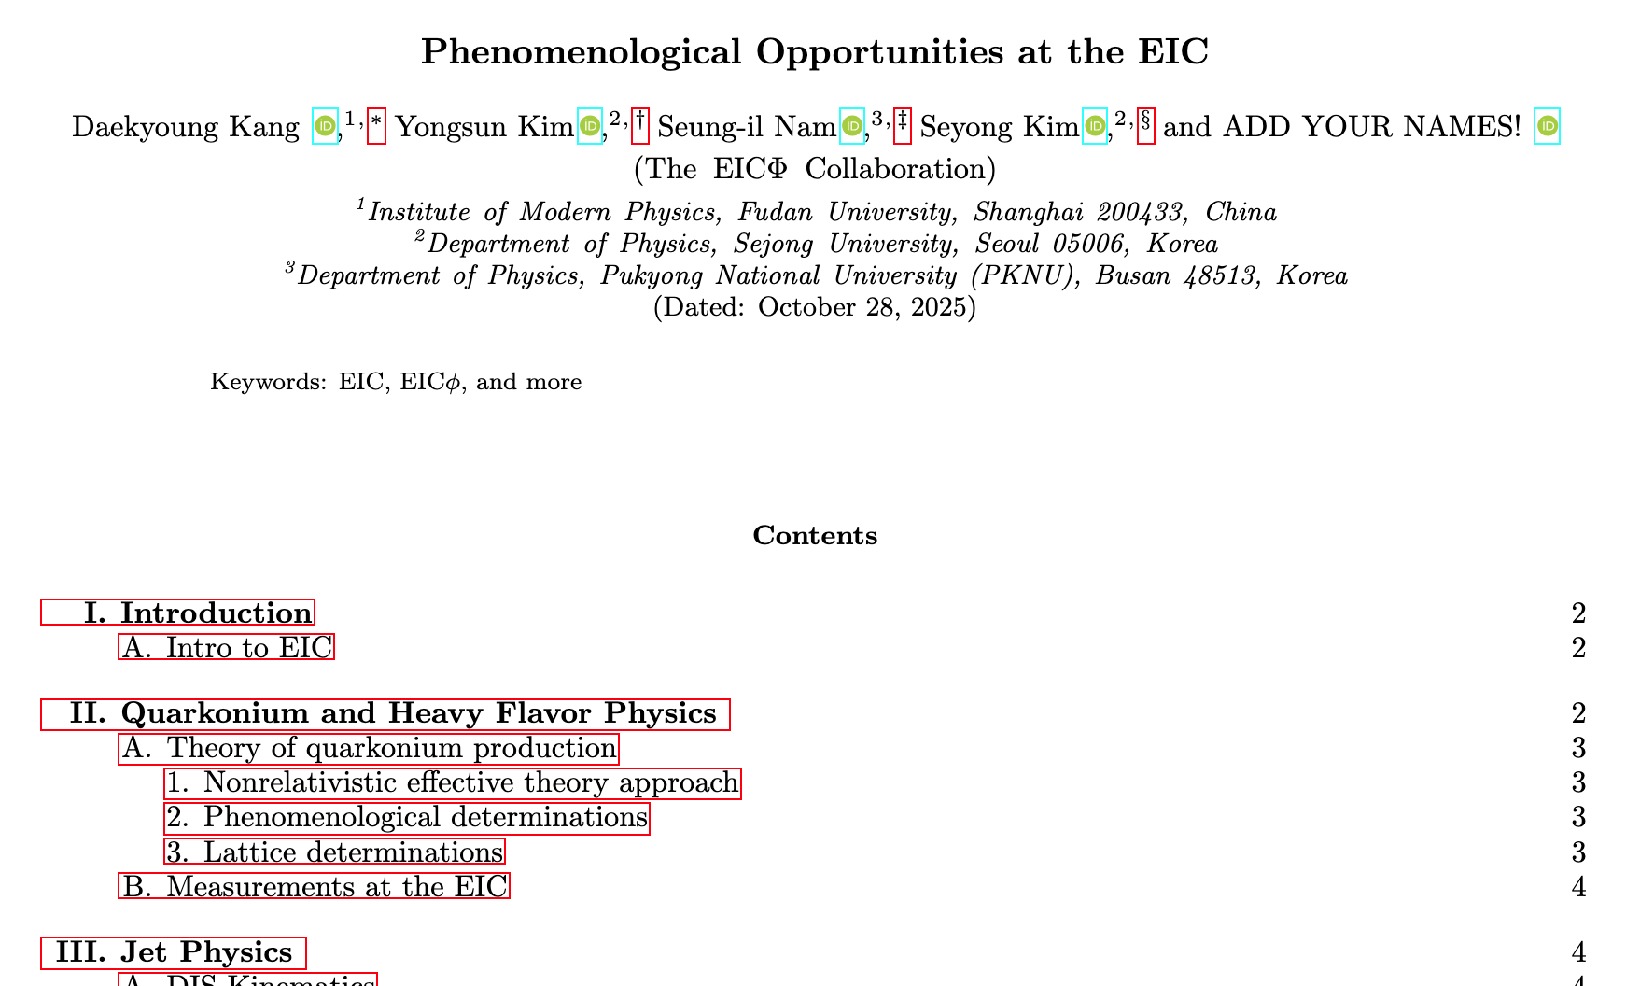
EIC𝜙 activity: Blueprint for the collaboration
Future plan (tentative): EIC school, Workshops, international exchange and collaboration program
Need support from Nuc/Hep/Astro community!

Slide 9


Slide 19
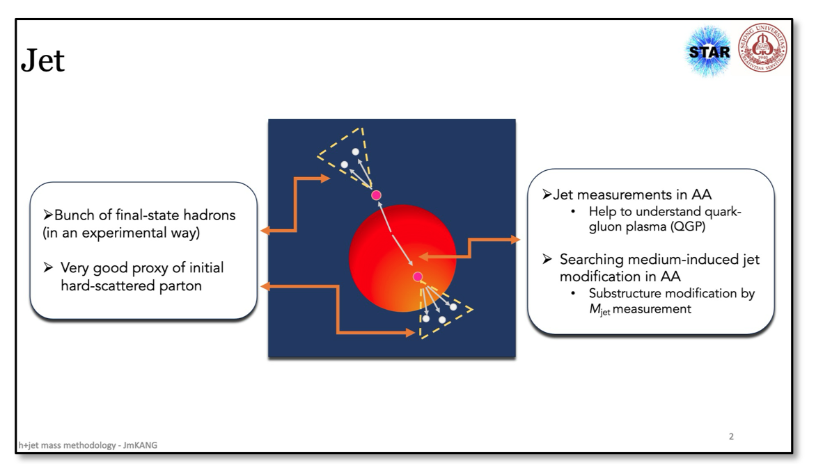
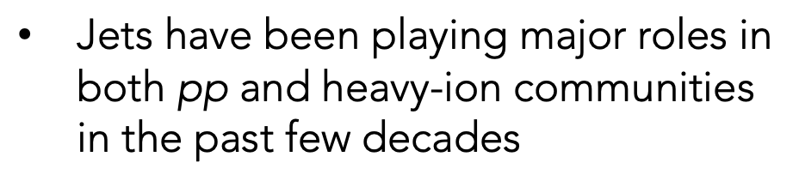

Slide 23


Slide 25
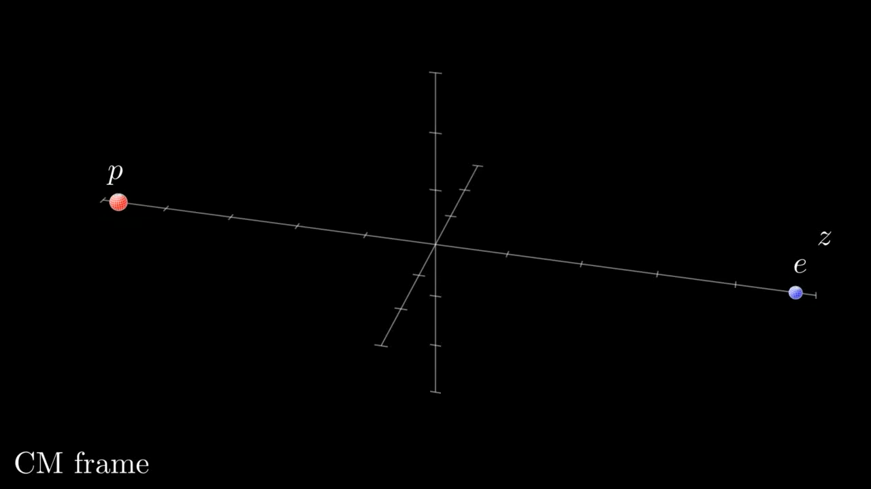
DIS thrust by D. Kangd properties
created by J.H. Ee

Slide 26
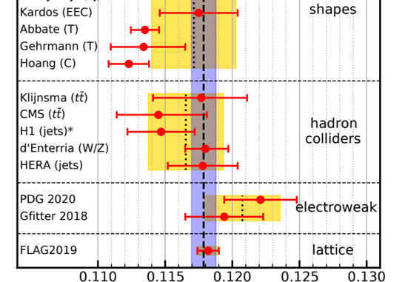
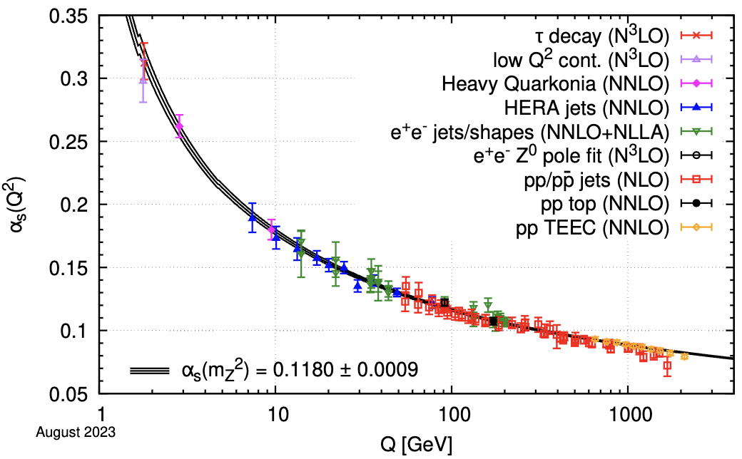
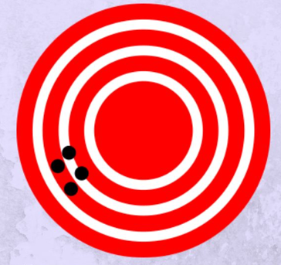

Jets in collider
A puzzle in the strong coupling
α_{s} values are different (3 sigma level). What’s wrong?
A long-lasting discrepancy remains unresolved for 15 years
Notes:
cross lines looking good? better

Slide 27
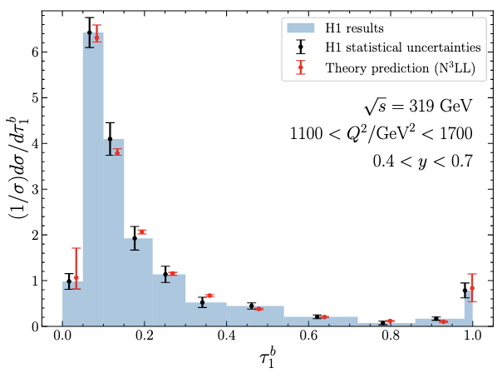
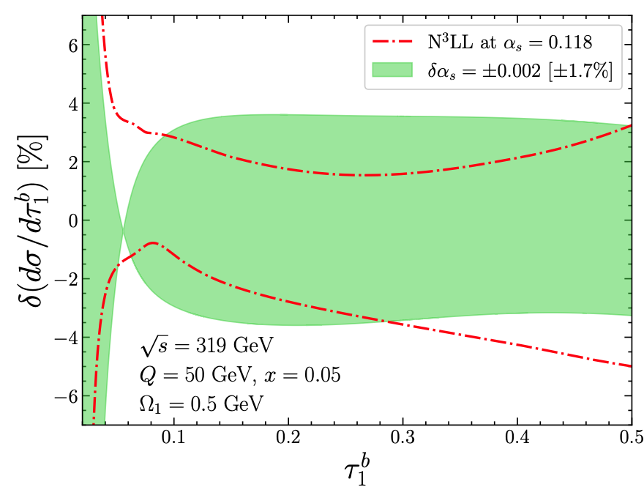
Up-to-date progress for HERA
[PRD2025 Ee, DK, Lee, Stewart]
World–leading precision improved with
higher-order O(α_{s}²) correction, non-perturbative correction, renormalon subtraction
The determination of the strong coupling is underway.
Theory vs. Exp (Not a fit)

Slide 28
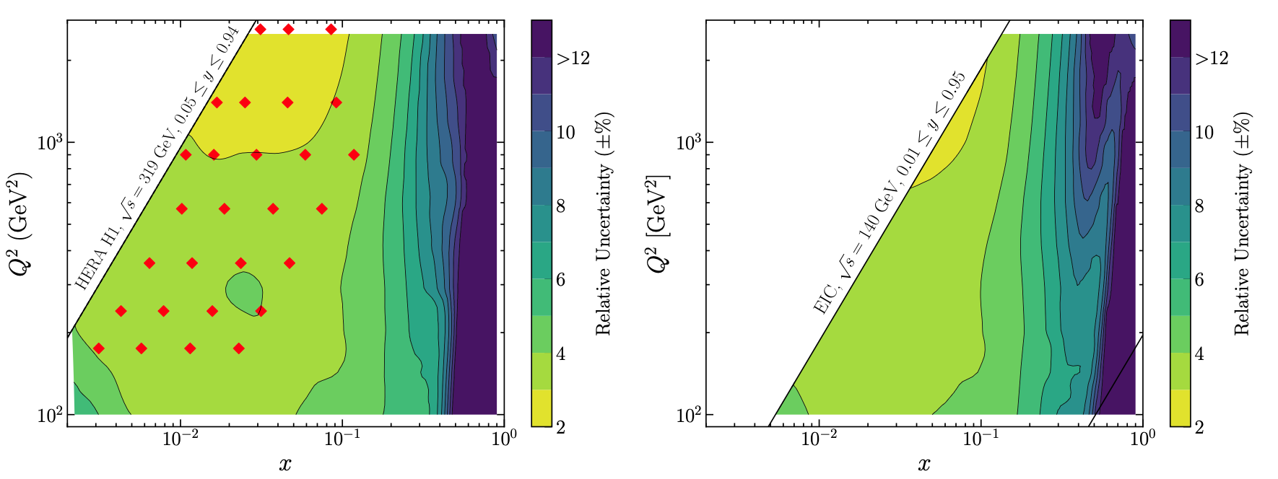
Uncertainty budget in x-Q² plane
[PRD2025 Ee, DK, Lee, Stewart]
HERA
EIC
Similar acuracy achieved by X. Liu
[2401.01941 Cao, Kang, Liu, Matry]
Notes:
Our preliminary results shows excellent convergence of perturbative uncertainty as we go from NLL to N3LL.
The width of band, which is perturbative uncertainty, reduces dramatically as we go from NLL to N3LL.
Final perturbative uncertainty is 1-3% at N3LL accuracy.
(more explain about the curve and spend more time here)

Slide 29

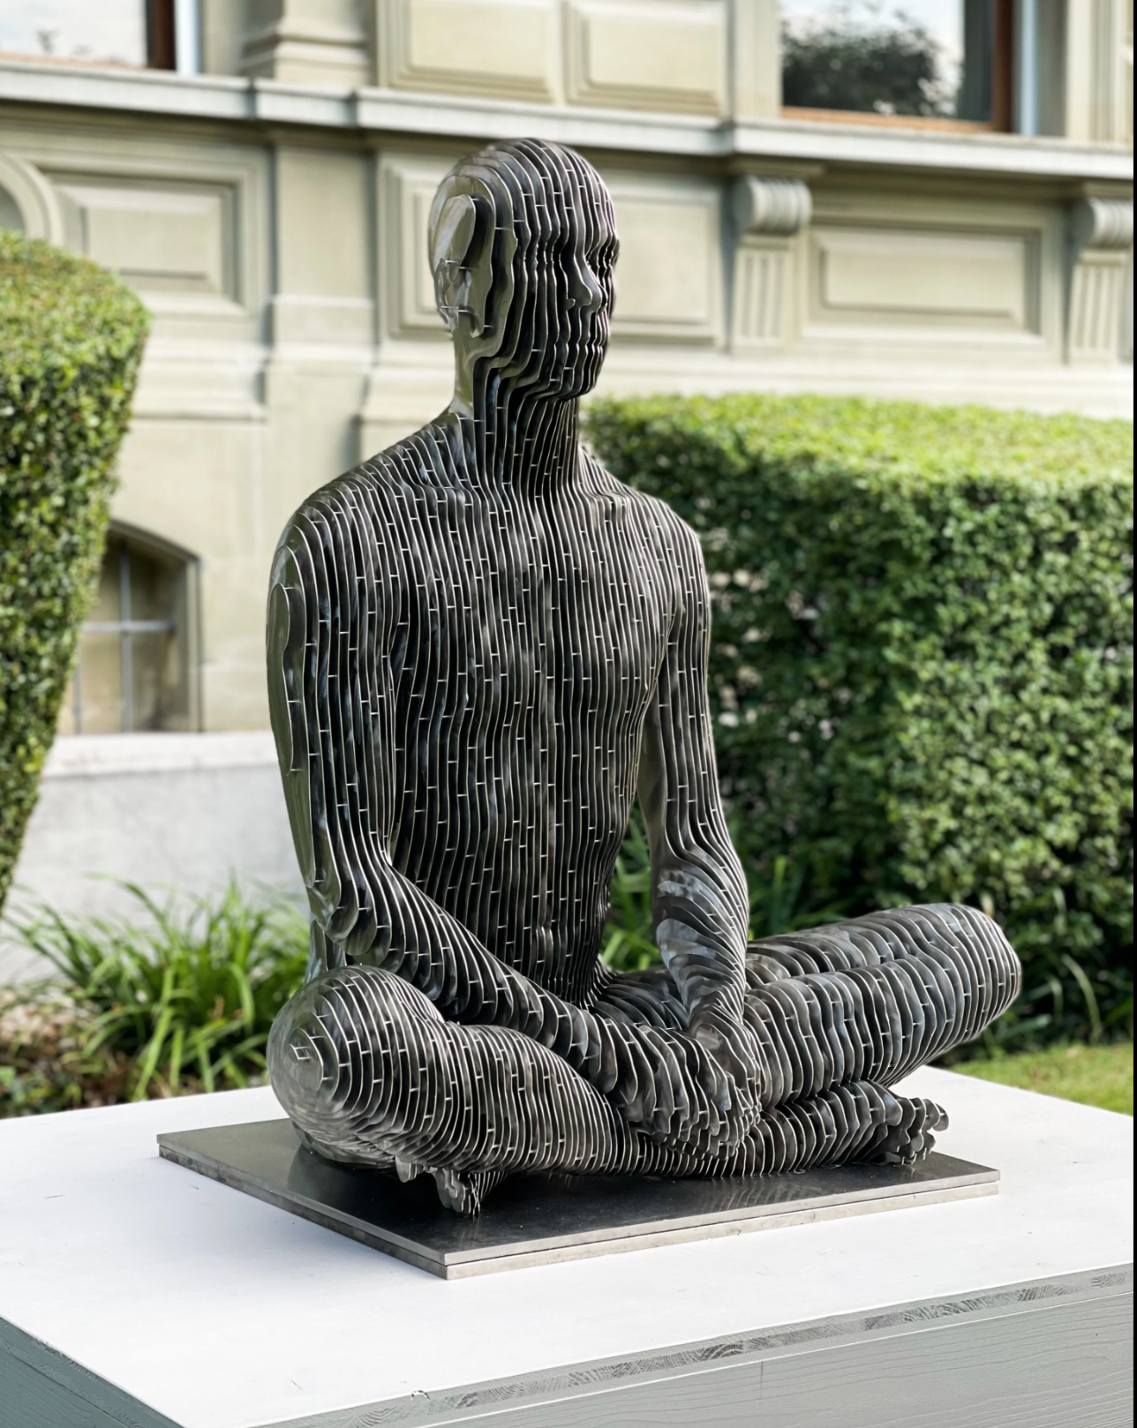
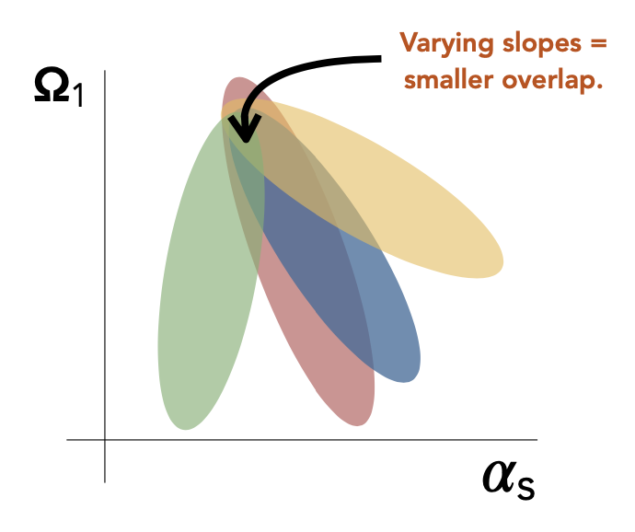
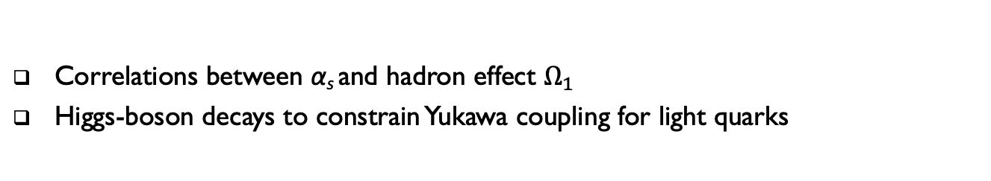
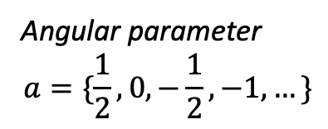
Angularity: view from different angle
Angular parameter $$a=\{\frac{1}{2}, 0,−\frac{1}{2}, −1, …\}$$
Correlations between α_{s} and hadron effect $Ω_{1}$
Higgs-boson decays to constrain Yukawa coupling for light quarks
[DK, J. Zhu, T. Maji, JHEP `21]
[Zhu, Song, Gao, DK, Maji, CPC `25]

Slide 30


Slide 34
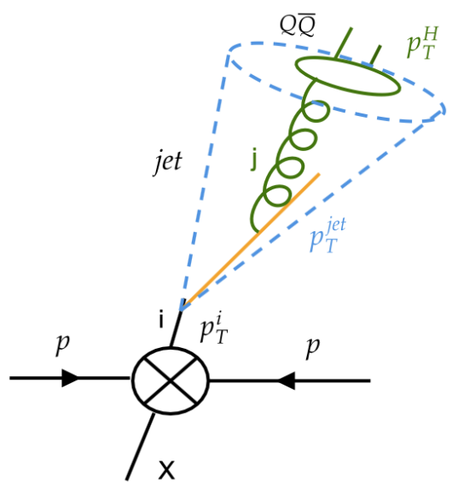

Slide 37


Slide 40
Summary and outlook
Future EIC promises fruitful physics program
Main pillars: mass, spin, 3D structure, gluon saturation, …
Jet physics
Quarkonium and exotics
Hadron structure and Lattice QCD
More ideas are needed
Good opportunity for nuclear community and future generation
Request for an EIC theory alliance in Korea
EICphi coll.: exploring full potential of the program
Synergy with the LHC, RHIC, Belle II, RAON, …
Need feedback and support from Nuc/Hep/Astro community

Slide 41
Thank you!
[PRD `19, Chien, Lee, DK, Makris]

Slide 42
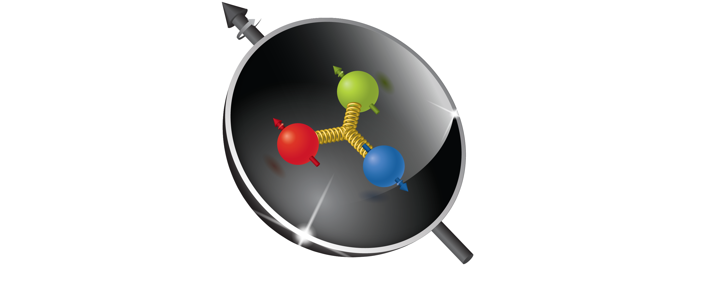
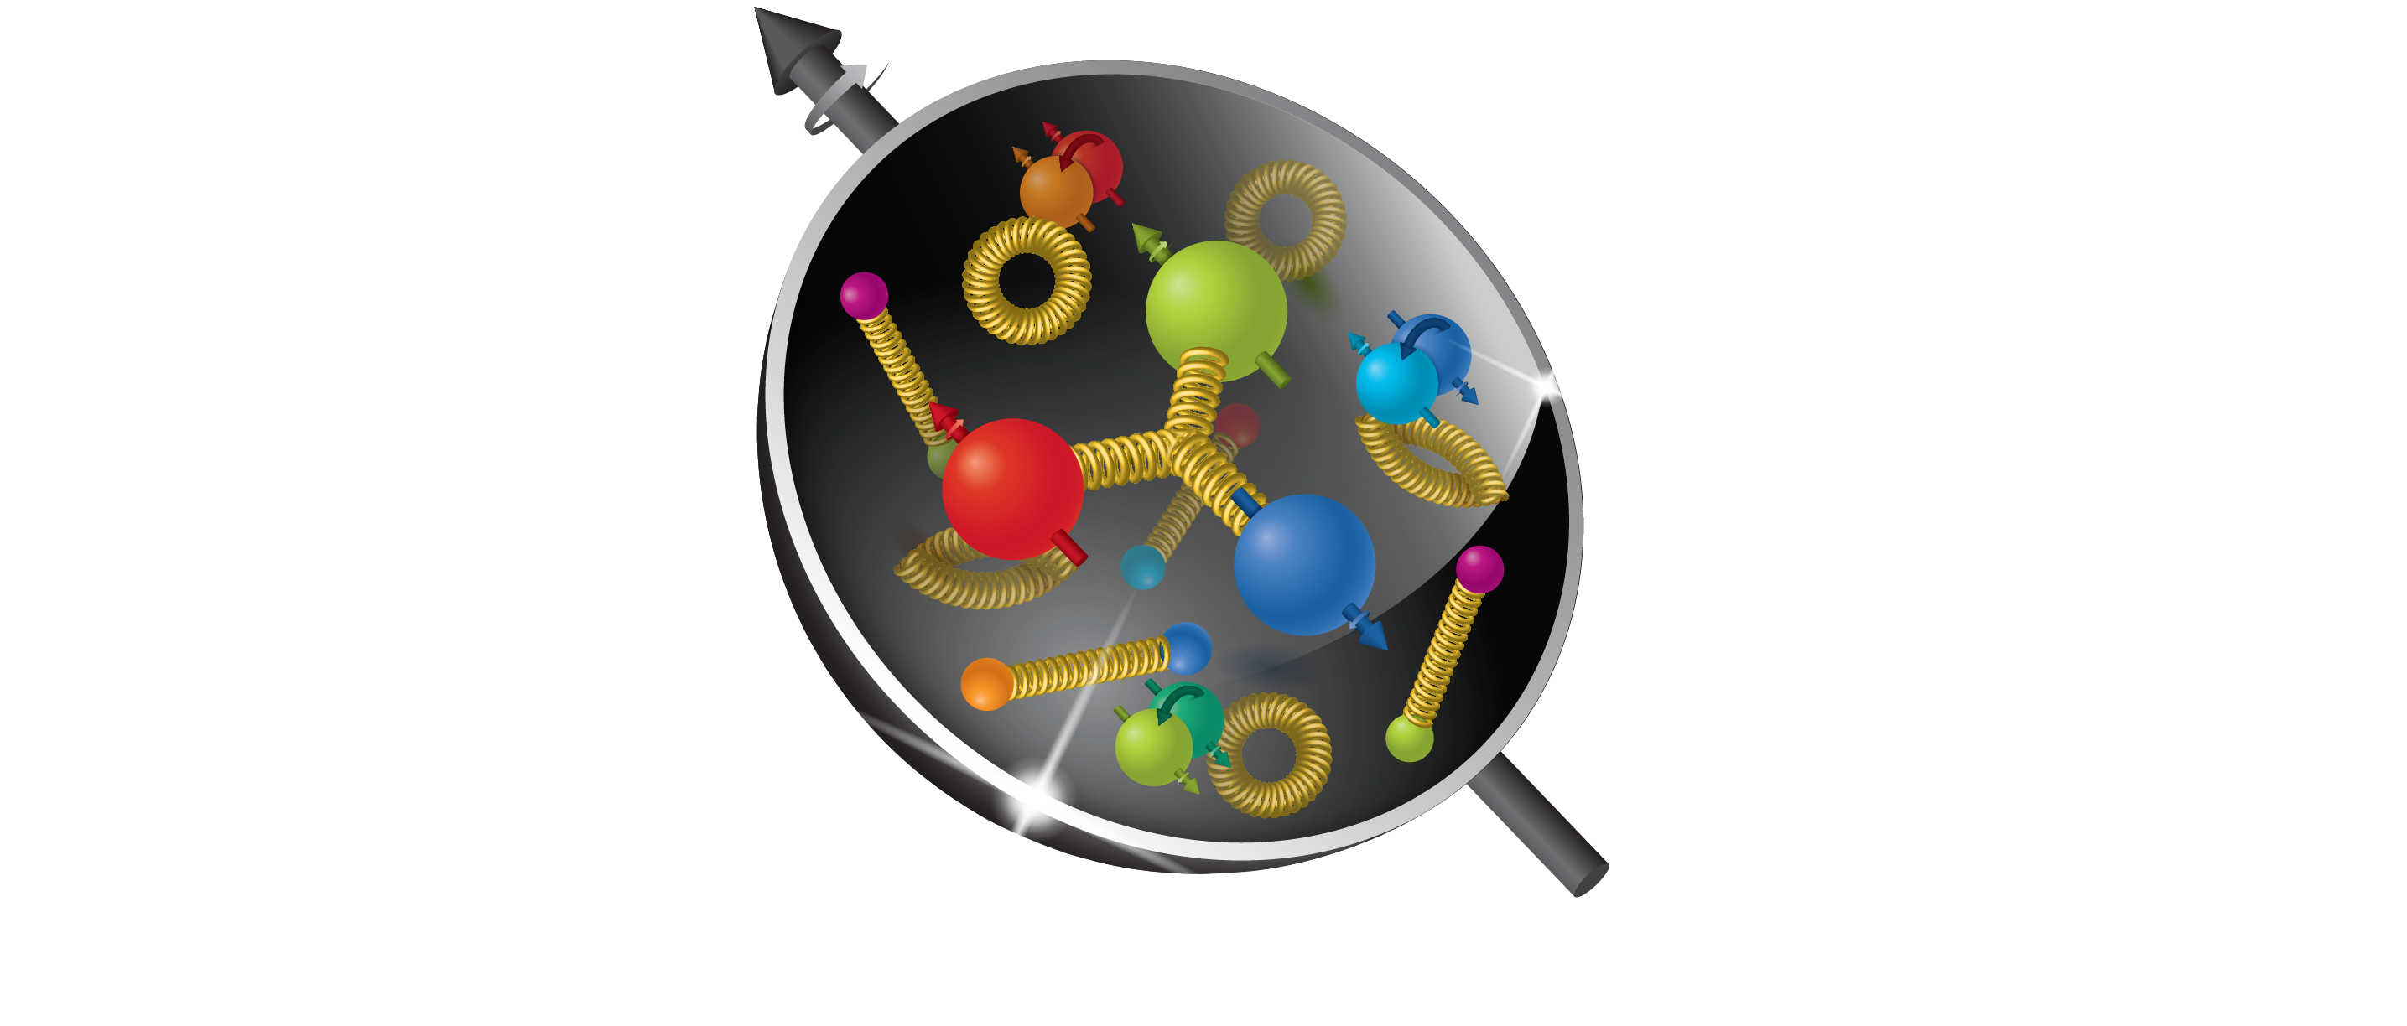
A milestone in proton/ion study

Slide 43
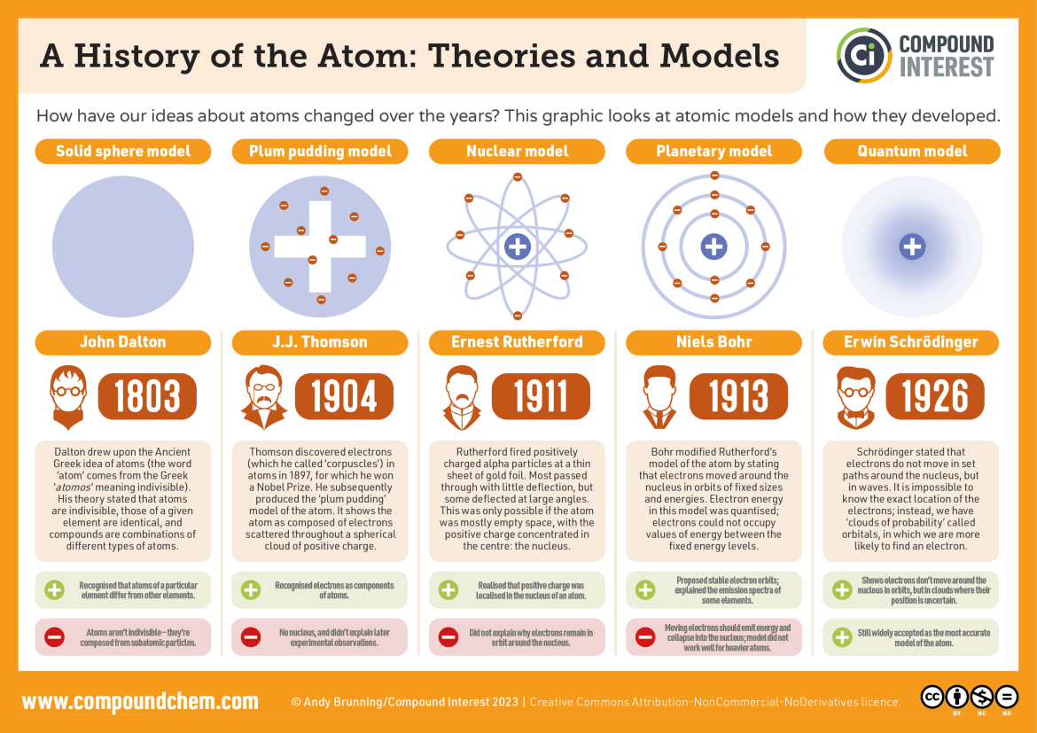
Proton
Studying atoms brought us to the doorstep of quantum mechanics!

Slide 44
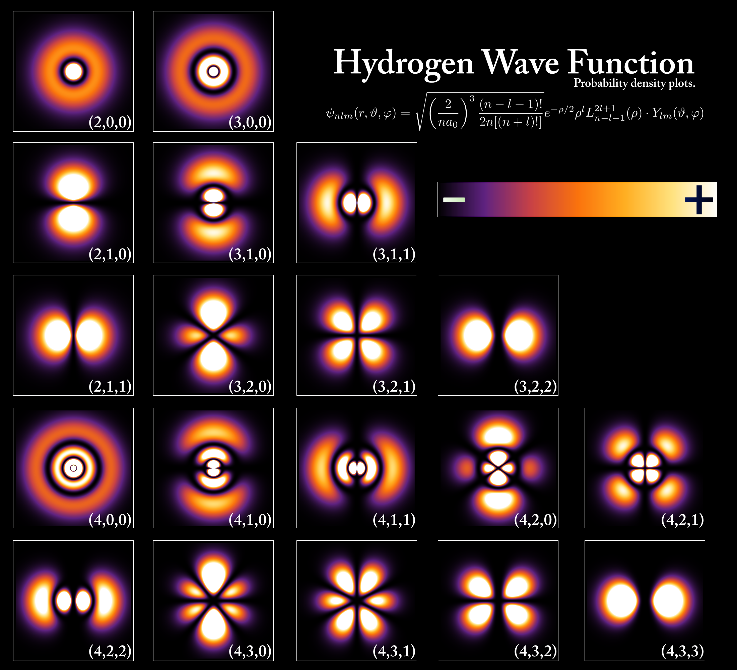
Proton

Slide 45
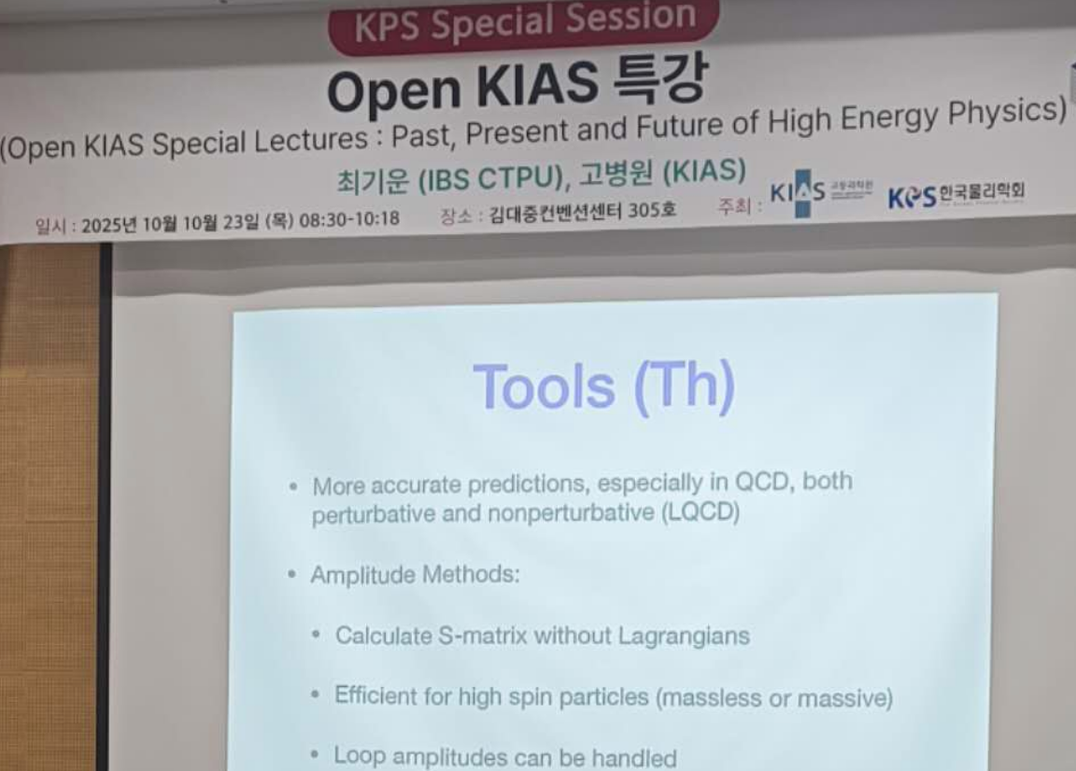
Proton
Notes:
New-physics oriented Search? QM from (classical observation?) black-body radiation.

Slide 46
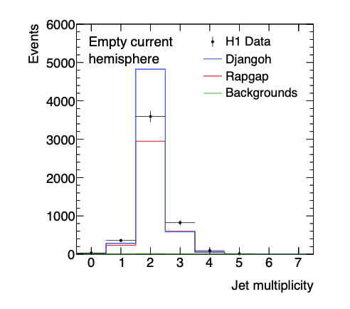
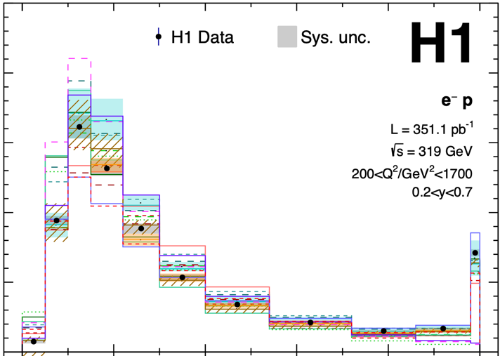
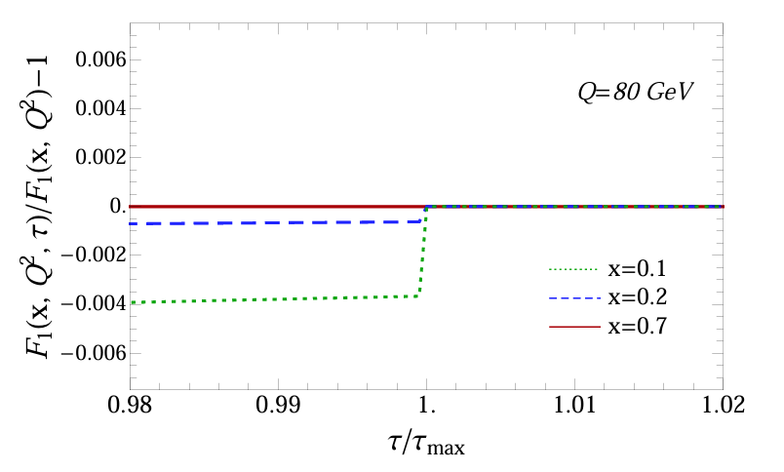

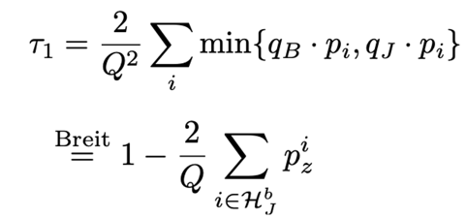
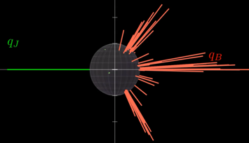

Observation by HERA H1 team
Our predictions have led a re-analysis of the HERA data (terminated in `07)
The empty hemisphere gives a peak at the endpoint, thrust =1
[H1 coll. EPJC ‘24]
[DK, Lee, Stewart, JHEP `14]
Notes:
comment on

Slide 47
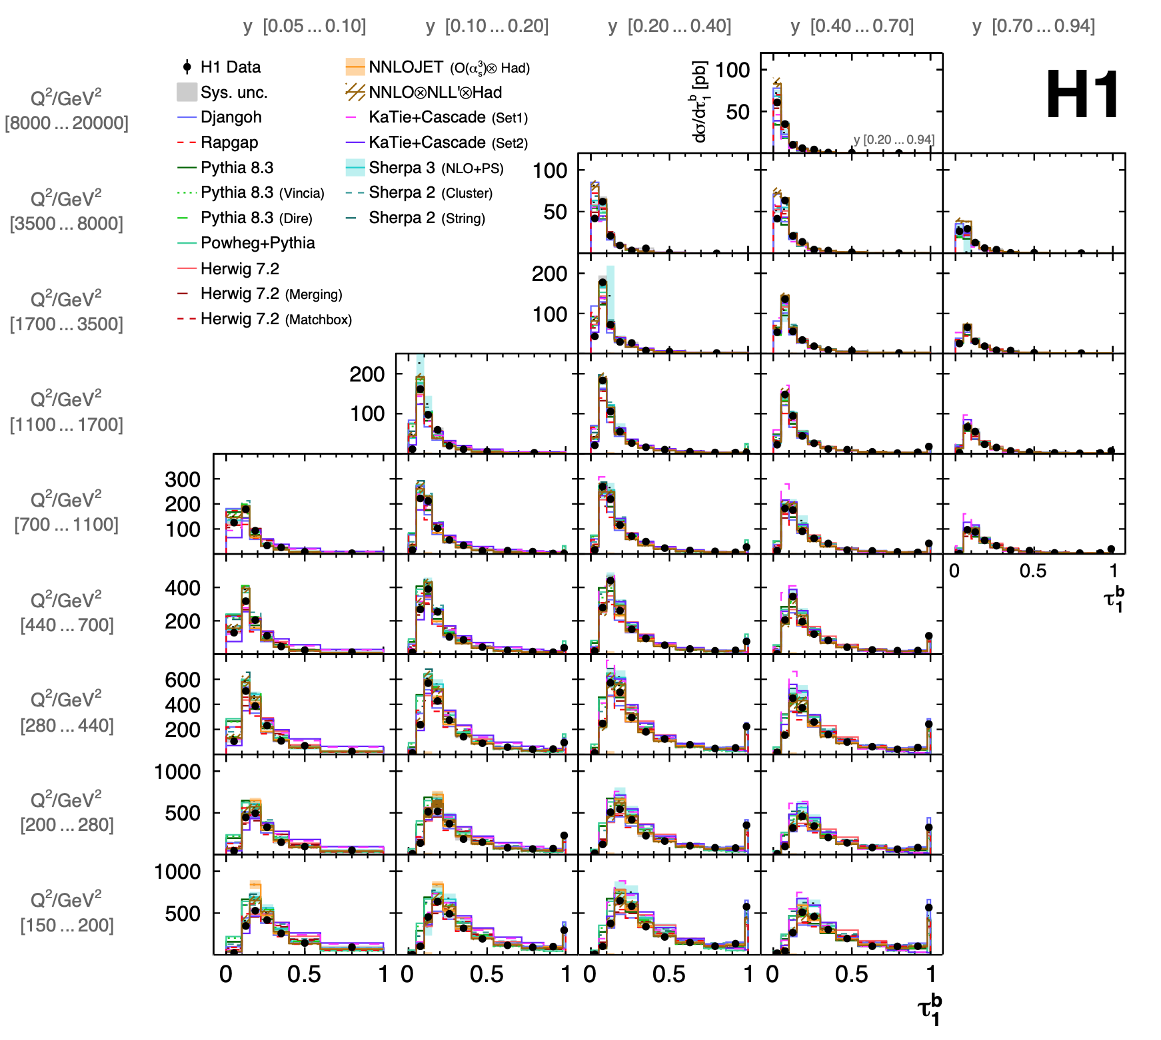
H1 thrust data
[2403.10109: H1 collaboration]

