Slide 1
Neutrino-nucleus scattering in quasi-elastic region
K. S. Kim
School of Liberal Arts and Science,
Korea Aerospace University, Korea
전남대학교 2025.11.19

Slide 2
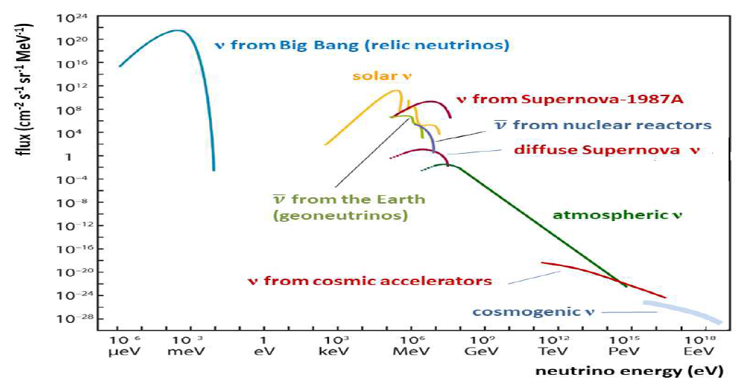

Slide 3
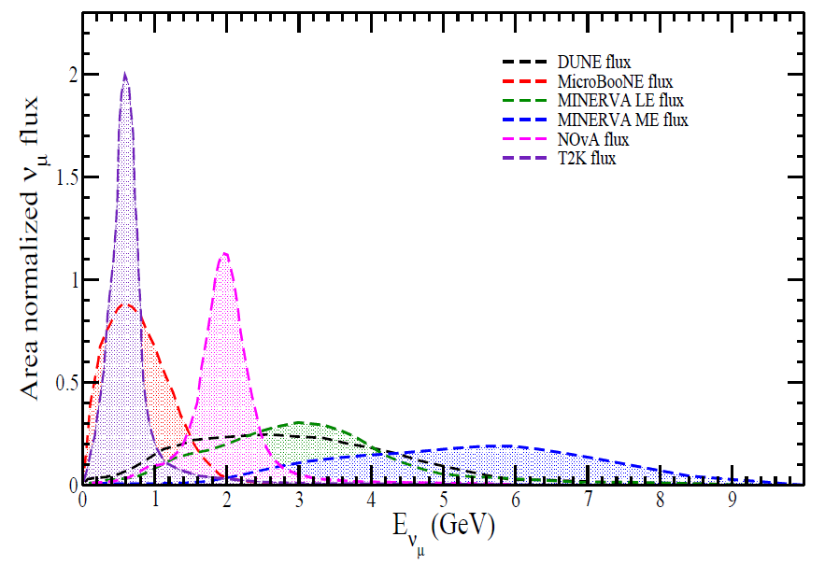
Questions :
neutrino mass hierarchy.
oscillation parameter.
CP-violation.
Dirac or Majorana particle.
etc.
Experiments :
Since Kamiokande, interests for the neutrino have widely increased.
Several experiments have been running or performed at BNL, NOMAD,
MiniBooNE, SciBooNE, MINERnA, MINOS, T2K, NOnA, DUNE, and etc.

Slide 4
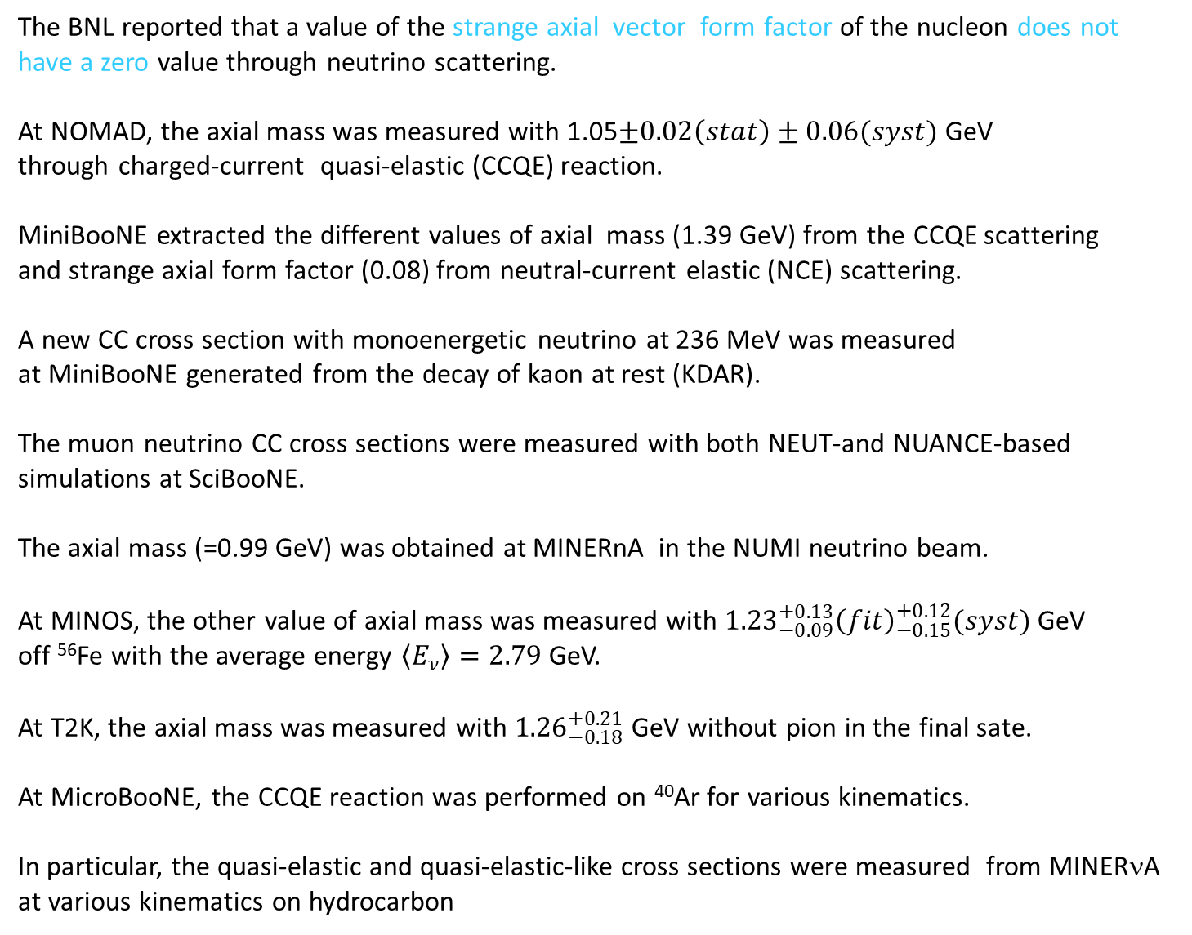
The BNL reported that a value of the strange axial vector form factor of the nucleon does not
have a zero value through neutrino scattering.
At NOMAD, the axial mass was measured with 1.05$±0.02\left(stat\right)±0.06(syst)$ GeV
through charged-current quasi-elastic (CCQE) reaction.
MiniBooNE extracted the different values of axial mass (1.39 GeV) from the CCQE scattering
and strange axial form factor (0.08) from neutral-current elastic (NCE) scattering.
A new CC cross section with monoenergetic neutrino at 236 MeV was measured
at MiniBooNE generated from the decay of kaon at rest (KDAR).
The muon neutrino CC cross sections were measured with both NEUT-and NUANCE-based
simulations at SciBooNE.
The axial mass (=0.99 GeV) was obtained at MINERnA in the NUMI neutrino beam.
At MINOS, the other value of axial mass was measured with ${1.23}_{−0.09}^{+0.13}{\left(fit\right)}_{−0.15}^{+0.12}(syst)$ GeV
off ⁵⁶Fe with the average energy $\left\langle E_{ν}\right\rangle =2.79$ GeV.
At T2K, the axial mass was measured with ${1.26}_{−0.18}^{+0.21}$ GeV without pion in the final sate.
At MicroBooNE, the CCQE reaction was performed on ⁴⁰Ar for various kinematics.
In particular, the quasi-elastic and quasi-elastic-like cross sections were measured from MINERνA
at various kinematics on hydrocarbon

Slide 5
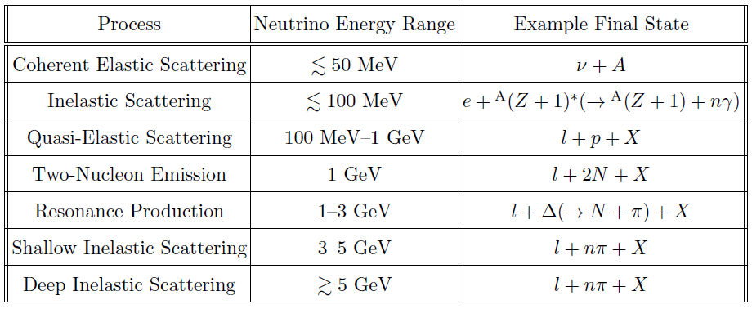
Main neutrino interaction channels in different energy ranges

Slide 6
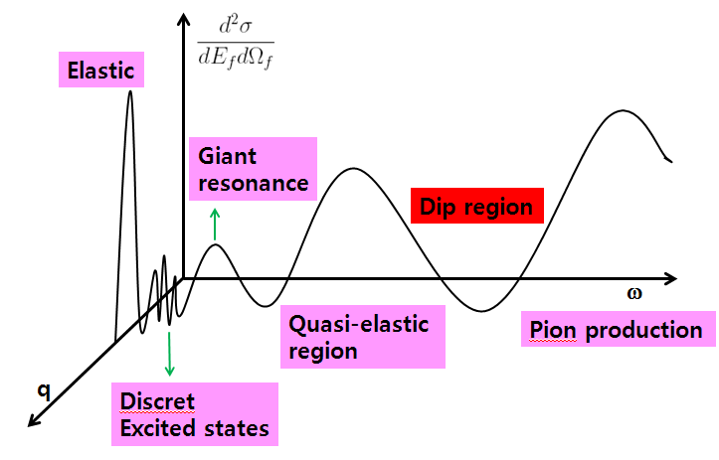
Dip region
Quasi-elastic
region
pion production
Discrete
excited states

Slide 7
Model
Inclusive neutrino-nucleus scattering in quasi-elastic (QE) region (no detection of the knocked-out nucleon).
Use a relativistic single particle model ( σ − ω model ) for bound nucleon.
Include the final state interaction (FSI) of the knocked-out nucleon by using relativistic mean field (RMF).
Include the Coulomb effect of the outgoing lepton for the charged-current (CC).
Investigate the contribution of the axial mass and axial strange form factor of weak current.
Investigate the effects of the proton and neutron emission.
Study the effect of neutrino electromagnetic properties.

Slide 8
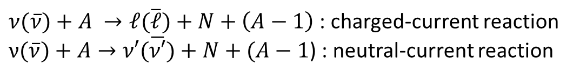
Kinematics
$ν(\overline{ν})+A →ℓ(\overline{ℓ})+N+\left(A−1\right)$: charged-current reaction
$ν(\overline{ν})+A→ν′(\overline{ν′})+N+(A−1$) : neutral-current reaction
Y
X
reaction plane
scattering plane
N
φ
l’
θl
θ
Z
(ω, q )
target
l

Slide 9
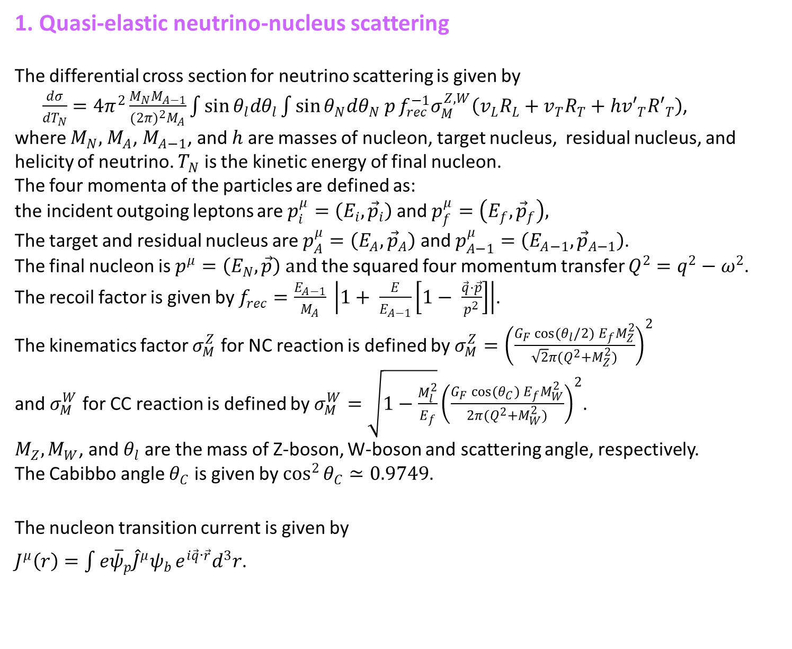
1. Quasi-elastic neutrino-nucleus scattering
The differential cross section for neutrino scattering is given by
$\frac{dσ}{{dT}_{N}}={4π}^{2}\frac{M_{N}M_{A−1}}{{(2π)}^{2}M_{A}}\int{\sin{θ_{l}{dθ}_{l}}}\int{\sin{θ_{N}{dθ}_{N} p}f_{rec}^{−1}σ_{M}^{Z,W}\left(v_{L}R_{L}+v_{T}R_{T}+{hv′}_{T}{R′}_{T}\right)}$,
where $M_{N},$ $M_{A}$, $M_{A−1}$, and $h$ are masses of nucleon, target nucleus, residual nucleus, and helicity of neutrino. $T_{N}$ is the kinetic energy of final nucleon.
The four momenta of the particles are defined as:
the incident outgoing leptons are $p_{i}^{μ}=\left(E_{i},{\vec{p}}_{i}\right)$ and $p_{f}^{μ}=\left(E_{f},{\vec{p}}_{f}\right),$
The target and residual nucleus are $p_{A}^{μ}=\left(E_{A},{\vec{p}}_{A}\right)$ and $p_{A−1}^{μ}=\left(E_{A−1},{\vec{p}}_{A−1}\right)$.
The final nucleon is $p^{μ}=\left(E_{N}, \vec{p}\right) and$ the squared four momentum transfer $Q^{2}=q^{2}−ω^{2}$.
The recoil factor is given by $f_{rec}=\frac{E_{A−1}}{M_{A}} \left|1+ \frac{E}{E_{A−1}}\left[1− \frac{\vec{q}⋅\vec{p}}{p^{2}}\right]\right|$.
The kinematics factor $σ_{M}^{Z}$ for NC reaction is defined by $σ_{M}^{Z}={\left(\frac{G_{F}\cos{(θ_{l}/2)} E_{f}M_{Z}^{2}}{\sqrt{2}π(Q^{2}+M_{Z}^{2})}\right)}^{2}$
and $σ_{M}^{W}$ for CC reaction is defined by $σ_{M}^{W}=\sqrt{1−\frac{M_{l}^{2}}{E_{f}}}{\left(\frac{G_{F}\cos{(θ_{C})} E_{f}M_{W}^{2}}{2π(Q^{2}+M_{W}^{2})}\right)}^{2}$.
$M_{Z}, M_{W}$, and $θ_{l}$ are the mass of Z-boson, W-boson and scattering angle, respectively.
The Cabibbo angle $θ_{C}$ is given by $\cos^{2}{θ_{C}≃0.9749}$.
The nucleon transition current is given by
$J^{μ}\left(r\right)=\int{e{\overline{ψ}}_{p}{\hat{J}}^{μ}ψ_{b}}{e^{i\vec{q}∙\vec{r}}d}^{3}r$.

Slide 10
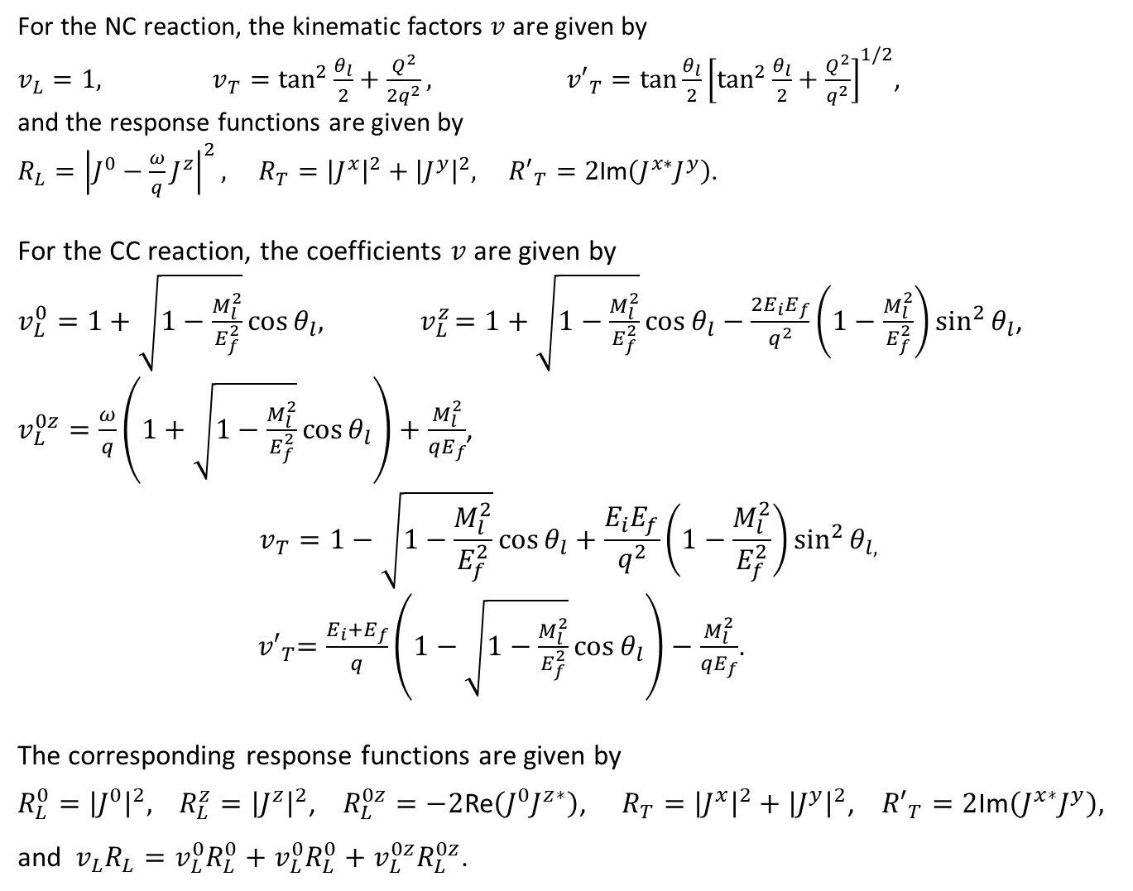
For the NC reaction, the kinematic factors $v$ are given by
$v_{L}=1, v_{T}=\tan^{2}{\frac{θ_{l}}{2}+\frac{Q^{2}}{{2q}^{2}}, {v′}_{T}=\tan{\frac{θ_{l}}{2}{\left[\tan^{2}{\frac{θ_{l}}{2}}+\frac{Q^{2}}{q^{2}}\right]}^{1/2}}}$,
and the response functions are given by
$R_{L}={\left|J^{0}−\frac{ω}{q}J^{z}\right|}^{2}, R_{T}={\left|J^{x}\right|}^{2}+{\left|J^{y}\right|}^{2}, {R′}_{T}=2$Im$\left(J^{x∗}J^{y}\right)$.
For the CC reaction, the coefficients $v$ are given by
$v_{L}^{0}=1+\sqrt{1−\frac{M_{l}^{2}}{E_{f}^{2}}}\cos{θ_{l}, }{ v}_{L}^{z}=1+\sqrt{1−\frac{M_{l}^{2}}{E_{f}^{2}}}\cos{θ_{l}}−\frac{{2E}_{i}E_{f}}{q^{2}}\left(1−\frac{M_{l}^{2}}{E_{f}^{2}}\right)\sin^{2}{θ_{l}}$,
$v_{L}^{0z}=\frac{ω}{q}\left(1+\sqrt{1−\frac{M_{l}^{2}}{E_{f}^{2}}}\cos{θ_{l}}\right)+\frac{M_{l}^{2}}{{qE}_{f}}$,
$$v_{T}=1−\sqrt{1−\frac{M_{l}^{2}}{E_{f}^{2}}}\cos{θ_{l}}+\frac{E_{i}E_{f}}{q^{2}}\left(1−\frac{M_{l}^{2}}{E_{f}^{2}}\right)\sin^{2}{θ_{l,}}$$
${ v′}_{T}=\frac{E_{i}+E_{f}}{q}\left(1−\sqrt{1−\frac{M_{l}^{2}}{E_{f}^{2}}}\cos{θ_{l}}\right)−\frac{M_{l}^{2}}{{qE}_{f}}$.
The corresponding response functions are given by
$R_{L}^{0}={\left|J^{0}\right|}^{2},$ $R_{L}^{z}={\left|J^{z}\right|}^{2}$, $R_{L}^{0z}=−2$Re$\left(J^{0}J^{z∗}\right)$, $R_{T}={\left|J^{x}\right|}^{2}+{\left|J^{y}\right|}^{2}$, ${R′}_{T}=2$Im$\left(J^{x∗}J^{y}\right),$
and $v_{L}R_{L}=v_{L}^{0}R_{L}^{0}+v_{L}^{0}R_{L}^{0}+v_{L}^{0z}R_{L}^{0z}$.

Slide 11
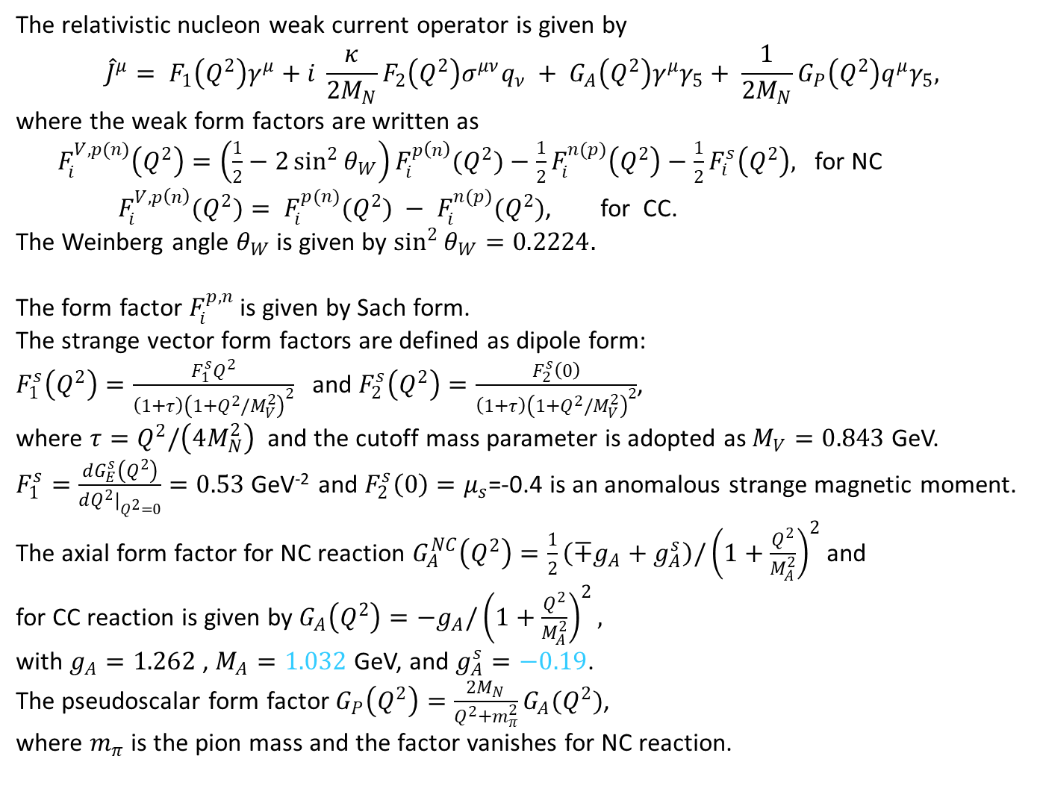
The relativistic nucleon weak current operator is given by
$${\hat{J}}^{μ}= F_{1}\left(Q^{2}\right)γ^{μ}+i \frac{κ}{{2M}_{N}}F_{2}\left(Q^{2}\right)σ^{μν}q_{ν} + G_{A}\left(Q^{2}\right)γ^{μ}γ_{5}+ \frac{1}{{2M}_{N}}G_{P}\left(Q^{2}\right)q^{μ}γ_{5},$$
where the weak form factors are written as
${ F}_{i}^{V,p(n)}\left(Q^{2}\right)=\left(\frac{1}{2}−2\sin^{2}{θ_{W}}\right)F_{i}^{p\left(n\right)}(Q^{2})−\frac{1}{2}F_{i}^{n(p)}\left(Q^{2}\right)−\frac{1}{2}F_{i}^{s}\left(Q^{2}\right),$ for NC
$F_{i}^{V,p\left(n\right)}(Q^{2})= F_{i}^{p(n)}(Q^{2}) − F_{i}^{n(p)}(Q^{2})$, for CC.
The Weinberg angle $θ_{W}$ is given by $\sin^{2}{θ_{W}}=0.2224.$
The form factor $F_{i}^{p,n}$ is given by Sach form.
The strange vector form factors are defined as dipole form:
$F_{1}^{s}\left(Q^{2}\right)=\frac{F_{1}^{s}Q^{2}}{\left(1+τ\right){\left(1+Q^{2}/M_{V}^{2}\right)}^{2}}$ and $F_{2}^{s}\left(Q^{2}\right)=\frac{F_{2}^{s}\left(0\right)}{\left(1+τ\right){\left(1+Q^{2}/M_{V}^{2}\right)}^{2}}$,
where $τ=Q^{2}/\left(4M_{N}^{2}\right)$ and the cutoff mass parameter is adopted as $M_{V}=0.843$ GeV.
$F_{1}^{s}=\frac{dG_{E}^{s}\left(Q^{2}\right)}{dQ^{2}|_{Q^{2}=0}}=0.53$ GeV⁻² and $F_{2}^{s}\left(0\right)=μ_{s}$=-0.4 is an anomalous strange magnetic moment.
The axial form factor for NC reaction $G_{A}^{NC}\left(Q^{2}\right)=\frac{1}{2}\left(∓g_{A}+g_{A}^{s}\right)/{\left(1+\frac{Q^{2}}{M_{A}^{2}}\right)}^{2}$ and
for CC reaction is given by $G_{A}\left(Q^{2}\right)=−g_{A}/{\left(1+\frac{Q^{2}}{M_{A}^{2}}\right)}^{2},$
with $g_{A}=1.262$ , $M_{A}=1.032$GeV, and $g_{A}^{s}=−0.19$.
The pseudoscalar form factor $G_{P}\left(Q^{2}\right)=\frac{{2M}_{N}}{Q^{2}+m_{π}^{2}}G_{A}(Q^{2})$,
where $m_{π}$ is the pion mass and the factor vanishes for NC reaction.

Slide 12
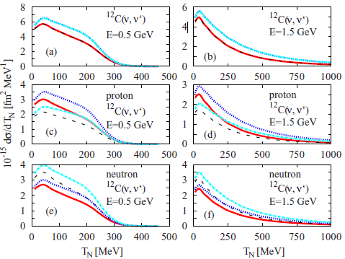
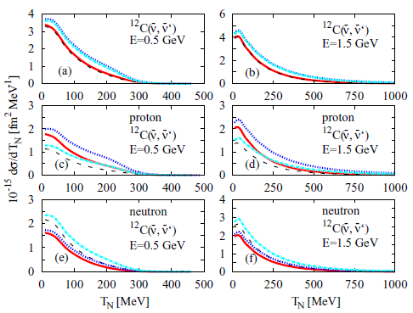
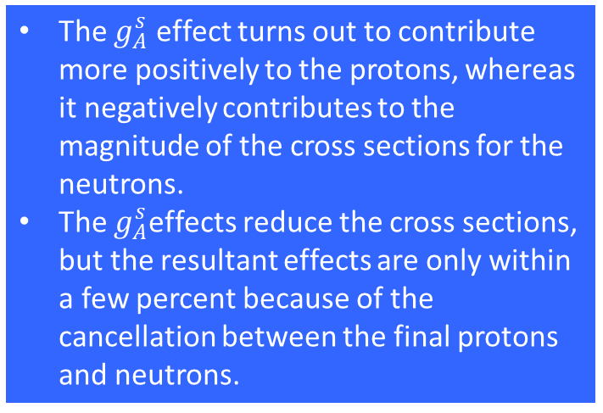
Differential cross sections
=(1.032, -0.19) :
=(1.032, 0.08) :
=(1.39, -0.19) :
=(1.39, 0.08) :
The $g_{A}^{s}$ effect turns out to contribute more positively to the protons, whereas it negatively contributes to the magnitude of the cross sections for the neutrons.
The $g_{A}^{s}$effects reduce the cross sections, but the resultant effects are only within a few percent because of the cancellation between the final protons and neutrons.

Slide 13
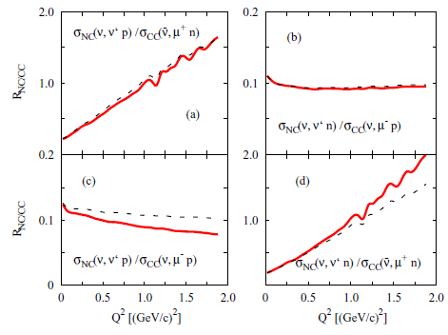
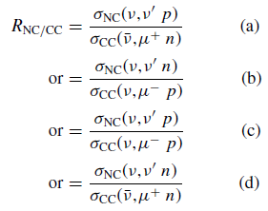
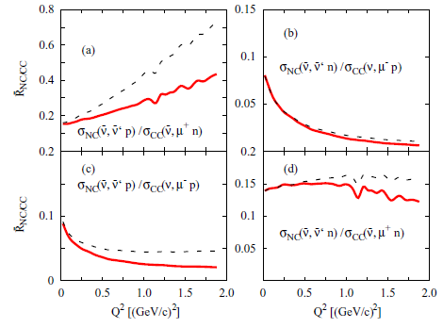
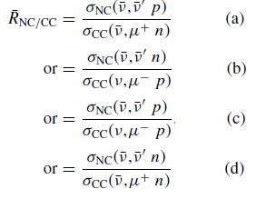

The effect of $M_{A}$
Ratio of NC to CC for neutrino
Ratio of NC to CC for antineutrino

Slide 14
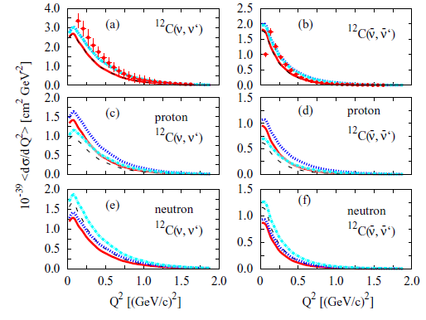
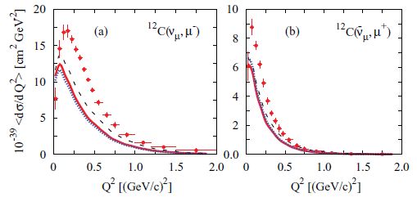



Comparison with MiniBooNE data
=(1.032, -0.19) :
=(1.032, 0.08) :
=(1.39, -0.19) :
=(1.39, 0.08) :
$M_{A}=1.03$2 :
with Coulomb
$M_{A}=1.39$ :
$M_{A}=1.03$2 :
without
Coulomb

Slide 15
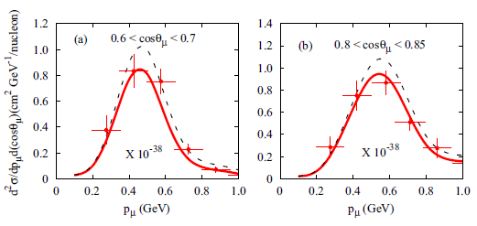
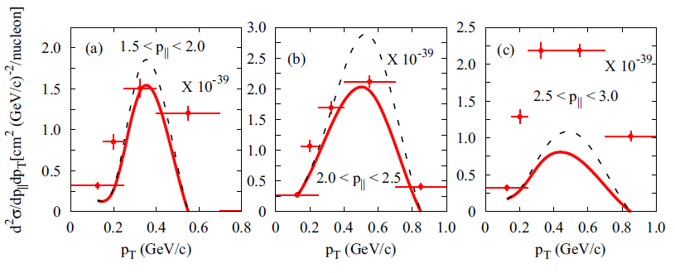
Comparison with other experimental data
T2K
MINERνA

Slide 16
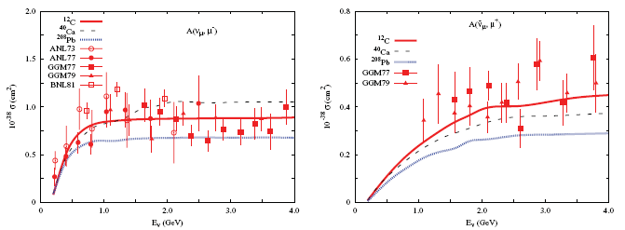
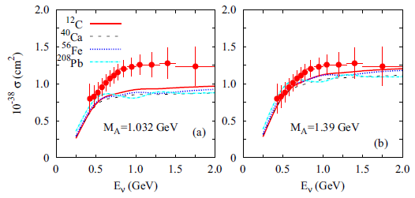
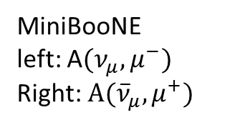
Total cross section
MiniBooNE
left: A$(ν_{μ}, μ^{−})$
Right:$A({\overline{ν}}_{μ}, μ^{+})$
The meaning of scaling is just that the total cross section is divided by the number of participated nucleons.
Another is that our model does not include the inelastic processes like the Delta, etc.

Slide 17
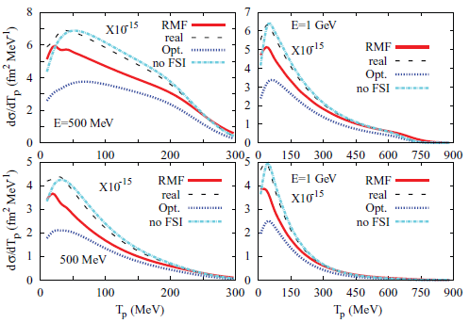
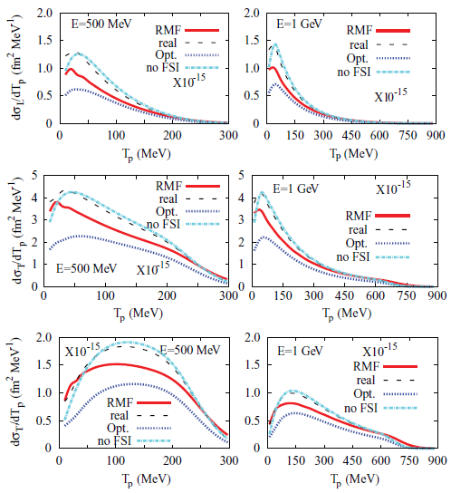
Final state interaction
incident neutrino
incident antineutrino
longitudinal cross section
transverse cross section
interference transverse cross section

Slide 18
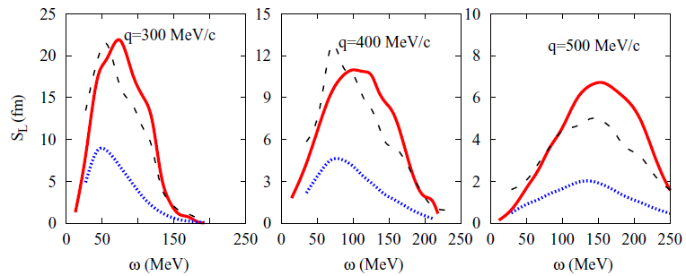



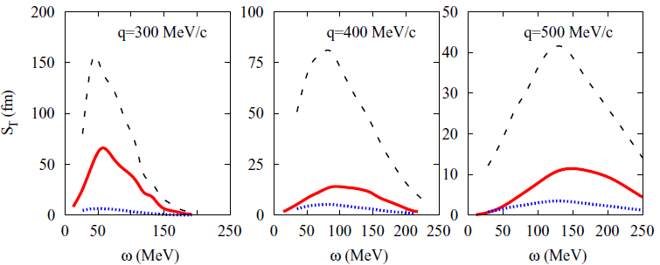
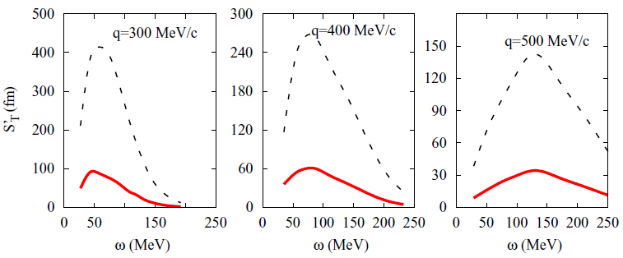
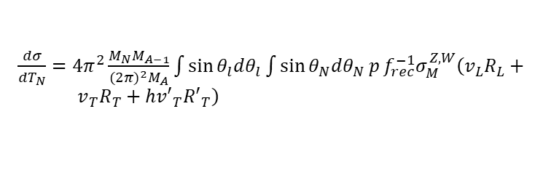
Extraction of structure function
$\frac{dσ}{{dT}_{N}}={4π}^{2}\frac{M_{N}M_{A−1}}{{(2π)}^{2}M_{A}}\int{\sin{θ_{l}{dθ}_{l}}}\int{\sin{θ_{N}{dθ}_{N} p}f_{rec}^{−1}σ_{M}^{Z,W}\left(v_{L}R_{L}+{ v}_{T}R_{T}+{hv′}_{T}{R′}_{T}\right)}$
(e, e’)
(ν, ν’)
: with axial term
: without axial term
: NC reaction
: CC reaction
The axial current plays an important role in the neutrino scattering.

Slide 19
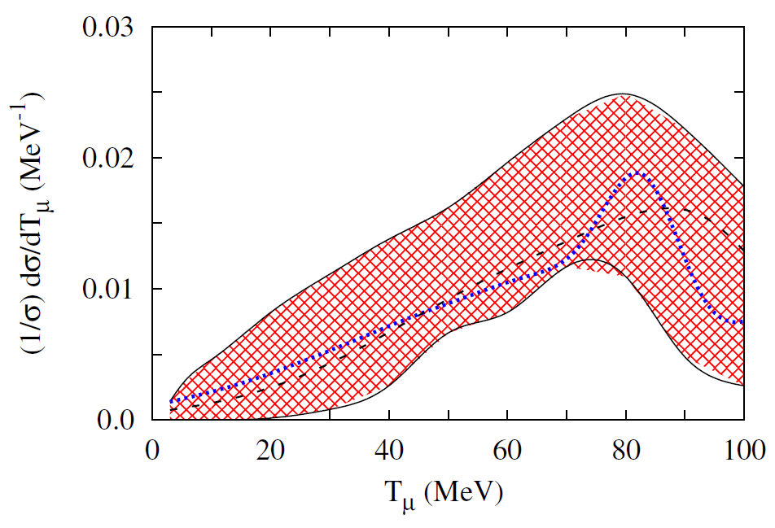
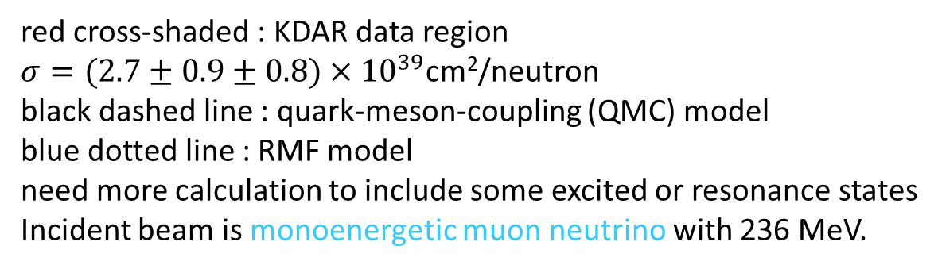
red cross-shaded : KDAR data region
$σ=(2.7±0.9±0.8)×{10}^{39}$cm²/neutron
black dashed line : quark-meson-coupling (QMC) model
blue dotted line : RMF model need more calculation to include some excited or resonance states
Incident beam is monoenergetic muon neutrino with 236 MeV.

Slide 20
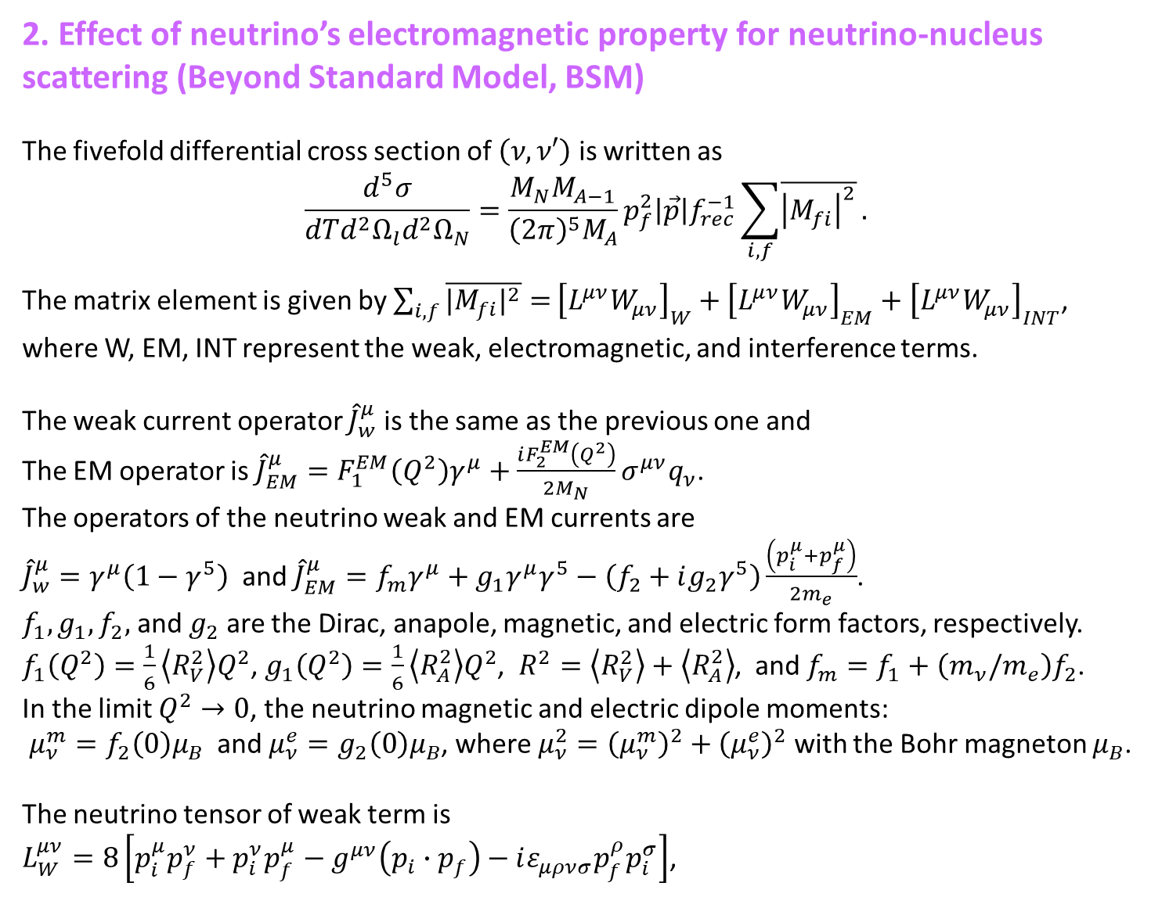
2. Effect of neutrino’s electromagnetic property for neutrino-nucleus scattering (Beyond Standard Model, BSM)
The fivefold differential cross section of $\left(ν, ν′\right)$ is written as
$$\frac{d^{5}σ}{dTd^{2}Ω_{l}d^{2}Ω_{N}}=\frac{M_{N}M_{A−1}}{{\left(2π\right)}^{5}M_{A}}p_{f}^{2}\left|\vec{p}\right|f_{rec}^{−1}\sum_{i,f}{\overline{{\left|M_{fi}\right|}^{2}}}.$$
The matrix element is given by $\sum_{i,f}{\overline{{|M_{fi}|}^{2}}=}{\left[L^{μν}W_{μν}\right]}_{W}+{\left[L^{μν}W_{μν}\right]}_{EM}+{\left[L^{μν}W_{μν}\right]}_{INT}$,
where W, EM, INT represent the weak, electromagnetic, and interference terms.
The weak current operator ${\hat{J}}_{w}^{μ}$ is the same as the previous one and
The EM operator is ${\hat{J}}_{EM}^{μ}=F_{1}^{EM}\left(Q^{2}\right)γ^{μ}+\frac{iF_{2}^{EM}\left(Q^{2}\right)}{2M_{N}}σ^{μν}q_{ν}$.
The operators of the neutrino weak and EM currents are
${\hat{J}}_{w}^{μ}=γ^{μ}\left(1−γ^{5}\right)$ and ${\hat{J}}_{EM}^{μ}=f_{m}γ^{μ}+g_{1}γ^{μ}γ^{5}−\left(f_{2}+ig_{2}γ^{5}\right)\frac{\left(p_{i}^{μ}+p_{f}^{μ}\right)}{2m_{e}}$.
$f_{1}, g_{1}, f_{2},$ and $g_{2}$ are the Dirac, anapole, magnetic, and electric form factors, respectively.
$f_{1}\left(Q^{2}\right)=\frac{1}{6}\left\langle R_{V}^{2}\right\rangle Q^{2}$, $g_{1}\left(Q^{2}\right)=\frac{1}{6}\left\langle R_{A}^{2}\right\rangle Q^{2}$, $R^{2}=\left\langle R_{V}^{2}\right\rangle +\left\langle R_{A}^{2}\right\rangle$, and $f_{m}=f_{1}+\left(m_{ν}/m_{e}\right)f_{2}$.
In the limit $Q^{2}→0$, the neutrino magnetic and electric dipole moments:
$μ_{ν}^{m}=f_{2}\left(0\right)μ_{B}$ and $μ_{ν}^{e}=g_{2}\left(0\right)μ_{B}$, where $μ_{ν}^{2}={\left(μ_{ν}^{m}\right)}^{2}+{\left(μ_{ν}^{e}\right)}^{2}$ with the Bohr magneton $μ_{B}$.
The neutrino tensor of weak term is
$L_{W}^{μν}=8\left[p_{i}^{μ}p_{f}^{ν}+p_{i}^{ν}p_{f}^{μ}−g^{μν}\left(p_{i}∙p_{f}\right)−iε_{μρνσ}p_{f}^{ρ}p_{i}^{σ}\right]$,

Slide 21
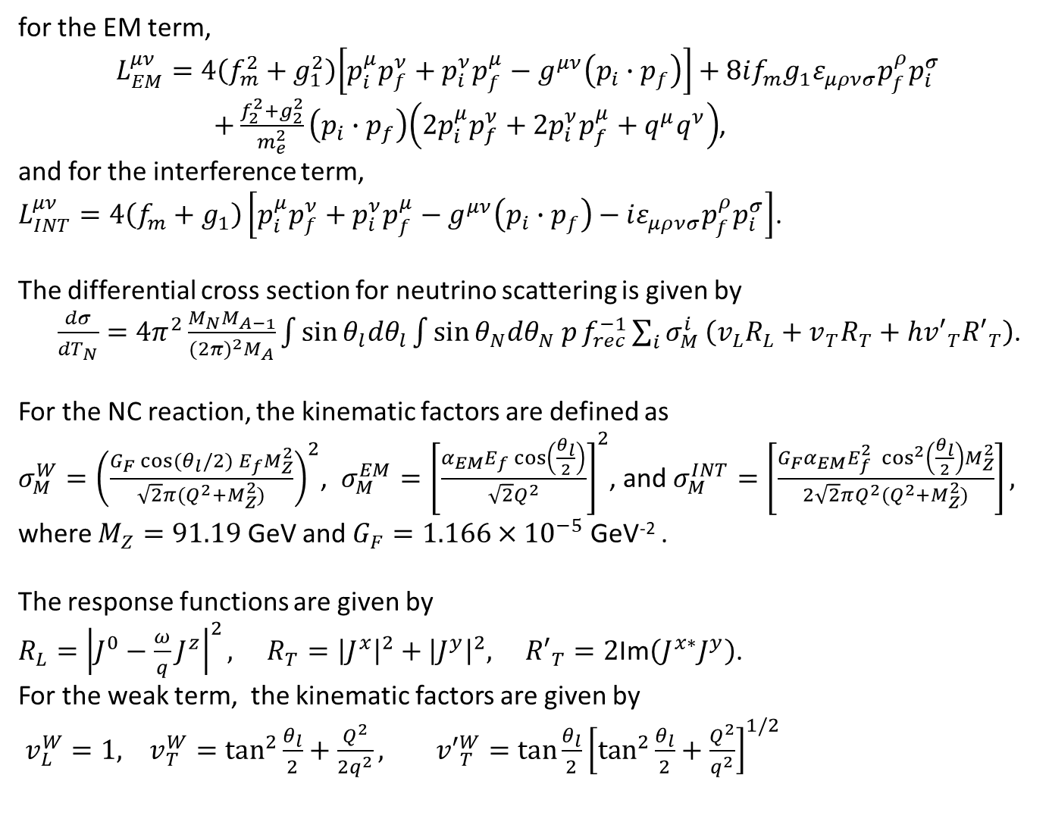
for the EM term,
$$L_{EM}^{μν}=4\left(f_{m}^{2}+g_{1}^{2}\right)\left[p_{i}^{μ}p_{f}^{ν}+p_{i}^{ν}p_{f}^{μ}−g^{μν}\left(p_{i}∙p_{f}\right)\right]+8if_{m}g_{1}ε_{μρνσ}p_{f}^{ρ}p_{i}^{σ}$$
$+\frac{f_{2}^{2}+g_{2}^{2}}{m_{e}^{2}}\left(p_{i}∙p_{f}\right)\left({2p}_{i}^{μ}p_{f}^{ν}+{2p}_{i}^{ν}p_{f}^{μ}+q^{μ}q^{ν}\right)$,
and for the interference term,
$L_{INT}^{μν}=4\left(f_{m}+g_{1}\right)\left[p_{i}^{μ}p_{f}^{ν}+p_{i}^{ν}p_{f}^{μ}−g^{μν}\left(p_{i}∙p_{f}\right)−iε_{μρνσ}p_{f}^{ρ}p_{i}^{σ}\right]$.
The differential cross section for neutrino scattering is given by
$\frac{dσ}{{dT}_{N}}={4π}^{2}\frac{M_{N}M_{A−1}}{{(2π)}^{2}M_{A}}\int{\sin{θ_{l}{dθ}_{l}}}\int{\sin{θ_{N}{dθ}_{N} p}f_{rec}^{−1}\sum_{i}{σ_{M}^{i}}\left(v_{L}R_{L}+v_{T}R_{T}+{hv′}_{T}{R′}_{T}\right)}$.
For the NC reaction, the kinematic factors are defined as
$σ_{M}^{W}={\left(\frac{G_{F}\cos{(θ_{l}/2)} E_{f}M_{Z}^{2}}{\sqrt{2}π(Q^{2}+M_{Z}^{2})}\right)}^{2}$, $σ_{M}^{EM}={\left[\frac{α_{EM}E_{f}\cos\left(\frac{θ_{l}}{2}\right)}{\sqrt{2}Q^{2}}\right]}^{2}$, and $σ_{M}^{INT}=\left[\frac{G_{F}α_{EM}E_{f}^{2} \cos^{2}\left(\frac{θ_{l}}{2}\right)M_{Z}^{2}}{2\sqrt{2}πQ^{2}(Q^{2}+M_{Z}^{2})}\right],$
where $M_{Z}=91.19$ GeV and $G_{F}=1.166×{10}^{−5}$ GeV⁻² .
The response functions are given by
$R_{L}={\left|J^{0}−\frac{ω}{q}J^{z}\right|}^{2}, R_{T}={\left|J^{x}\right|}^{2}+{\left|J^{y}\right|}^{2}, {R′}_{T}=2$Im$\left(J^{x∗}J^{y}\right)$.
For the weak term, the kinematic factors are given by
$v_{L}^{W}=1, v_{T}^{W}=\tan^{2}{\frac{θ_{l}}{2}+\frac{Q^{2}}{{2q}^{2}}, {v′}_{T}^{W}=\tan{\frac{θ_{l}}{2}{\left[\tan^{2}{\frac{θ_{l}}{2}}+\frac{Q^{2}}{q^{2}}\right]}^{1/2}}}$

Slide 22
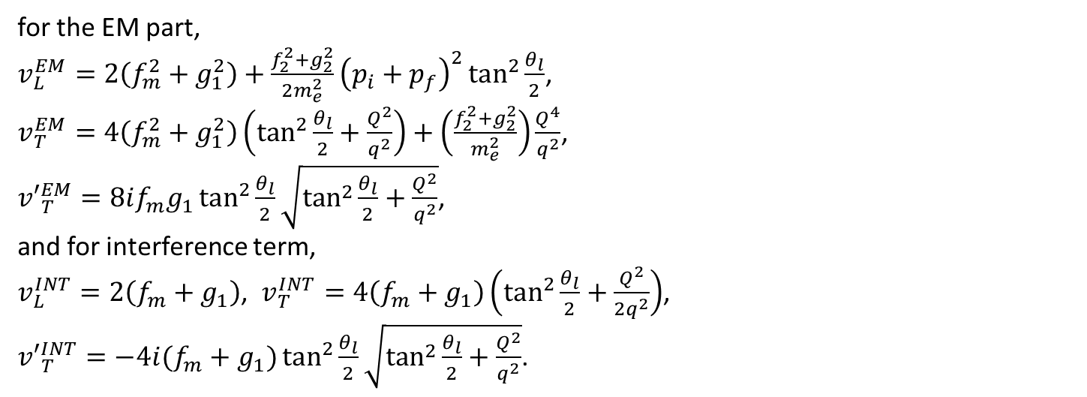
for the EM part,
$v_{L}^{EM}=2\left(f_{m}^{2}+g_{1}^{2}\right)+\frac{f_{2}^{2}+g_{2}^{2}}{{2m}_{e}^{2}}{\left(p_{i}+p_{f}\right)}^{2}\tan^{2}{\frac{θ_{l}}{2}}$,
$v_{T}^{EM}=4\left(f_{m}^{2}+g_{1}^{2}\right)\left(\tan^{2}{\frac{θ_{l}}{2}+\frac{Q^{2}}{q^{2}}}\right)+\left(\frac{f_{2}^{2}+g_{2}^{2}}{m_{e}^{2}}\right)\frac{Q^{4}}{q^{2}}$,
${v′}_{T}^{EM}=8if_{m}g_{1}\tan^{2}{\frac{θ_{l}}{2}\sqrt{\tan^{2}{\frac{θ_{l}}{2}+\frac{Q^{2}}{q^{2}}}}}$,
and for interference term,
$v_{L}^{INT}=2\left(f_{m}+g_{1}\right)$, $v_{T}^{INT}=4\left(f_{m}+g_{1}\right)\left(\tan^{2}{\frac{θ_{l}}{2}+\frac{Q^{2}}{2q^{2}}}\right)$,
${v′}_{T}^{INT}=−4i(f_{m}+g_{1})\tan^{2}{\frac{θ_{l}}{2}\sqrt{\tan^{2}{\frac{θ_{l}}{2}+\frac{Q^{2}}{q^{2}}}}}$.

Slide 23
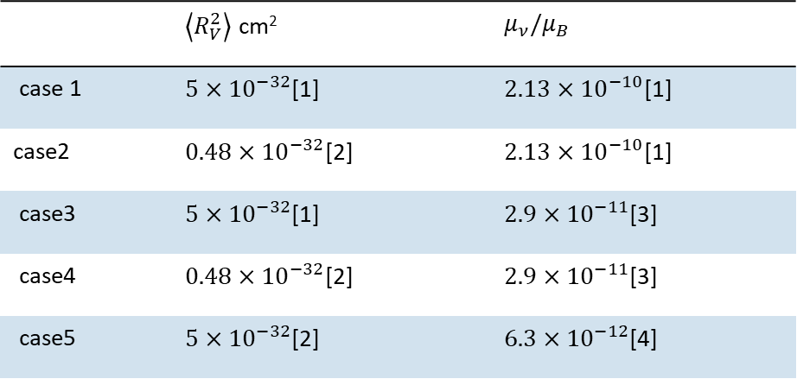
Various combinations of the charge radii and magnetic moments.
 | $\left\langle R_{V}^{2}\right\rangle$ cm² | $$μ_{ν}/μ_{B}$$
case 1 | $5×{10}^{−32}$[1] | $2.13×{10}^{−10}$[1]
case2 | $0.48×{10}^{−32}$[2] | $2.13×{10}^{−10}$[1]
case3 | $5×{10}^{−32}$[1] | $2.9×{10}^{−11}$[3]
case4 | $0.48×{10}^{−32}$[2] | $2.9×{10}^{−11}$[3]
case5 | $5×{10}^{−32}$[2] | $6.3×{10}^{−12}$[4]
Refs.
[1] M. A. Corona, M. Cadeddu, N. Cargioli, F. Dordei, C. Giunti, Y. F. Li, C.A. Ternes, and Y. Y. Zhang, JHEP 09, 164 (2022). (Dresden II )
[2] L. A. Ahrens et al., Phys Rev. D 41, 3297 (1990). (BNL-E734)
[3] A. Beda et al., Adv. High Energy Phys. 2012, 350150 (2012). (GEMMA)
[4] A. N. Khan, Phys. Lett. B 837, 137650 (2023). (XENONnT)

Slide 24
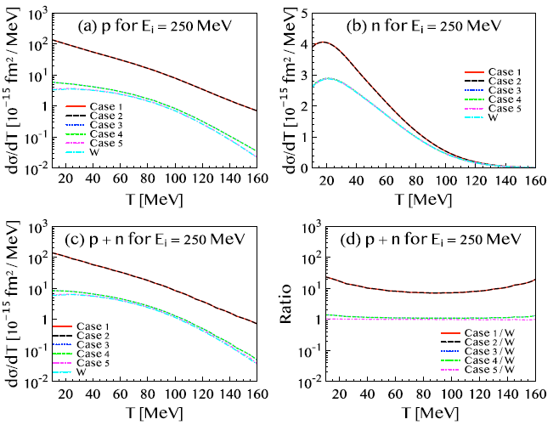
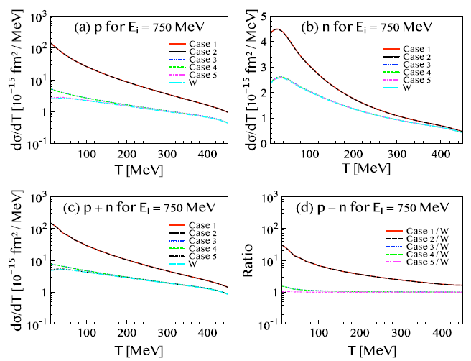
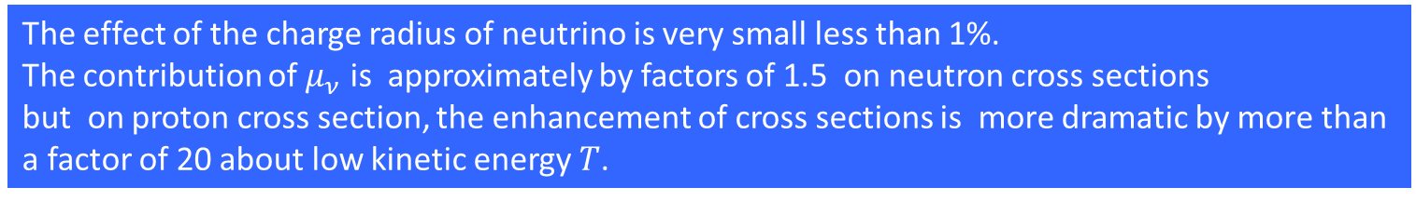
The effect of the charge radius of neutrino is very small less than 1%.
The contribution of $μ_{ν}$ is approximately by factors of 1.5 on neutron cross sections
but on proton cross section, the enhancement of cross sections is more dramatic by more than a factor of 20 about low kinetic energy $T$.

Slide 25
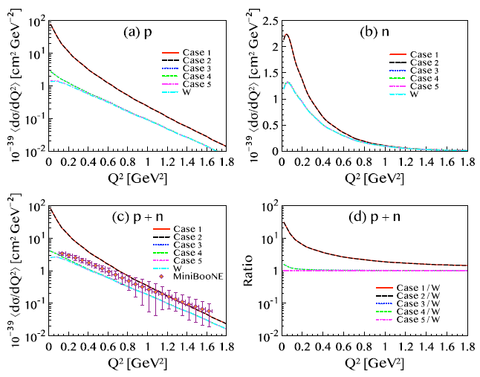
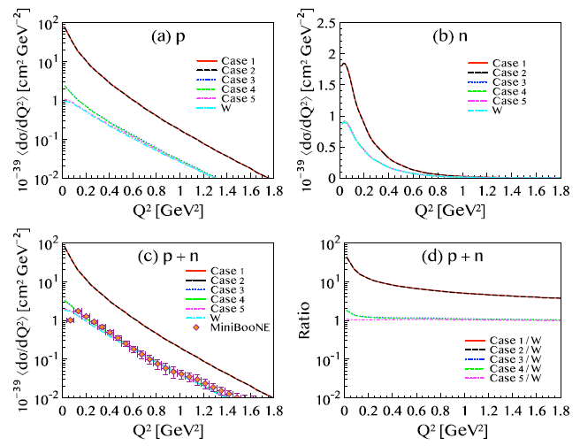

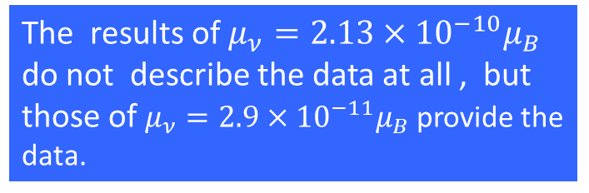
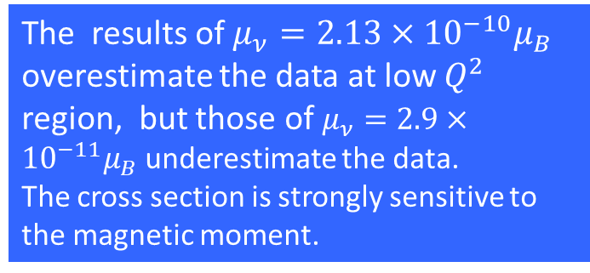

¹²C$\left(ν, ν′\right)$
The results of $μ_{ν}=2.13×{10}^{−10}μ_{B}$
overestimate the data at low $Q^{2}$ region, but those of $μ_{ν}=2.9×{10}^{−11}μ_{B}$ underestimate the data.
The cross section is strongly sensitive to the magnetic moment.
¹²C$\left(\overline{ν}, \overline{ν}′\right)$
The results of $μ_{ν}=2.13×{10}^{−10}μ_{B}$
do not describe the data at all , but those of $μ_{ν}=2.9×{10}^{−11}μ_{B}$ provide the data.

Slide 26
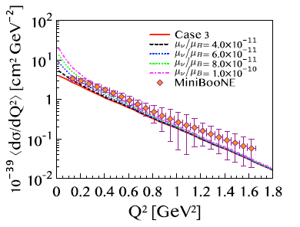
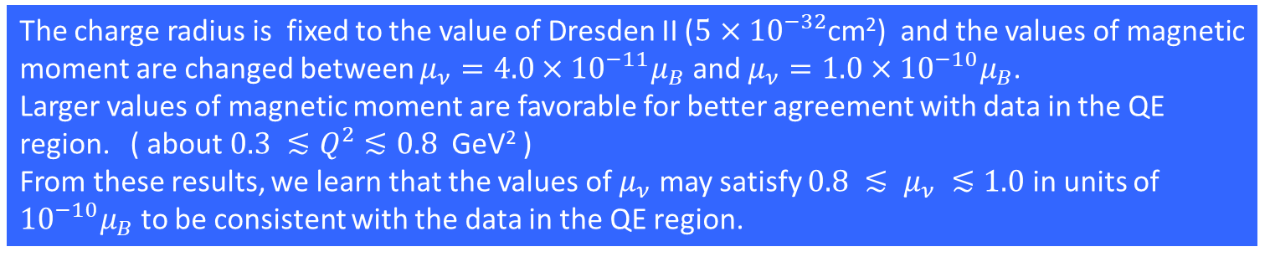
The charge radius is fixed to the value of Dresden II ($5×{10}^{−32}$cm²) and the values of magnetic moment are changed between $μ_{ν}=4.0×{10}^{−11}μ_{B}$ and $μ_{ν}=1.0×{10}^{−10}μ_{B}$.
Larger values of magnetic moment are favorable for better agreement with data in the QE region. ( about $0.3 ≲Q^{2}$ $≲0.8$ GeV² )
From these results, we learn that the values of $μ_{ν}$ may satisfy $0.8 ≲ μ_{ν} ≲1.0$ in units of ${10}^{−10}μ_{B}$ to be consistent with the data in the QE region.

Slide 27
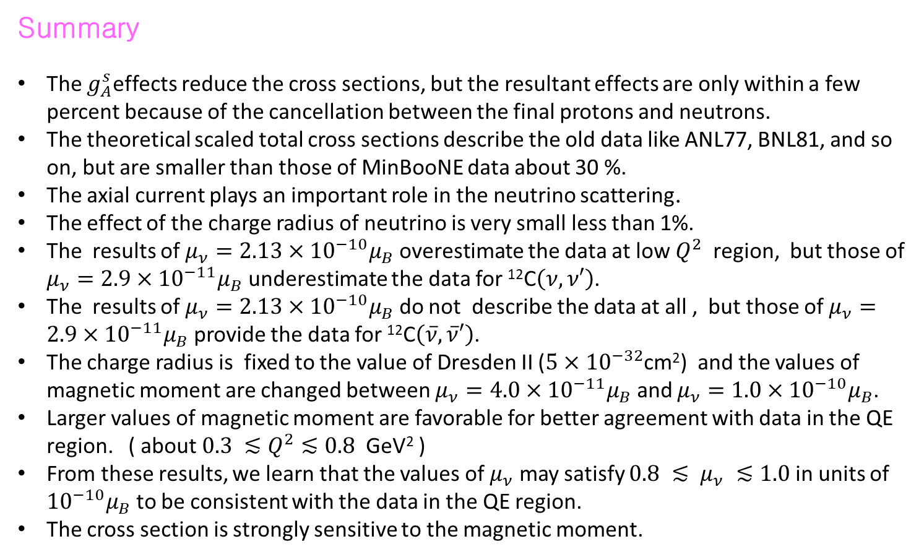
Summary
The $g_{A}^{s}$effects reduce the cross sections, but the resultant effects are only within a few percent because of the cancellation between the final protons and neutrons.
The theoretical scaled total cross sections describe the old data like ANL77, BNL81, and so on, but are smaller than those of MinBooNE data about 30 %.
The axial current plays an important role in the neutrino scattering.
The effect of the charge radius of neutrino is very small less than 1%.
The results of $μ_{ν}=2.13×{10}^{−10}μ_{B}$ overestimate the data at low $Q^{2}$ region, but those of $μ_{ν}=2.9×{10}^{−11}μ_{B}$ underestimate the data for ¹²C$\left(ν, ν′\right)$.
The results of $μ_{ν}=2.13×{10}^{−10}μ_{B}$ do not describe the data at all , but those of $μ_{ν}=2.9×{10}^{−11}μ_{B}$ provide the data for ¹²C$\left(\overline{ν}, \overline{ν}′\right)$.
The charge radius is fixed to the value of Dresden II ($5×{10}^{−32}$cm²) and the values of magnetic moment are changed between $μ_{ν}=4.0×{10}^{−11}μ_{B}$ and $μ_{ν}=1.0×{10}^{−10}μ_{B}$.
Larger values of magnetic moment are favorable for better agreement with data in the QE region. ( about $0.3 ≲Q^{2}$ $≲0.8$ GeV² )
From these results, we learn that the values of $μ_{ν}$ may satisfy $0.8 ≲ μ_{ν} ≲1.0$ in units of ${10}^{−10}μ_{B}$ to be consistent with the data in the QE region.
The cross section is strongly sensitive to the magnetic moment.

Slide 28
Thank you for your attention

Slide 29
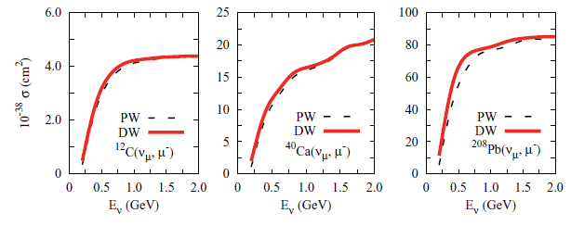
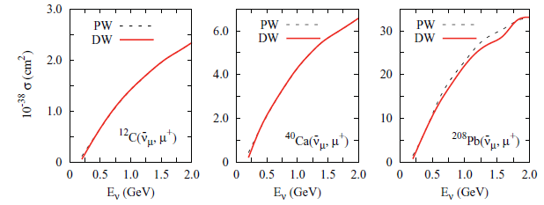
Coulomb effect for total cross section
A (ν_{μ}, μ⁻)
A (ν_{μ}, μ⁺)

Slide 30
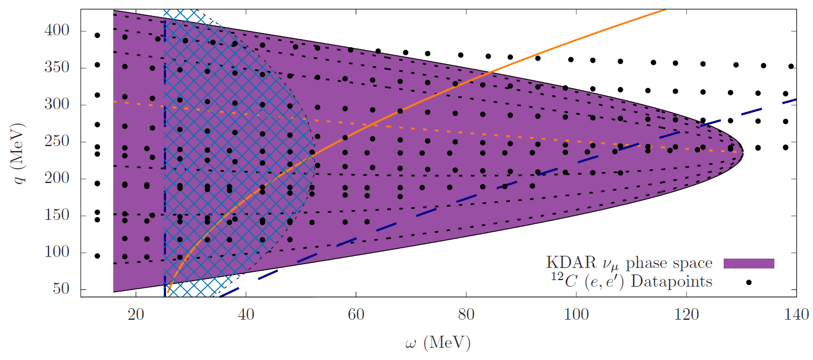
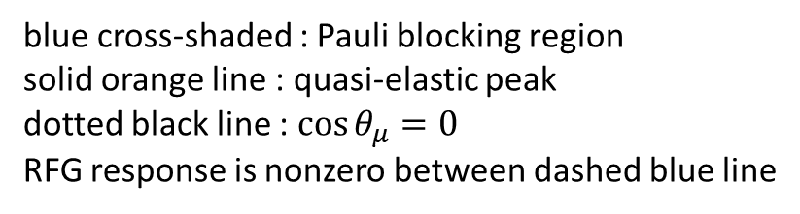
KDAR data
→ relativistic Fermi gas model (RFG)
blue cross-shaded : Pauli blocking region
solid orange line : quasi-elastic peak
dotted black line : $\cos{θ_{μ}=0}$
RFG response is nonzero between dashed blue line

